Slide 1
THE FUTURE OF RESEARCH INSTRUCTOR’S GUIDE TO RESEARCH CURRICULUM
MASSAGE THERAPY FOUNDATION – EDUCATION COMMITTEE
Robin B. Anderson, MEd, BA, LMT, BCTMB, CEAS

Slide 2
Where are we now?

Slide 3
Evaluation of MT Research
Established findings –
effects, mechanisms, processes already known
Needed research –
ones that are not known
Methodological strengths–
good scientific processes to demonstrate results
Methodological weaknesses and limitations –
which ones were not so good
Conclusions –
what have we done over the last 20 years and where do we go to move forward

Slide 4
Quantity of Research
Significant increases in performed studies from approximately 1998 to 2008
Mostly in the subcategories of Medicine, Pharmacology, and Veterinary Science (MPV) and Social Sciences, Arts, and Humanities (SAH)
Close to 6000 studies have been completed
Still in infancy in relation to other healthcare fields

Slide 5
What do we know now?
Effect on mood
Reduction of MS pain including LBP
Anxiety reduction
Arthritis
Amelioration of the effects of cancer treatment
Stress reduction
Increase oxytocin

Slide 6
Recommendations for Scope of Research
Build a research infrastructure within the massage therapy profession
Fund research into the safety and efficacy of massage therapy
Fund studies which demonstrate physiological effects are attributed to massage therapy
Stem from a wellness paradigm
Study the profession itself and what makes a skilled massage therapist that contributes to a positive therapeutic encounter

Slide 7
What do we need to know?
Multidimensional studies showing different outcomes
Formal definition of MT itself
Effects on brain activity
Formal definition of the MT profession
Body awareness as a measurable outcome
Enhanced proprioception
Improved body image
Reduction of dissociation
“Dosages” for treatment planning and the nature of the therapeutic encounter
MT Effect on medication uptake
The therapists themselves
Physiological and psychological elements in a treatment session
Required training
Working conditions for optimal treatment
Career satisfaction
Education and training

Slide 8
What is holding us back?
Lack of universal standards in the profession itself
Therapeutic setting
Education
Regulation of scope of practice
Comparison or control to MT in research
To another form of treatment
To no treatment at all
PLACEBO
DOUBLE BLINDING
Restriction in range of outcomes
Reduction overemphasized in terms of ecological validity
How it is done in real life vs. a research setting
Lack of research literacy among massage therapists
Methods drive the research questions
Other way around makes for better research
Confusion within and between groups being studied

Slide 9
Dryden & Moyer, pp. 224 - 227
Where do you see the future of massage therapy research going?
Case Example in the Book

Slide 10
Future Directions
Bridge the disconnect between researchers and MT clinicians
Improve upon protocol descriptions with clearly defined terminology and some specificity
Acquiring needed funding by writing clear and well organized grant applications
MT in integrative health care – in the midst of an identity crisis
Cost-effectiveness of MT treatment
Longitudinal MT studies
Assessing the therapeutic encounter/treatment session, creating some standards
Documentation
Expectations of the patient
Typical testing or requirements of the therapist
We are not alone! But we are in our infancy in terms of existence

Slide 11
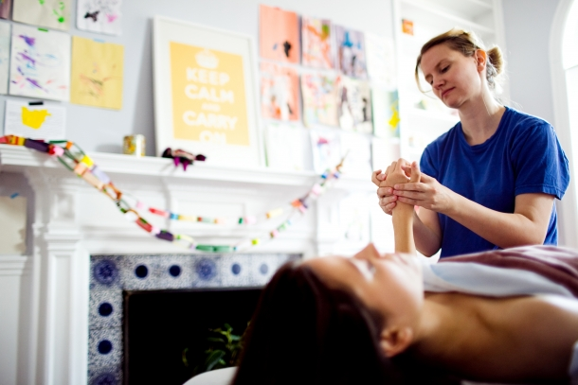
What can YOU do?
Use Evidence-Informed Practice model until Evidence-Based Practice evolves
KEEP READING and stay current
Advocate for your profession
Expand your knowledge
Interact with others – both peers and individuals from other health care professions

