Slide 1





Slide 2
Bringing MASSAGE TO MAINSTREAM MEDICINE
Nancy Ann Cotter MD
Clinical Assistant Professor
Dept PMR, Rutgers NJ Medical School
Clinical Director, Whole Health
VANJ Medical Center

Slide 3
Bringing Massage to Mainstream Medicine
What are the needs of organizations, institutions, and individuals as pertains to massage therapists?
Organization: Why, safety, economics
Institution: Why, for who, how much, safety, economics, risk
Individual: Who do I want to work with? How do I communicate my message? What are the logistics of getting scheduled and getting paid?

Slide 4
LMT
Facility
Organization

Slide 5
Massage as part of an organization
Healthcare organization: Is this part of our mission?
    Personalized care for those who prefer holistic approach
    Mission to decrease opioid medication
      Many younger patients prefer less pharmaceutical medicine
        Example: VA and CIH
      Culturally relevant for some populations
    Being a leader in an area that is important to the organizations mission ie nonpharmacologic pain management; ministering to the sick
Return on investment: what will the returns be?
    Higher satisfaction scores- patient and family
    Decreased medication usage
    Risk avoidance
Risk and risk avoidance

Slide 6
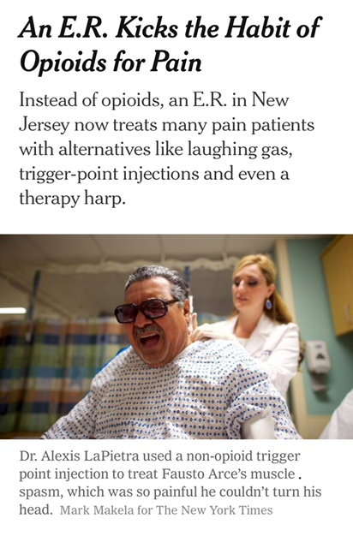
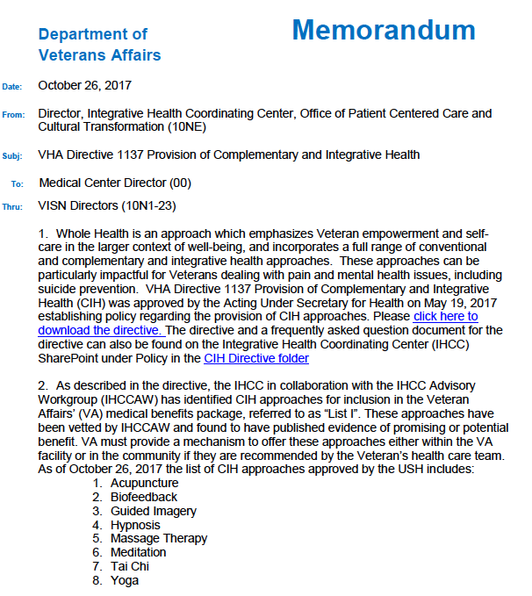

Slide 7
Massage in an institution: Patient satisfaction!
Attracts patients: edge over the competition
  Example: new parents package on Mother -Baby Unit
Patient safety: addresses pain and anxiety nonpharmacologically
    non-pharmacologic pain management for rehab in substance use disorder;
    specialty massage for patients with specific diagnoses
Comfort/ compassion: support for the most vulnerable
    Human touch in hospice, pediatrics; may be supported by donors
Calming: caring for anxious family members
    massage for family members of ICU patients
Economics: fewer medications, fewer adverse effects, leads to decreased length of stay

Slide 8
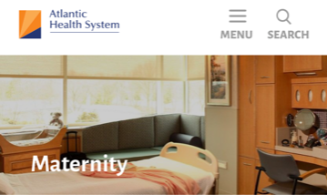
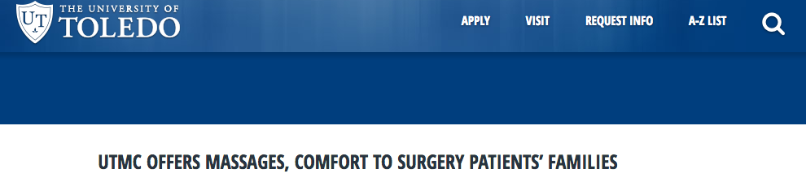
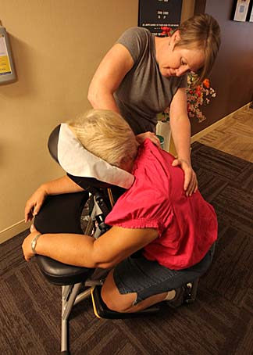
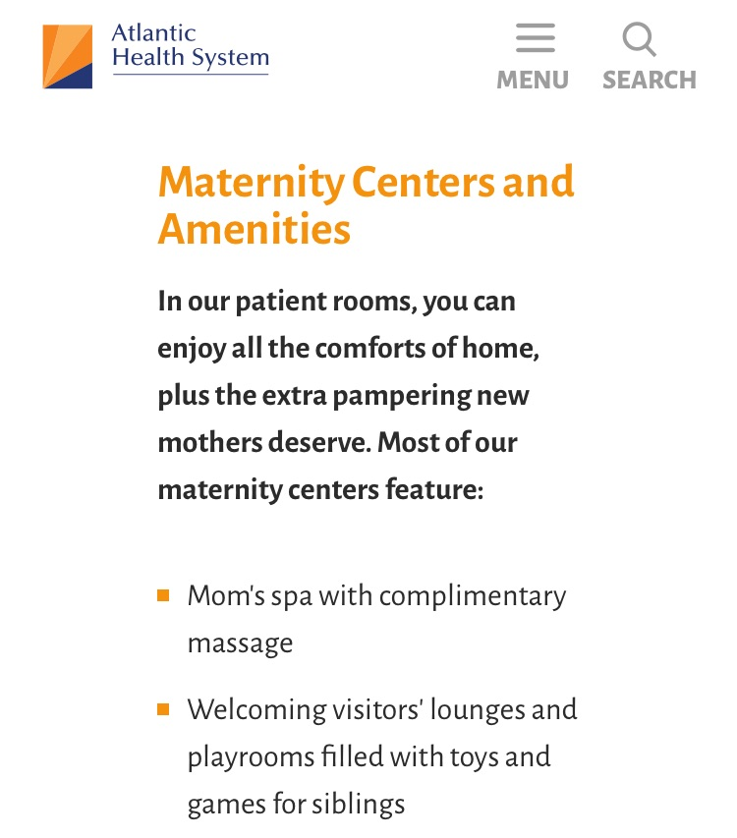

Slide 9

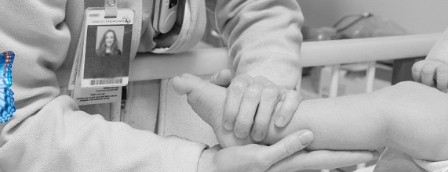

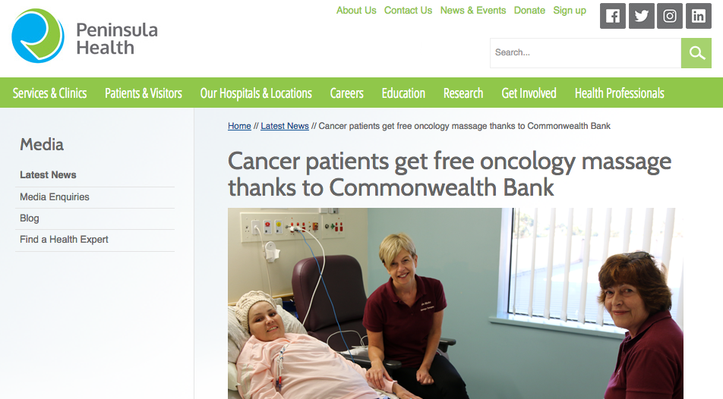
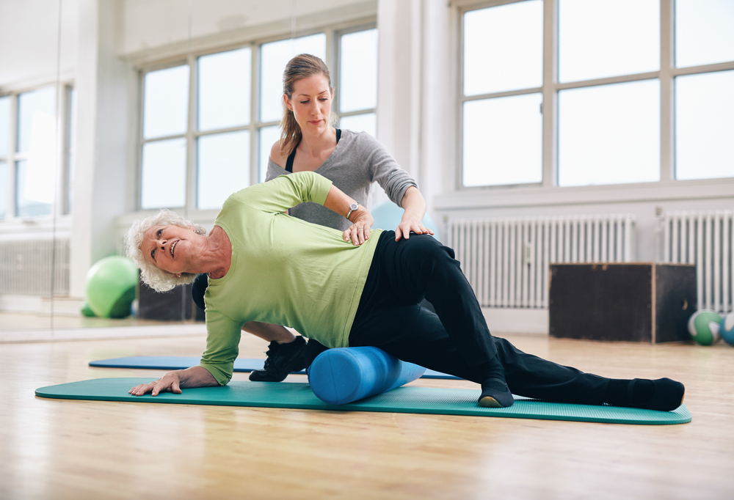

Slide 10
How does the LMT get the attention of a hospital?
Individual: Who do I want to work with?
    Specific age group: pediatrics, elderly, new mothers, teens
    Specific diagnosis group: Oncology, Cardiology, HIV etc
    If you don’t have experience , or don’t know what your “fit” is: volunteer!
How do I communicate my message?
    Special training and experience
    SOAP notes ; documenting pre – and – post
      Understanding the pressures of the decision makers
      Respecting the many vantage points of decision makers ( ie need for “evidence base”
What are the logistics of getting scheduled and getting paid? 10 min

Slide 11
LMT
Facility
Organization

