Slide 2
“Some Kind of Peace” –
Integrating Massage Therapy for
Hospitalized Palliative Care Patients
Hunter Groninger, MD
Georgetown University Medical Center
MedStar Washington Hospital Center
Washington, DC

Slide 3
No Potential Conflict of Interest to Declare
The presenter is free of any affiliation (financial or otherwise) with a commercial entity.

Slide 4
Learning Objectives
At the conclusion of this presentation, participants will be able to:
1. Appreciate clinical integration model for MT to drive research
2. Define “total pain” and reflect on related MT research challenges
3. Review one institutional research pathway
4

Slide 5
Clinical and Research Partnership
912-bed academic health center in Washington, DC
Tertiary care, regional referral
Safety net
About 70% African-American
Busiest Palliative Care program in region
Highly-trained MTs
Clinical partnerships at 7 facilities in DC Metro
Experienced in research development/participation
>5,000 pt contacts annually

Slide 6
Our dedicated PC research team

Slide 7
Palliative Care
Holistic supportive care for patients with advanced illness and their families
“Transdisciplinary” model

Slide 8
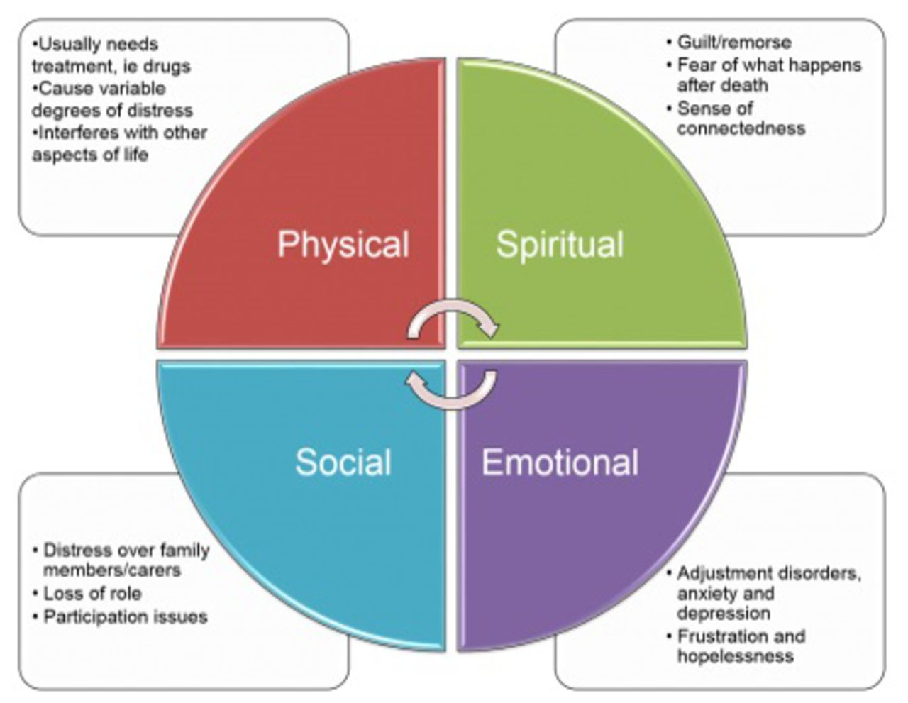
“Total Pain”

Slide 9
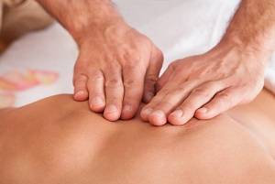
Integrating into Palliative Care
MD
Nursing
Patient
Social
Work
PharmD
Spiritual
Care
Clinical team member (bidirectional)
EHR Documentation
Clinical knowledge of advanced illness

Slide 10
Integrating into Palliative Care
MD
Nursing
Patient
Social
Work
PharmD
Spiritual
Care
Clinical team member (bidirectional)
EHR Documentation
Clinical knowledge of advanced illness
“conversation with your nervous system”

Slide 11
Project 1: Pain management in pts w/opioids
Massage therapy (MT) group: 44 patients
Quiet time (QT) group: 42 patients
No differences between groups in age, sex, race, LOS, severity of illness
High satisfaction with both study arms
Percent pain relief reported (71% MT; 69% in QT, p=0.83)
Preference for intervention (89% MT; 88% QT, p=0.93)
Significant improvement in pain at 24hr in MT group (5.3 vs 3.7, p=0.03)
Funded by The Latham Foundation
Notes:
30% reduction in pain score- clinically significant as well

Slide 12
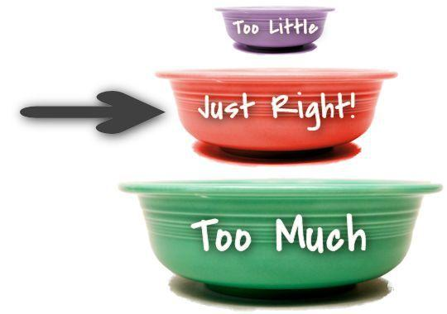
Hospital massage: how much is enough?
Successive massages better
Sturgeon 2009; Sherman 2014.
Length of massage may impact
Sherman 2014; Perlman AI 2012.
Quality/style of intervention?
Notes:
Sturgeon: breast cancer outpateints receiving weekly for 3 weeks
Sherman: chronic neck pain receiving 30 or 60 min for 1-3 times/week for 4 weeks; 60min better than 30min; more frequent better than once weekly
Perlman: OA of knee found 60min doses in outpt setting for 8 weeks better for pain than for longer period of time or 30min sessions

Slide 13
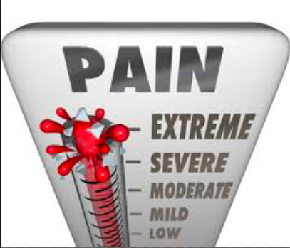
Measuring what matters
Self-reported pain scale

Slide 14
Measuring what matters
Self-reported pain scale
Pain bothersomeness
Well-being
Peacefulness

Slide 15
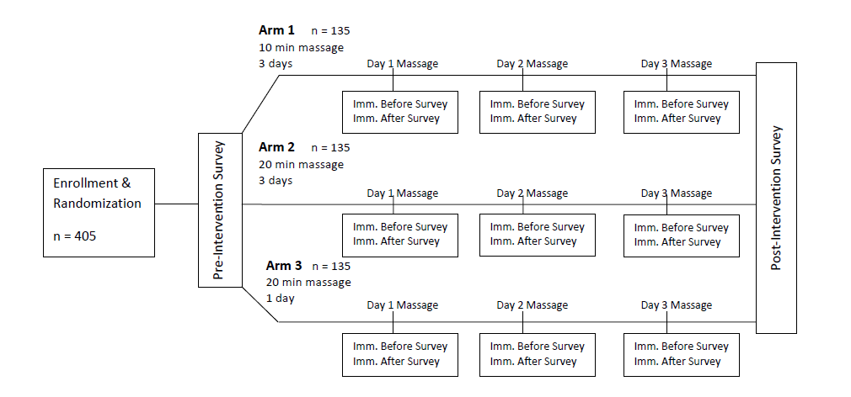
Project 2: Dosing Study
Exclusion criteria:
Incapacitated
Expected LOS < 3d
Unstable spine; fever; airborne
McGill QOL
Distress therm
Peace question
McGill QOL
Distress therm
Peace question
SRPS
Distress
Peace

Slide 16
Dosing trial: early snapshot (n=215)
Sex
Female: 53%
Male: 47%
Race
African American: 76%
White: 18%
Asian: 3%
Other: 2%
Primary Diagnosis
Heart Disease: 48%
Cancer: 31%
Infection: 7%
Sickle Cell: 6%
Other: 6%
Length of Stay (Days)
Median: 21
Range: 2-147
SD: 22.68

Slide 17
Qualitative data examples:
“I believe that there is some value to touch that is very therapeutic, especially during these times when you’re being poked and prodded….having all these subcutaneous injections along with glucometer readings; it gives some kind of peace.”
“I can tell a difference between the days I had a massage and the days I didn’t.”
“Tell you the truth, it felt so good, I almost fell asleep. Honestly, and then after she left, I felt like I was more alert, and like I said, like I told you before it was very refreshing.”
“For that time that I got the massage, I felt great because I wasn’t in any pain.”
“She just said “whatever position is comfortable for you, I can work with that.” And that’s what she did and that was very impressive and helpful because when you already in a lot of pain you don’t want to do too much moving. So, that’s what I really liked.

Slide 18
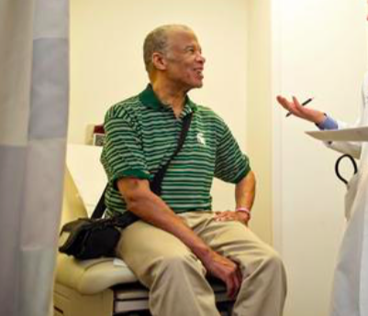
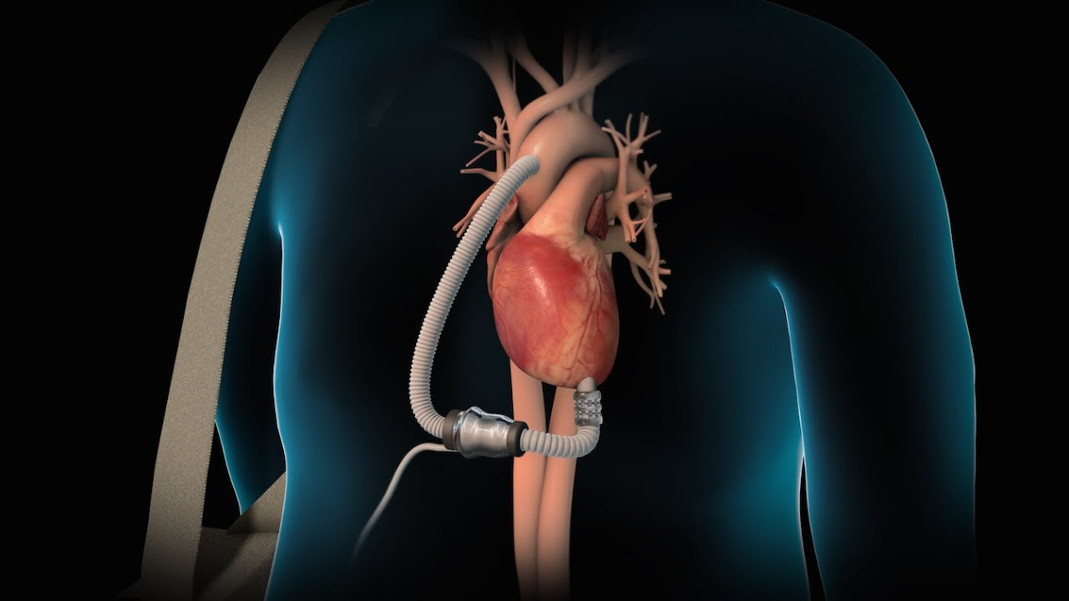
Massage post-LVAD

Slide 19
Massage post-LVAD
74 subjects:
Usual post-LVAD care + regular massage (8 weeks)
Usual post-LVAD care
Primary outcome:
6-item Self-Efficacy in Chronic Illness Scale
Secondary outcomes:
Brief COPE
McGill QOL
Satisfaction

Slide 20
Lessons learned to date:
Integrating MT improves research process
Advanced illness population, hospitals unique
Need better instruments for measuring MT impact
Leverage current events

Slide 21
Many Thanks….
Anne Kelemen, LICSW, Investigator
Lauren Cates, CMT, Investigator, Director of Healwell
Gianna Shipp, Palliative Care Research Coordinator
Stephanie Blease, Analyst, MedStar Health Research Institute
Kathryn Walker, PharmD, BCPS, CPE
Mihriye Mete, Statistician, MedStar Health Research Institute
Lucille Eddy, LMT, Service Director of Healwell
Kerry Jordan, LMT, Operations Director of Healwell

Slide 22
References
O'Gara T, Kemper KJ, Birkedal J, Curl W, Miller N, Abadie B. Survey of Conventional and Complementary and Alternative Therapy in Patients With Low Back Pain. J Surg Orthop Adv. 2016 Spring;25(1):27-33.
Barnes PM, Bloom B, Nahin RL. Complementary and alternative medicine use among adults and children: United States, 2007. Natl Health Stat Report. 2008 Dec 10;(12):1-23.
Crawford C, Boyd C, Paat CF, Price A, Xenakis L, Yang E, Zhang W; Evidence for Massage Therapy (EMT) Working Group. The Impact of Massage Therapy on Function in Pain Populations-A Systematic Review and Meta-Analysis of Randomized Controlled Trials: Part I, Patients Experiencing Pain in the General Population. Pain Med. 2016 May 10. pii: pnw099. [Epub ahead of print]
Fletcher CE, Mitchinson AR, Trumble EL, Hinshaw DB, Dusek JA. Perceptions of other integrative health therapies by Veterans with pain who are receiving massage. J Rehabil Res Dev. 2016;53(1):117-26. doi: 10.1682/JRRD.2015.01.0015.
Boyd C, Crawford C, Paat CF, Price A, Xenakis L, Zhang W; Evidence for Massage Therapy (EMT) Working Group. The Impact of Massage Therapy on Function in Pain Populations-A Systematic Review and Meta-Analysis of Randomized Controlled Trials: Part III, Surgical Pain Populations. Pain Med. 2016 Sep;17(9):1757-72. doi: 10.1093/pm/pnw101.
Crawford C, Boyd C, Paat CF, Price A, Xenakis L, Yang E, Zhang W; Evidence for Massage Therapy (EMT) Working Group. The Impact of Massage Therapy on Function in Pain Populations-A Systematic Review and Meta-Analysis of Randomized Controlled Trials: Part I, Patients Experiencing Pain in the General Population. Pain Med. 2016 May 10. pii: pnw099.

Slide 23
References
Wang AT, Sundt TM 3rd, Cutshall SM, Bauer BA. Massage therapy after cardiac surgery. Semin Thorac Cardiovasc Surg. 2010 Autumn;22(3):225-9. doi: 10.1053/j.semtcvs.2010.10.005.
Bauer BA, Cutshall SM, Wentworth LJ, Engen D, Messner PK, Wood CM, Brekke KM, Kelly RF, Sundt TM 3rd. Effect of massage therapy on pain, anxiety, and tension after cardiac surgery: a randomized study. Complement Ther Clin Pract. 2010 May;16(2):70-5. doi: 10.1016/j.ctcp.2009.06.012. Epub 2009 Jul 14.
Berger L Tavares M, Berger B. A Canadian experience of integrating complementary therapy in a hospital palliative care unit. J Palliat Med. 2013 Oct;16(10):1294-8. doi: 10.1089/jpm.2013.0295.
Sherman KJ, Cook AJ, Wellman RD, Hawkes RJ, Kahn JR, Deyo RA, Cherkin DC. Five-week outcomes from a dosing trial of therapeutic massage for chronic neck pain. Ann Fam Med. 2014 Mar-Apr;12(2):112-20. doi: 10.1370/afm.1602.
Perlman AI, Ali A, Njike VY, Hom D, Davidi A, Gould-Fogerite S, Milak C, Katz DL. Massage therapy for osteoarthritis of the knee: a randomized dose-finding trial. PLoS One. 2012;7(2):e30248. doi: 10.1371/journal.pone.0030248. Epub 2012 Feb 8.
Chase T, Jha A, Brooks CA, Allshouse A. A pilot feasibility study of massage to reduce pain in people with spinal cord injury during acute rehabilitation. Spinal Cord. 2013 Nov;51(11):847-51. doi: 10.1038/sc.2013.104. Epub 2013 Sep 17.
Mitchell AJ, Morgan JP, Petersen D, Fabbri S, Fayard C, Stoletniy L, Chiong J. Validation of simple visual-analogue thermometer screen for mood complications of cardiovascular disease: the Emotion Thermometers. J Affect Disord. 2012 Feb;136(3):1257-63. doi: 10.1016/j.jad.2011.06.008. Epub 2011 Jul 1.

