Slide 1
Moving beyond opioid therapy:
The role of the NIH-DoD-VA Pain Management Collaboratory
Robert D. Kerns, Ph.D.
Yale University

Slide 2
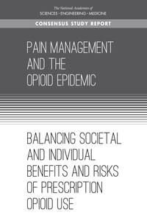
Public health perspective
Notes:
I want to begin with referencing three particularly important pain policy and research initiatives in which I was privileged to participate. One key provision of the Affordable Care Act was the requirement of a report from the Institute of Medicine (now the National Academies of Medicine) regarding the state of pain care, education and research in the US. I was privileged and honored to be selected to serve as one of 19 members of the committee. Among our findings was an agreement that pain is best understood as a subjective experience and that a biopsychosocial perspective the most applicable conceptual framework for understanding that experience. Consistent with the subjective nature of pain, the committee asserted that pain is what the person says it is, and that respect for patient self-reports is the foundation for optimal pain care. A report commissioned by the committee provided strong evidence to support labeling pain and chronic pain as public health problems. The report found that chronic pain affects about 1/3 of all adults, that pain conditions are among the most disabling of all medical problems, and that pain costs the US about $1/2 trillion each year in direct healthcare costs and indirect costs associated with lost productivity. Unfortunately, pain is often poorly treated, and there is strong evidence of disparities in pain care. At the same time, it is important to acknowledge the additional public health challenge that interfaces with these pain-specific efforts, namely the opioid epidemic and the specific interface in the context of opioid related harms in the context of therapeutic use. For the purposes of this talk I will focus entirely on the public health crisis of undertreated pain and the IOM’s call for a national transformation in pain prevention, care, education and research related to pain. All of these efforts originated from the Affordable Care Act. First came the establishment of an IOM sponsored committee that laid out case for labeling pain as a public health problem and that made specific recommendations across the domains of pain prevention, care, education and research. Following on the recommendation of the IOM committee, the HHS, and particularly the Interagency Pain Research Coordinating Committee that was chartered following the requirements of the ACA, developed a comprehensive National Pain Strategy that made more specific short and long term recommendations to address the findings of the previously published IOM report. (next slide)

Slide 3
Harms related to therapeutic use of opioids is a significant contributor to the opioid crisis

Slide 5
Pain as a public health problem
In 2016, an estimated 20.4% (50.0 million) of U.S. adults had chronic pain (CP) and 8.0% (19.6 million) had high impact chronic pain (HICP). (Dahlhamer et al., 2018)
Higher prevalence of both CP and HICP were observed among:
women,
older adults,
previously but not currently employed adults,
adults living in poverty,
adults with public health insurance, and
rural residents (Dahlhamer et al. 2018)
Pain conditions are among the most disabling health problems (Stewart et al., 2003)
Costs of pain are estimated at $500-$635 billion (IOM, 2011)
Disparities in pain prevalence and care are well documented (Green et al., 2003; Janevic et al., 2017)

Slide 6
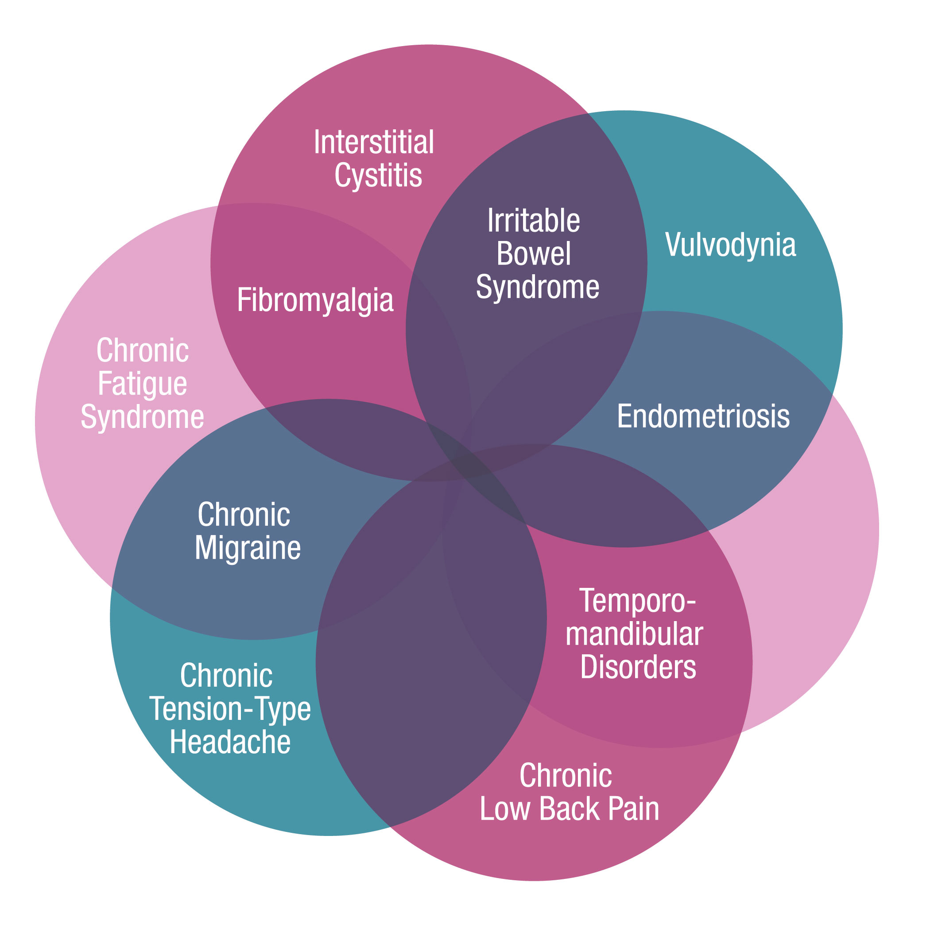
Complexities of chronic pain represent management challenges
Chronic Overlapping Pain Conditions (Chronic Pain Research Alliance)
Prevalence of Chronic Pain, PTSD and TBI in a
sample of 340 veterans who served in era of
Afghanistan and Iraq wars
Chronic Pain
N=277
81.5%
PTSD N=232
68.2%
16.5%
2.9%
10.3%
42.1%
12.6%
6.8%
TBI
N=227
66.8%
5.3%
Lew, H.L. et al. (2009). Prevalence of chronic pain, posttraumatic stress disorder, and post-concussive syndrome in OEF/OIF veterans: The polytrauma clinical triad. Journal of Rehabilitation Research and Development, 46, 697-702.

Slide 7
Findings and recommendations
Pain is a biopsychosocial condition that often requires integrated, patient-centered, evidence-based, multimodal, and interdisciplinary care.
Efforts should span the continuum from pain prevention, through efforts to mitigate the progression of acute pain to a chronic condition and the development of high-impact chronic pain, to pain at the end-of-life.
Efforts should address all ages of the life-span.
Notes:
I’m certain that everyone is familiar with the seminal report of the Institute of Medicine Committee for Advancing Pain Research, Care and Education on which I was privileged to serve. Among its many findings and recommendations is a clear and consistent encouragement of acceptance of a single standard for pain care, that is one that promotes integrated, patient-centered, evidence-based, multimodal and interdisciplinary care. Although this descriptive phrase is most often used in the context of conceptualizing a standard of care for persons with complex chronic pain, I believe that the intent of the IOM Committee was to assert the relevance of this model for the continuum from pain prevention, through acute pain to pain management at the end of life and across all age groups. (next slide)

Slide 8
The National
Pain Strategy
Professional Education & Training
.
Population Research
Public Education & Communication
Service Delivery & Payment
Disparities
The Office of the Assistant Secretary for Health at the U.S. Department of Health and Human Services. (2016). National Pain Strategy. Washington, DC.
Care & Prevention
Notes:
I am sure that all of you are also well aware of the Department of Health and Human Services National Pain Strategy published in March 2016. As one of the co-chairs of the Service Delivery and Payment chapter of this document, I want to highlight the recommendations from this group as particularly relevant to today’s discussion. At the same time, it is important to acknowledge that each of the other chapters and recommendations are also relevant. (next slide)

Slide 9
Framework
Service
Delivery & Payment
Public health entities have a role in pain care and prevention
Many challenges exist for access to quality pain
care, which is often:
not based on best evidence.
not team based.
limited to pharmacological treatment offered by one primary care practitioner or to procedure-oriented and incentivized specialty care.
More quality research is needed on the effectiveness of pain interventions, integrated care, models of care delivery, and reimbursement innovations.
We need more effective methods to disseminate research findings and incentives to incorporate them into clinical practice.
Current reimbursement practices complicate development of a population-based approach, which would use integrated, interdisciplinary, patient-centered teams.
Notes:
This slide specifically reminds us of some of the known challenges and opportunities relevant to today’s discussion. In brief, although the National Pain Strategy highlights gaps in scientific knowledge, it emphasized the gap between existing evidence that could be used to inform the delivery of integrated and multimodal pain care and current standards of practice that unfortunately incentivize care that is unimodal, volume based and fragmented. (next slide)

Slide 10
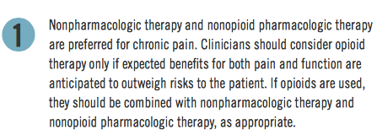
Center for Disease Control Guidelines – March, 2017

Slide 11
American College of Physicians Guidelines – Feb, 2017
1) Acute/sub-acute: non-pharmacological (e.g., heat, massage, acupuncture, spinal manipulation)
2) Chronic: non-pharmacological (e.g., exercise, multidisciplinary rehab, mindfulness-based stress reduction, cognitive-behavioral therapy)
3) Chronic: if no response to above, NSAIDs (first line), anti-depressants, low-level opioids (2nd line), opioids (last resort)

Slide 12
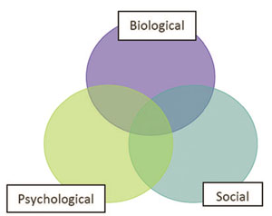
Non-pharmacological approaches ready for implementation
Manual therapies
Acupuncture
Massage
Manipulation
Cognitive Behavioral Therapy
Yoga
Aerobic exercise
Acceptance & Commitment Therapy
Mindfulness Based Stress Reduction
Tai chi
Coordination/ stabilization exercise
Behavioral/
Psychological therapies
Exercise/
movement therapies
Resistance exercise
Notes:
SOTA consensus was that multiple nonpharmacological approaches had adequate RCT evidence of efficacy. Some conventional, some CIH, none an answer for all pts.

Slide 13
Massage Therapy: Evidence for chronic pain management
Back pain
Neck and shoulder pain
Headache
Carpal Tunnel Syndrome
Osteoarthritis
Fibromyalgia
Hospice
Nahin RL, Boineau R, Khalsa PS, Stussman BJ, Weber WJ. Evidence-Based Evaluation of Complementary Health Approaches for Pain Management in the United States. Mayo Clin Proc. 2016 Sep;91(9):1292-306.
47% of persons who pursue massage therapy do so for medical reasons, especially for pain management
Massage therapy is recommended by the Joint Commission, American College of Physicians and the Federation of State Medical Boards
https://www.amtamassage.org/opioids?utm_source=%2finfocenter%2fhealthcare_articles-and-associations%2fMassage-Therapy-as-an-Alternative-to-Opioids.html&utm_medium=web&utm_campaign=redirect

Slide 14
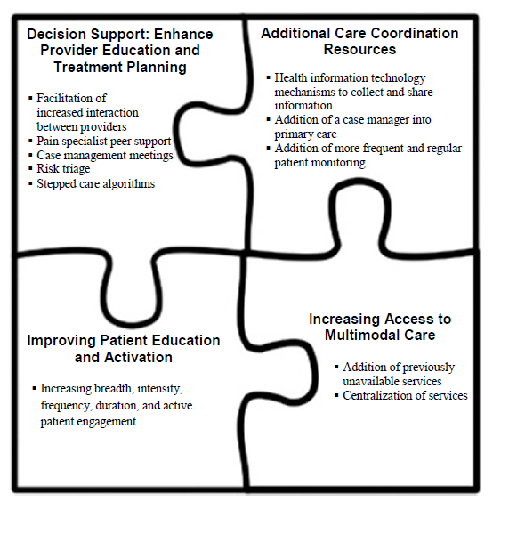
Models for pain care delivery
11 articles (10 studies) included
Most were RCTS of fair-good quality (3 poor)
Most had 12 month follow-up (range 6-18)
Most used usual care control
Baseline mean pain 5.1-7.7 on 10-point scale
9 diverse models of care delivery
Peterson K, et al. (2017). Evidence Brief: Effectiveness of Models Used to Deliver Multimodal Care for Chronic Musculoskeletal Pain. VA ESP Project #09-199.
Notes:
Read left column. Across all studies, four key components of the interventions were identified. Read from puzzle figure. (next slide)

Slide 15
Federal Pain Research Strategy https://iprcc.nih.gov/FPRS/FPRS.htm
Cross cutting priority: EFFECTIVE MODELS OF CARE DELIVERY FOR PAIN MANAGEMENT
Statement of the Problem: Despite the significant burden of pain, effective programs, services, and interventions are not always accessible, available, or utilized.
Recommendation: Develop, Evaluate, Improve Models of Pain Care.
Research is needed to develop new or improve current models of primary, secondary, tertiary care to improve pain management along the continuum of the pain experience.
Research should include studies on models of integrated care, team care delivery, and reimbursement innovations.
Notes:
Finally, following on the heels of the publication of the NPS, the IPRCC sponsored the development of a long-term strategic plan… Among the recommendations were two that I think are particularly relevant to the focus of today’s symposium.

Slide 16
Gap between evidence and practice
Growing evidence to support integrated, coordinated, multimodal and interdisciplinary models of pain care that support patient activation and pain self-management
Significant organizational/systems, provider and patient-level barriers to timely and equitable access to these approaches
Veteran and military health systems are ideally positioned to address this gap
Notes:
The bottom line is that there is growing evidence to support the delivery of integrated care, but numerous organizational, provider and patient level barriers undermine timely and equitable access to these approaches. These challenges are no doubt greatest in the private, fee for service environment, and the National Pain Strategy section on Service Delivery and Reimbursement emphasized recommendations for percolating innovation in addressing these barriers, particularly reimbursement challenges and financial incentives. In the meantime, integrated learning healthcare systems such as the VA may serve as a proving ground for studying these models of care.

Slide 17
Pain as a public health problem: Military Service Members and Veterans
Approximately 45% of active duty military service members report pain (Toblin et al, 2014)
50-75% of US military Veterans experience persistent pain (Kerns et al., 2003; Haskell et al., 2006; Nahin, 2017)
Veterans with pain, compared to non-Veterans with pain, report more severe pain (Nahin, 2017)
The proportion of Veterans in care in VHA with painful musculoskeletal conditions is steadily increasing over time (Goulet et al., 2016)
Pain is among the most costly disorders treated in VHA settings (Yu et al., 2003)
Notes:
So, with these important policy initiatives in mind, I’d like to offer some data to support the foundational assertions of the IOM Committee report that pain is a public health problem. The IOM committee commissioned an important report that documented that chronic pain is a highly prevalent, often disabling, and costly problem and that disparities in pain and pain care are also well established.

Slide 18
Pain Management is a high priority for the Departments of Health and Human Services (HHS), Defense (DoD) and Veterans Affairs (VA)
VA launched its National Pain Management Strategy in 1998
Army Surgeon General’s Pain Management Task Force Report published in 2010
National Center for Complementary and Integrative Health (NCCIH) Council Working Group Report on “Strengthening collaborations with the DoD and VA” published in 2015

Slide 19
NIH-DoD-VA Pain Management Collaboratory
$81 Million investment over six years
Sponsors:
NIH: National Center for Complementary and Integrative Health, National Institute for Neurological Disorders and Stroke, National Institute of Drug Abuse, National Institute of Alcohol Abuse and Alcoholism, National Institute of Child Health and Human Development, National Institute of Nursing Research, Office of Behavioral and Social Sciences Research, Office of Research on Women’s Health
DoD: Clinical Rehabilitative Medicine Research Program, Military Operational Medicine Research Program
VA: Health Services Research & Development Service, Office of Research and Development
Key objectives:
Support investigators to do the necessary planning and pilot testing to demonstrate that they can effectively implement the proposed pragmatic trial
Conduct pragmatic clinical trials to evaluate whether non-pharmacological approaches to pain management are effective when delivered in the setting of the Veterans and/or military health care systems (VA and MHS)
Why pragmatic studies?
Emphasizes generalizability of results and protect rigor
Answer questions that inform VA and MHS about what services to make available to patients with pain throughout their systems
Results may inform other health care systems about nonpharmacological treatments for pain management

Slide 20
Pragmatic Clinical Trials
Phased cooperative agreement research applications to conduct large-scale, pragmatic clinical trials
2 year planning phase
2 to 4 year implementation phase
Transition to the implementation phase dependent upon completing milestones in the planning phase
During the implementation phase, the Pragmatic Clinical Trial teams will work with their respective funding agency, and the PMC Coordinating Center coordinate resource needs and monitor progress
Notes:
The Pragmatic Trial Demonstration Projects are phased cooperative agreement research applications. The projects a 2 year planning phase (UG3), which project are in their second year of funding, and will be looking to transition to 2-4 year implementation phase (UH3) at the end of this fiscal year or sometime in in Early to mid FY20.
All projects will be milestone-driven, and transition to the implementation phase (UH3) will be dependent upon the successful progress made during the planning phase
During the implementation phase the Demonstration Project teams, in cooperation with their respective funding agency rep and the PMC Coordinating Center, will determine resource needs and monitor progress towards the negotiated milestones.

Slide 21
Outcomes
Primary: pain and pain reduction, ability to function in daily life, quality of life, and medication usage/reduction/discontinuation.
Secondary: assessing comorbid conditions or those co-occurring with high frequency in this population

Slide 22
Pragmatic Clinical Trials - NIH
Julie Fritz, Dan Rhon - University of Utah
SMART Stepped Care Management for Low Back Pain in Military Health System
Steven George, Susan Hastings - Duke University
Improving Veteran Access to Integrated Management of Chronic Back Pain
Cyndy Long, Christine Goertz- Palmer College of Chiropractic
Chiropractic Care for Veterans: A Pragmatic Randomized Trial Addressing Dose Effects for cLBP
Alicia Heapy- Yale University
Cooperative Pain Education and Self-management: Expanding Treatment for Real-world Access (COPES ExTRA)
Marc Rosen, Steve Martino - Yale University
Engaging Veterans Seeking Service-Connection Payments in Pain Treatment
Karen Seal, William Becker -Northern California Institute
Implementation of a Pragmatic Trial of Whole Health Team vs. Primary Care Group Education to Promote Non-Pharmacological Strategies to Improve Pain, Functioning, and Quality of Life in Veterans
Notes:
A total of 11 demonstration projects and the coordinating center were funded in FY2016 and FY2017. Six projects and the coordinating center were funded by the NIH and are listed here.

Slide 23
Pragmatic Clinical Trials - VA, DoD
VA Funded Pragmatic Trial:
Stephanie Taylor - VA HSR&D CSHI
Complementary and Integrative Health for Pain in the VA: A National Demonstration Project
DoD Funded Pragmatic Trials :
Diana Burgess- DoD-MOMRP
Testing two scalable, Veteran-centric Mindfulness-based Interventions for Chronic Musculoskeletal Pain: A Pragmatic, Multisite Trial
Shawn Farrokhi, Christopher Dearth - DoD-CRMRP
Resolving the Burden of Low Back Pain in Military Service Member and Veterans: A Multi-site Pragmatic Clinical Trial
Brian Ilfeld - DoD-CRMRP
Ultrasound-Guided Percutaneous Peripheral Nerve Stimulation: A Non-Pharmacologic Alternative for the Treatment of Postoperative Pain
Donald McGeary, Jeffrey Goodie - DoD-CRMRP
Targeting Chronic Pain in primary Care Settings Using Internal Behavioral Health Consultants
Notes:
The VA funded one project and the DoD funded four.

Slide 24
Chiropractic Care for Veterans: A Pragmatic Randomized Trial Addressing Dose Effects for cLBP (Goertz and Long)
Evaluate the comparative effectiveness of a low dose (1-5 visits) of standard chiropractic care against a higher dose (8-12 visits) in Veterans with cLBP.
Evaluate the comparative effectiveness of chiropractic chronic pain management (CCPM; one scheduled chiropractic visit per month x 10 months), compared to usual care, following the initial treatment described in Aim 1.
Evaluate the impact of CCPM on health services outcomes compared to usual care.
Evaluate patient and clinician perceptions of non-specific treatment factors, effectiveness of study interventions, and impact of the varying doses of standard chiropractic care and the CCPM on clinical outcomes across 3 VA facilities using a mixed method, process evaluation approach.
Notes:
Four VHA sites, 766 Veterans

Slide 25
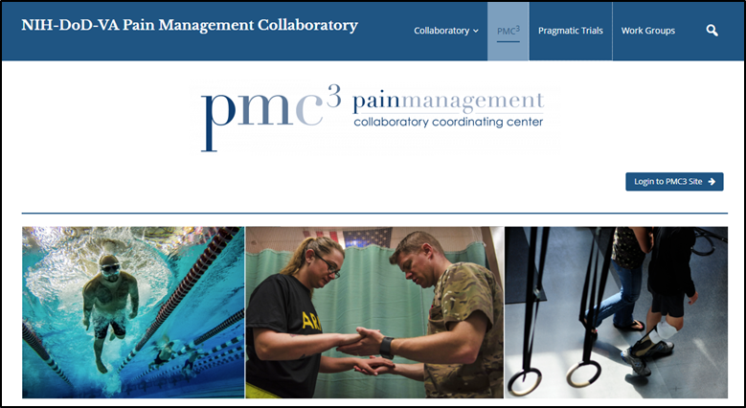
Pain Management Collaboratory Coordinating Center (PMC³)
Robert Kerns, Cynthia Brandt, and Peter Peduzzi Yale University and VA Connecticut
Works with Demonstration Project teams to develop, initiate and implement a research protocol;
Coordinates and convenes Steering Committee of all PIs and federal partner representatives;
Support Demonstration Projects via PMC work groups;
Disseminate best research practices and within military and veteran health care systems
Notes:
The purpose of the Coordinating Center is to provide national leadership for the PMC program for internal and external stakeholders. The PMC provides assistance and to the 11 projects to enable them to conduct efficient, large-scale pragmatic clinical trials. During this initial 2 year planning phase, the Coordinating Center has been an important resourse for he 11 demaortaion projects in helping them prepare for all facets of the implementation phase.

Slide 26
PMC Working Groups
Electronic Health Records
Chairs from Coordinating Center
Investigators from Pragmatic Clinical Trials
Representatives from NIH, DoD, and VA
Additional experts/resources
Purpose:
Guide and support Pragmatic Clinical Trial teams
Disseminate knowledge
Stakeholder Engagement
Phenotypes/Outcomes
Ethical/Regulatory
Study Design/Biostatistics
Data Sharing
Implementation Science
Notes:
Work Groups were established and are managed by the PMC3.
The Work Groups provide a forum for discussion of challenges and solutions across projects; harmonized and standardized policies and processes will be vetted in these groups.
Work Groups are expected to address, at a minimum, the following areas: Stakeholder Engagement, Ethical/Regulatory, Study Design/Biostatistics, Phenotype/Outcomes, Electronic Health Records (EHR), Data Sharing, and Implementation Science. Work Groups are chaired by persons appointed by the Coordinating Center and participants include individuals from the Demonstration Projects, and staff from the NIH, DoD, and VA.

Slide 27
Executive Committee VA, DoD, NIH Centers, Offices & Institutes
Funding Agency Project Officers and/or Scientists
Steering Committee
Coordinating Center
Demonstration Projects
Working Groups
Notes:
This is a visual description of what the NIH-DoD-VA Pain Management Collaboratory looks like:
1 - There is a single coordinating center to support the pragmatic trials
2 – Each funding agency or supports or co-supports individual Pragmatic Clinical Trials that fit within their priorities
3 – Groups come together under a steering committee structure with the PIs, Program Officials/Project Scientists, and the PMC Coordinating Center for monthly calls and yearly in person meeting
6 – Coordinating Center establishes cores/workgroups for common themes important to most if not all of the trials

Slide 28
PMC Progress
Project Milestones
Individual demonstration project planning phase milestones have been reviewed and approved by their respective funding agencies
Harmonization
All projects have agreed to include the PEG3 as an outcome measure
Inclusion criteria and phenotyping harmonization, as appropriate to individual trials
Site Overlap
Projects that plan to recruit or perform interventions at the same locations are making plans to address and minimize competition for subjects and possible contamination
Website Development
Check it out: www.painmanagementcollaboratory.org

Slide 29
Thanks
Robert.kerns@yale.edu
www.painmanagementcollaboratory.org
Twitter: @Drbob52

