Slide 1

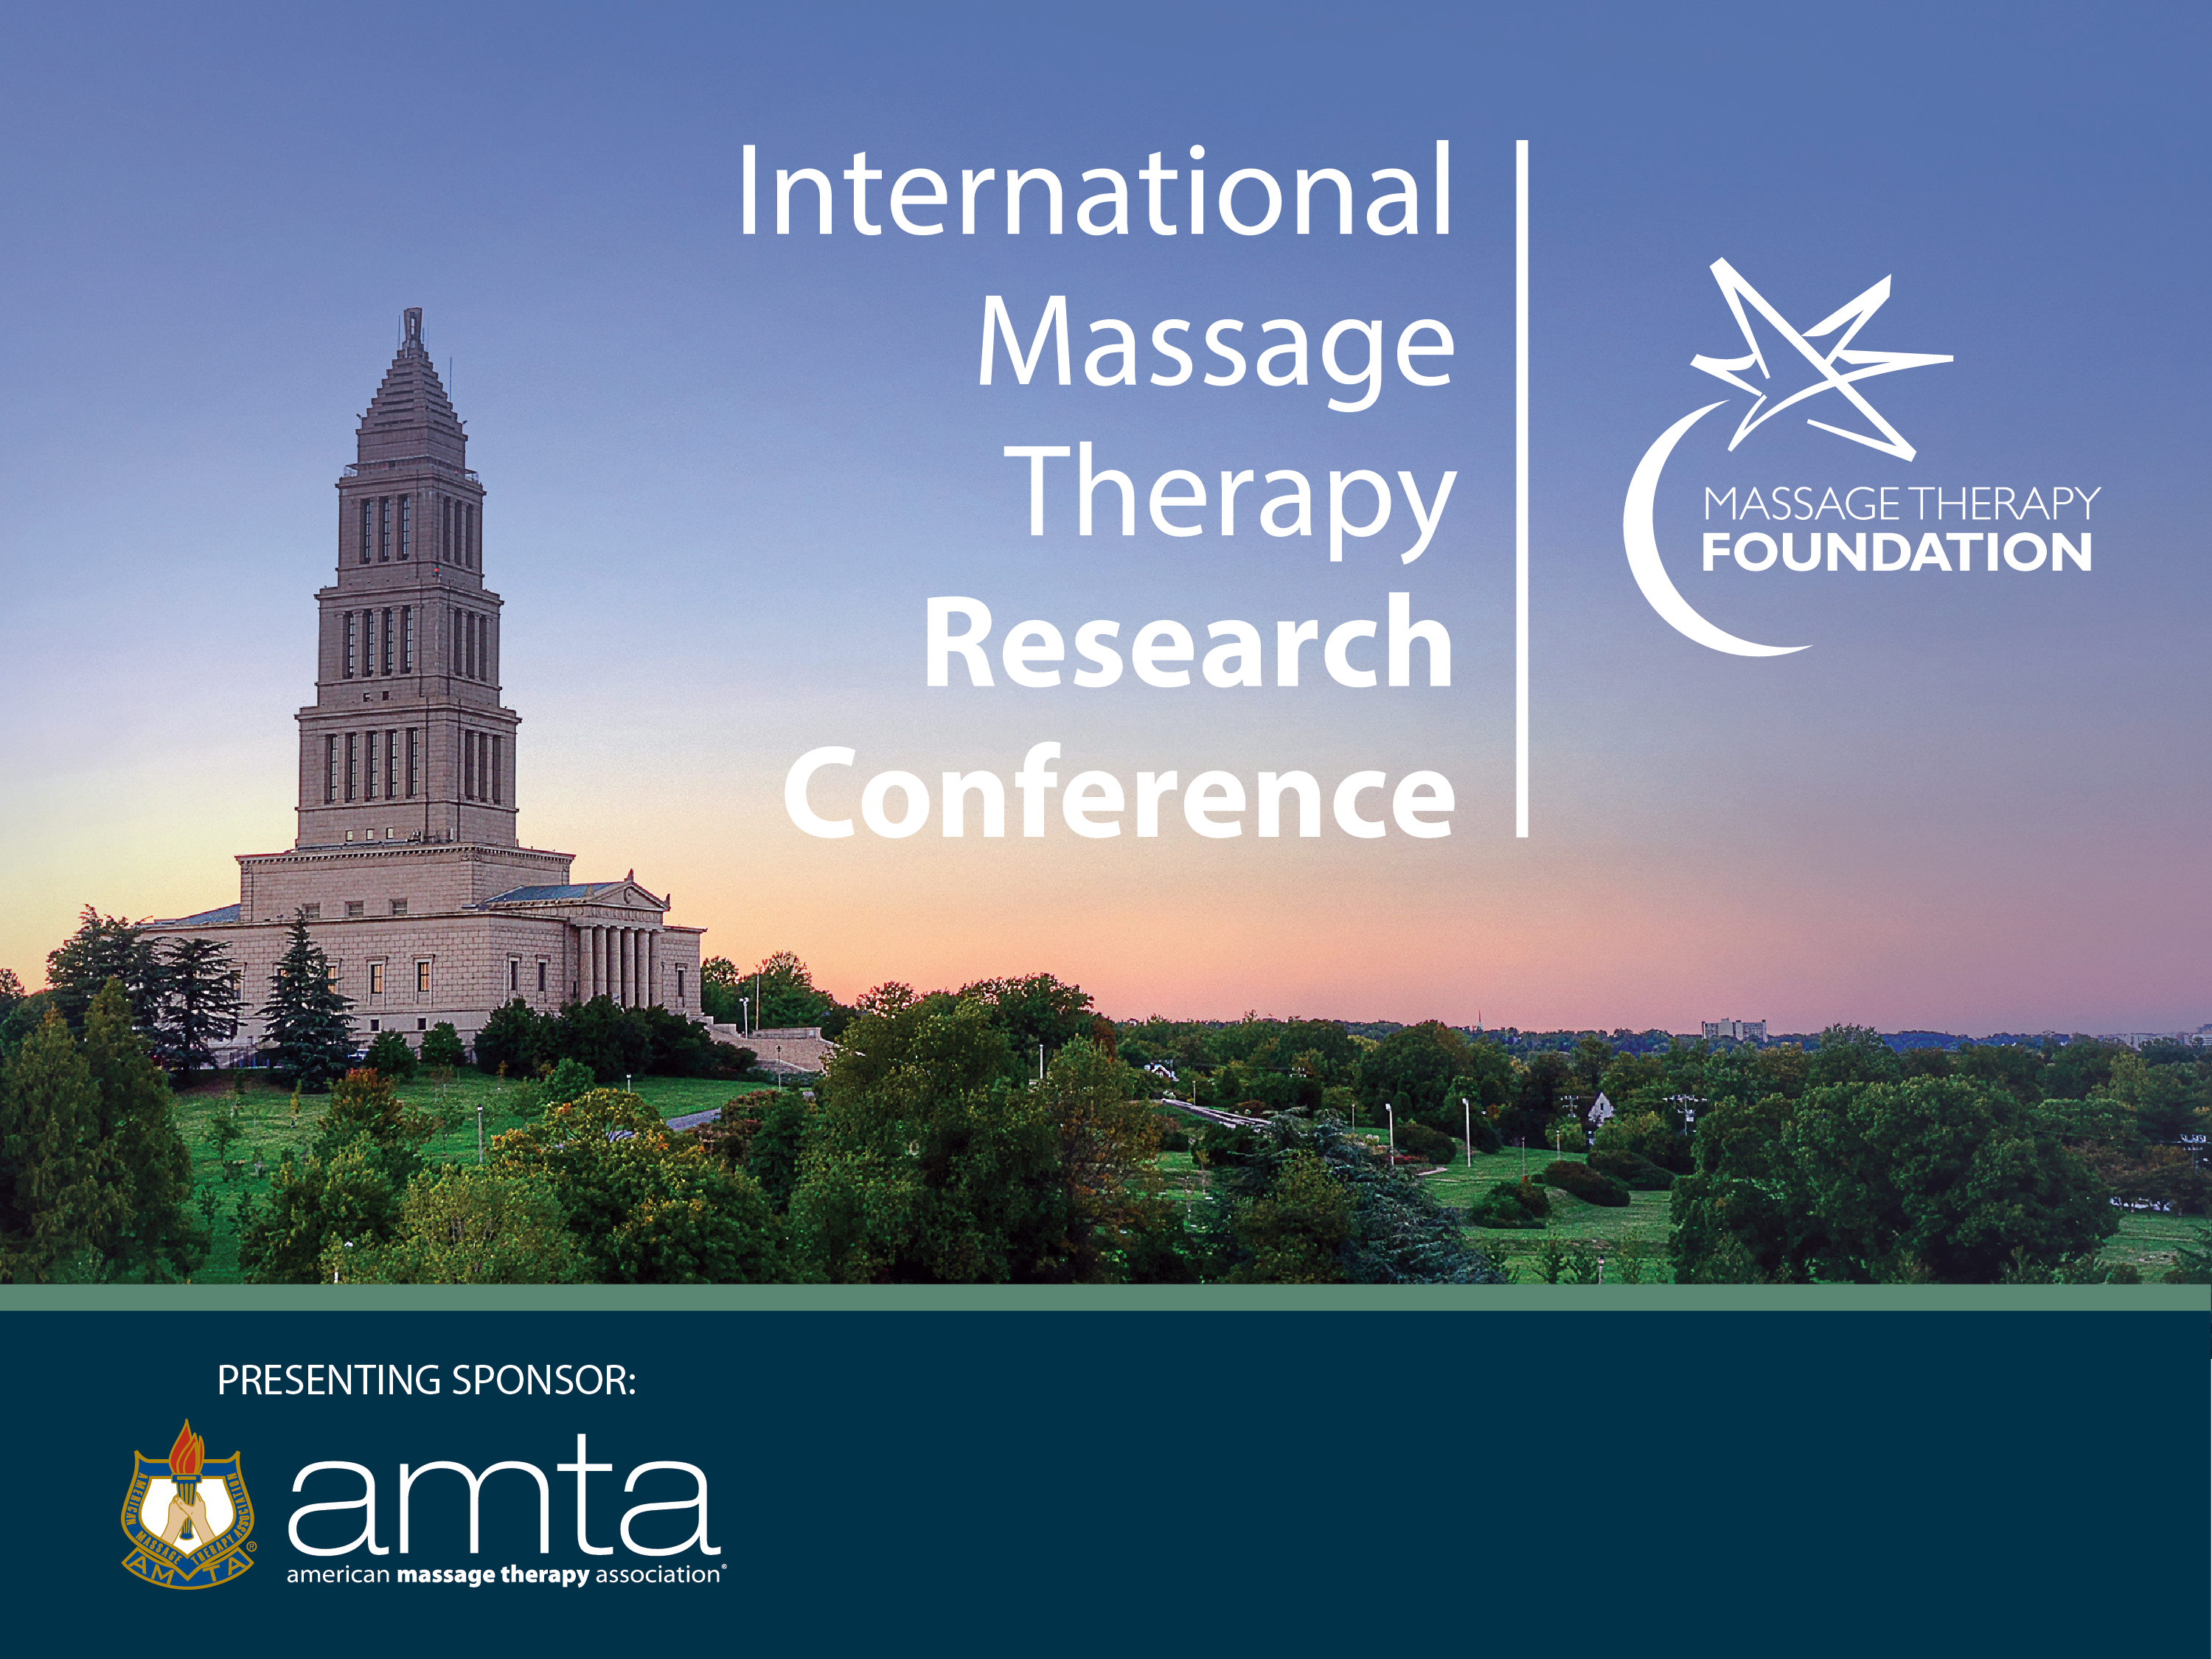
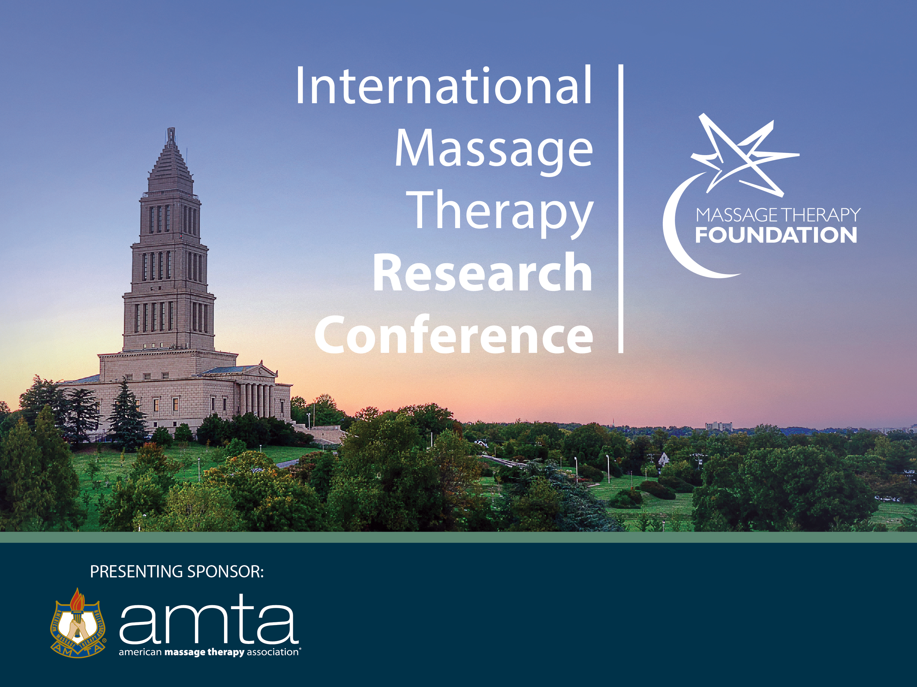
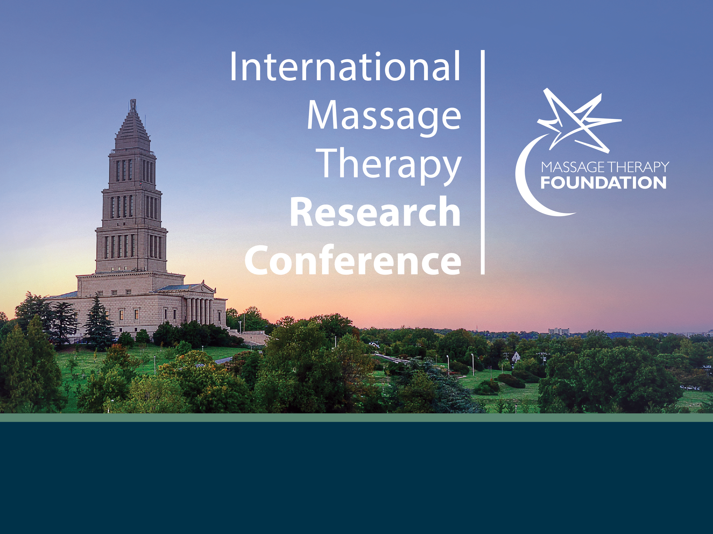

Slide 2
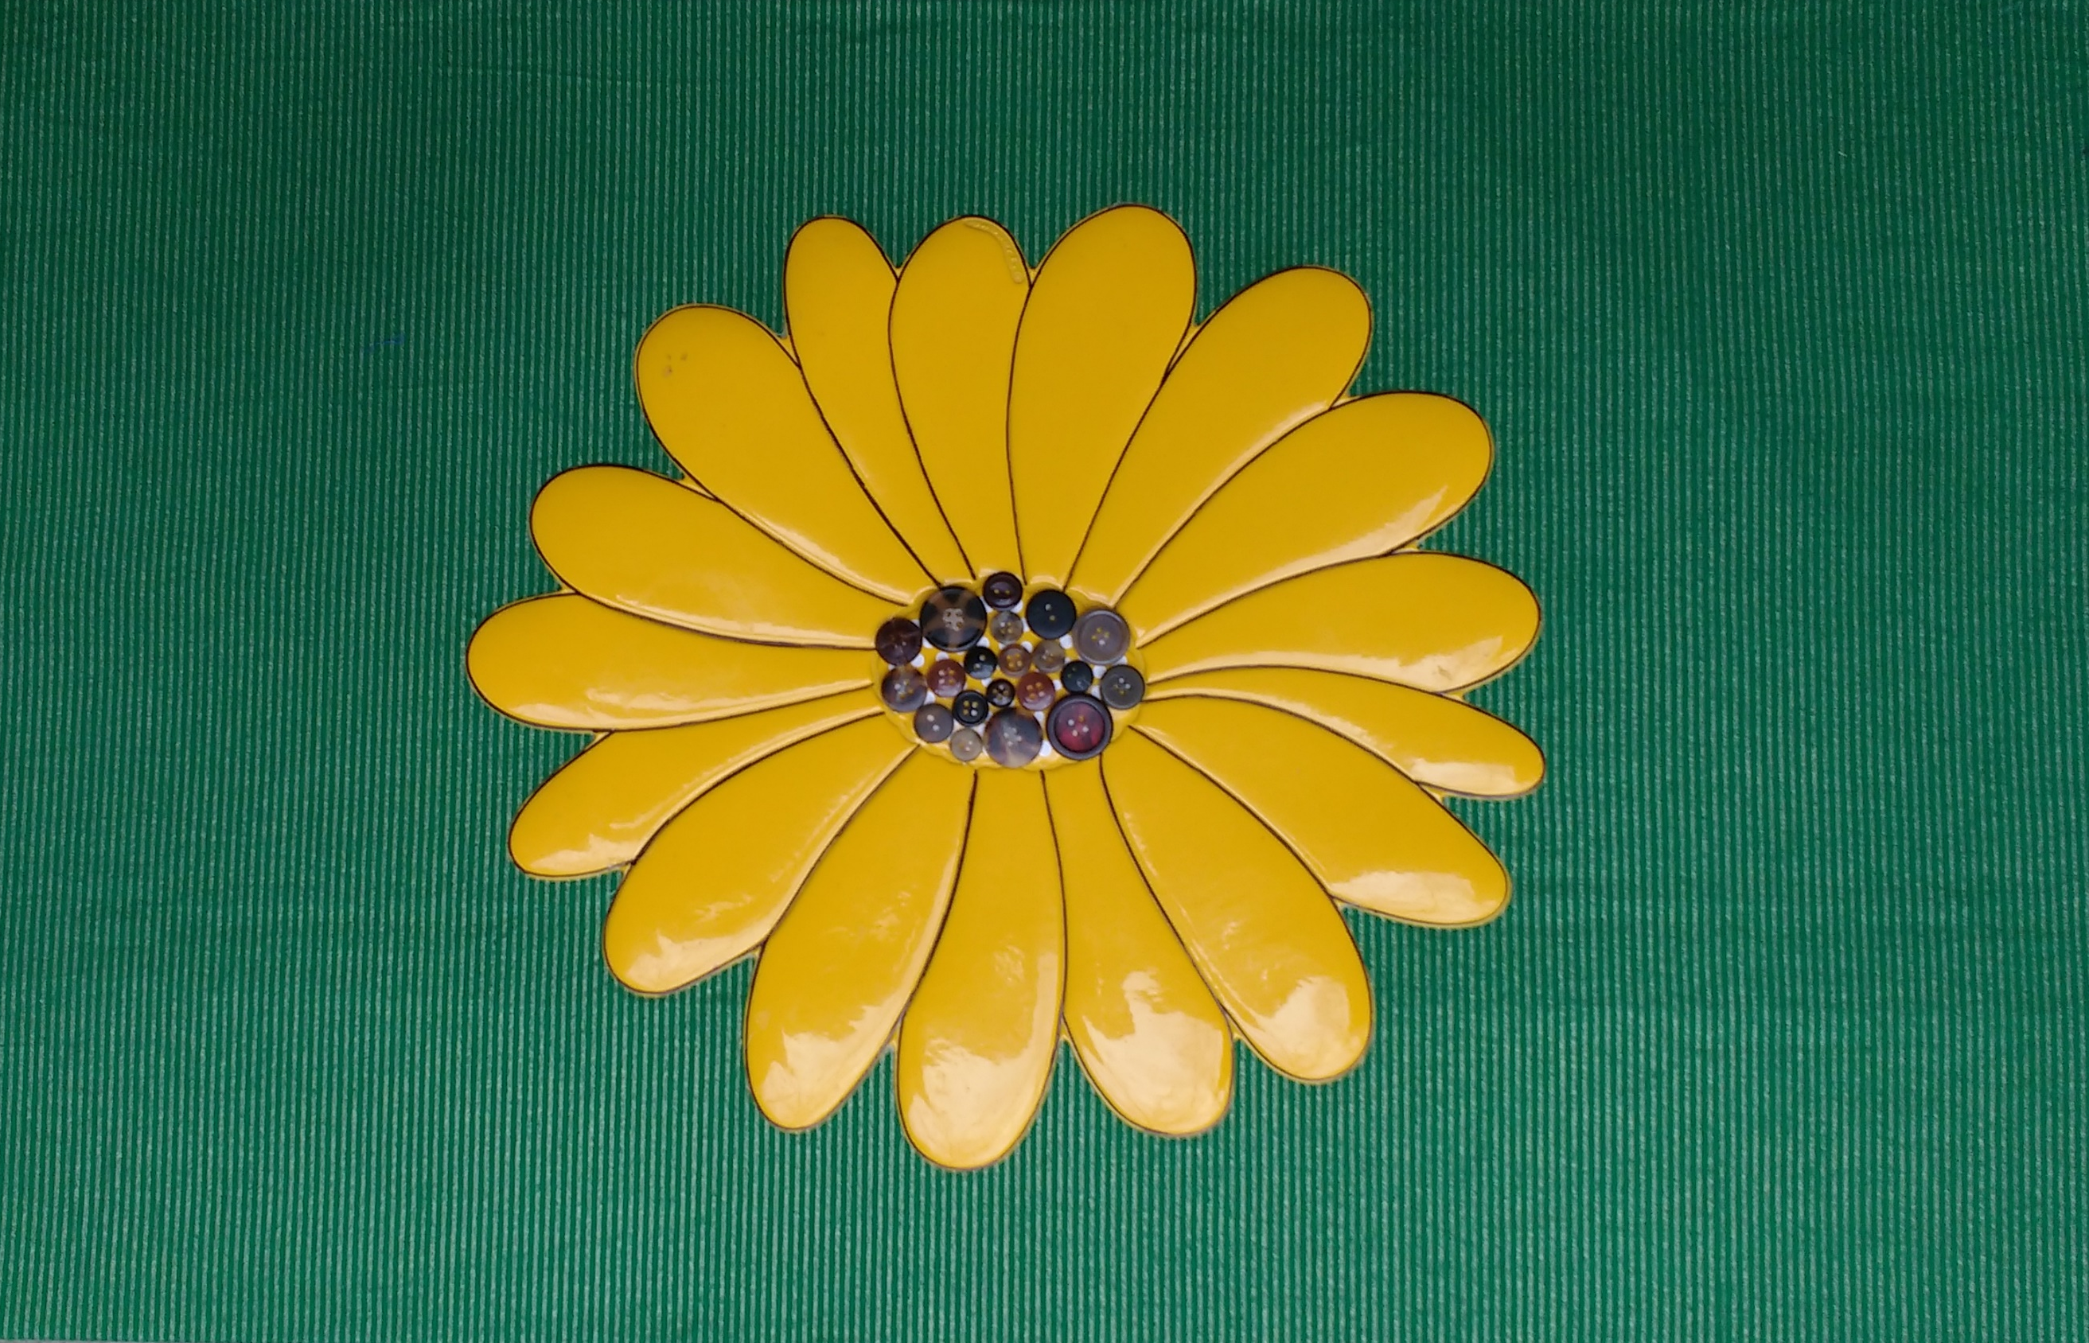
MTF, case reports, & research
Erika Larson
LMT, MSBIOE, BSME

Slide 3
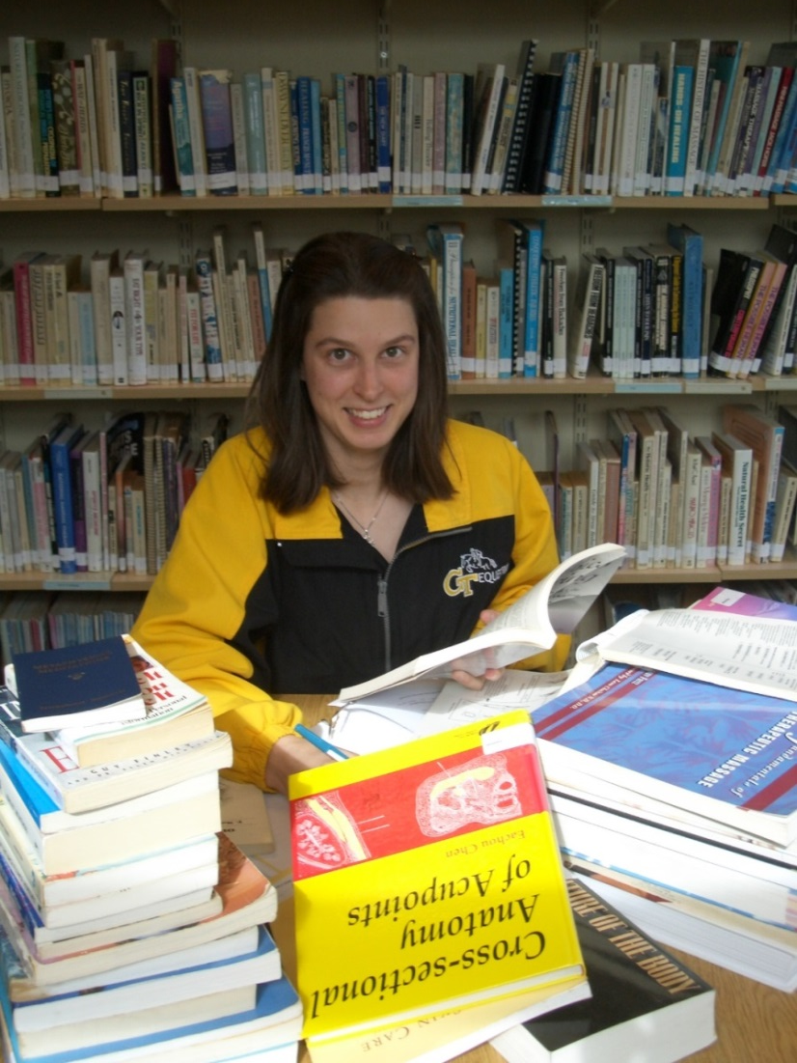
Finding MTF
Massage therapy education
Science & art
MTF resources
ASM 2006, Craig 2006, Fry 2005
Notes:
Atlanta School of Massage. (2006). Atlanta School of Massage student binder. Atlanta, GA: Atlanta School of Massage.
Craig LH, Svircev A, Haber M, Juncos JL. Controlled pilot study of the effects of neuromuscular therapy in patients with Parkinson's disease. Mov Disord. 2006 Dec;21(12):2127-33. doi: 10.1002/mds.21132.
Fry T, Xerogeanes JW, Reeves WC. Rehabilitation of ruptured quadriceps tendon complicated by a post-operative wound infection and delayed surgical repair. J Bodyw Mov Ther. 2005 Apr 1;9(2):158-65. doi: 10.1016/j.jbmt.2004.06.005

Slide 4
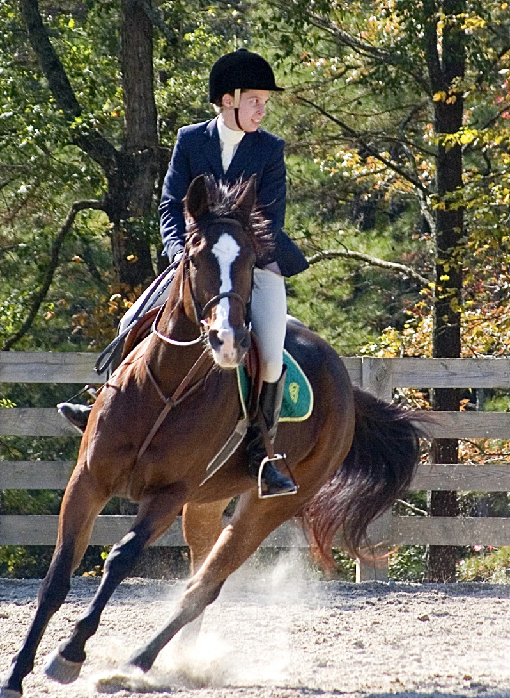
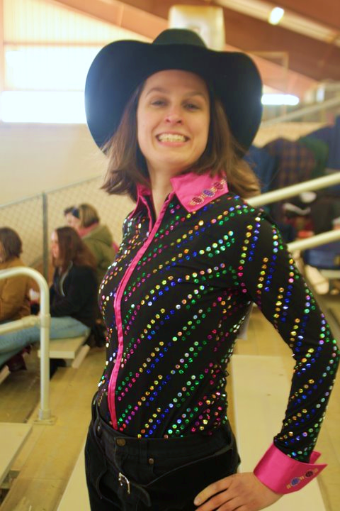
Life happens…

Slide 5
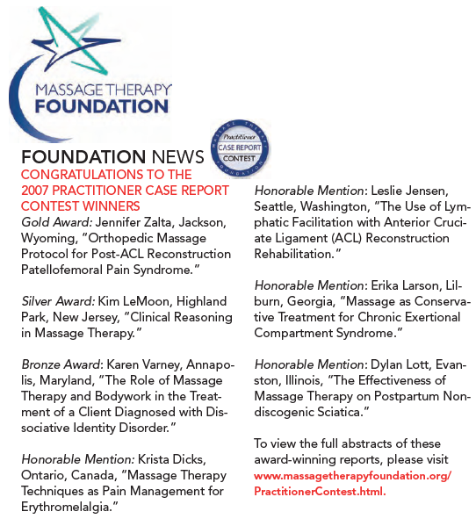
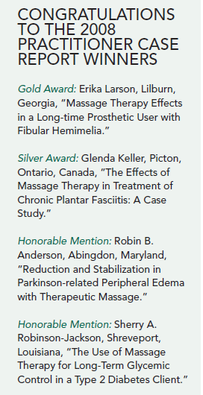
Case report contest
AMTA 2008, AMTA 2009b
Notes:
AMTA. Massage Therapy Foundation News. Hands On. 2008; 19(3): 11.
AMTA. Massage Therapy Foundation: Foundation News. Hands On. 2009 20(2):14.

Slide 6
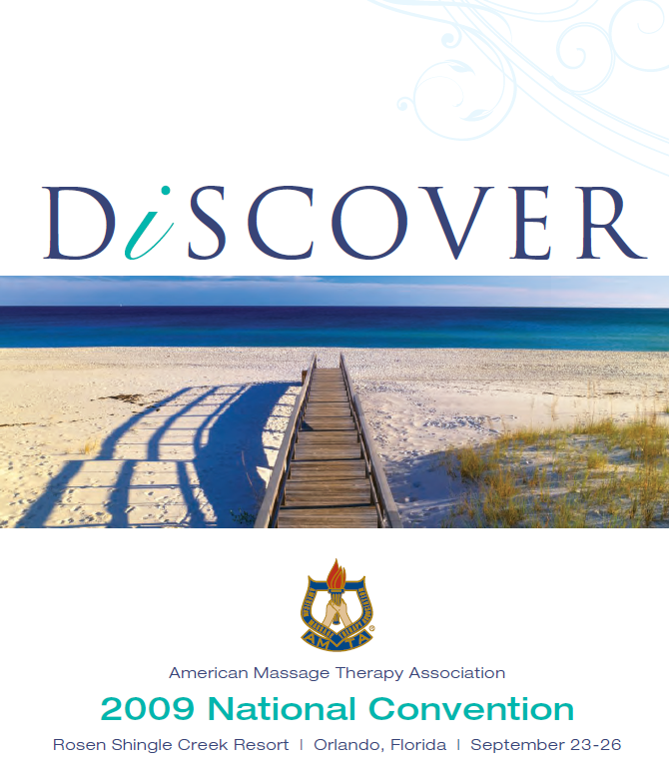
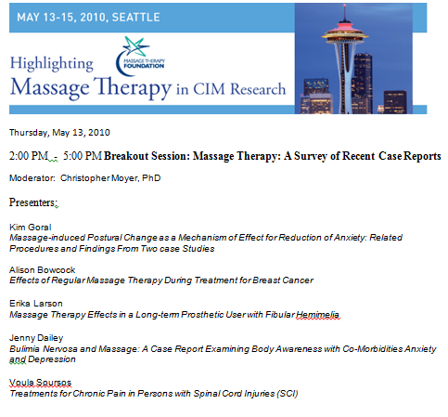
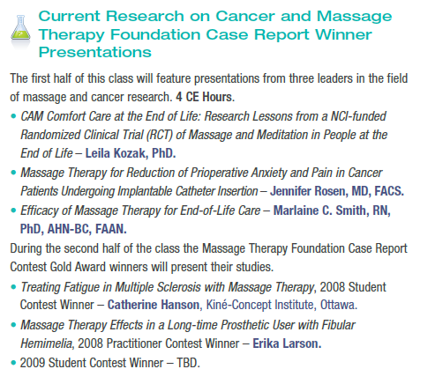
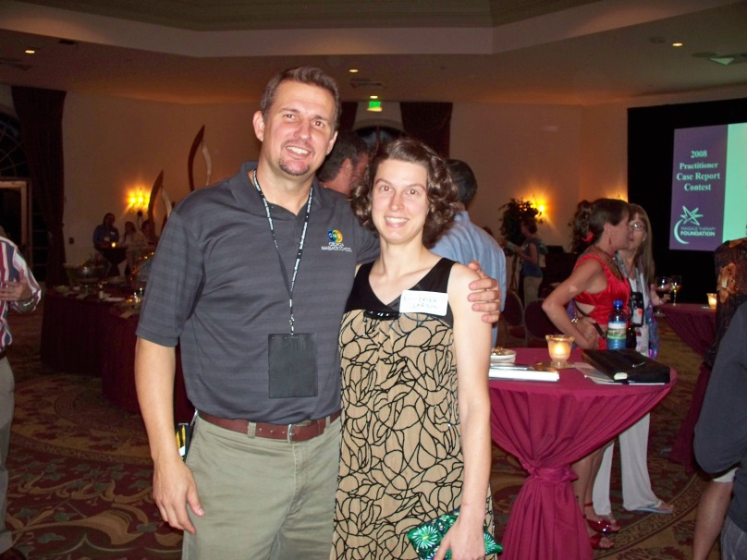
Making connections
AMTA 2009a, MTF 2010
Notes:
AMTA. AMTA 2009 National Convention. Massage Therapy Journal. 2009a; 48 Suppl:6.
Massage Therapy Foundation. http://guest.cvent.com/EVENTS/Info/Agenda.aspx?e=3f3002ae-dfa2-457a-af5b-787a5aad8a73. Accessed March 18, 2010.

Slide 7

Emory-ASM partnership
Collaborative partnership between
  Emory University School of Medicine
  Atlanta School of Massage
ASM, Emory, Kennedy 2018, Kinkead 2018, Larson 2018a, Rapaport 2016
Notes:
Atlanta School of Massage. Atlanta School of Massage. Atlanta School of Massage website. http://www.atlantaschoolofmassage.com/the-program/massage-school-class-schedules/. c2016. Accessed August 21, 2016.
Emory Healthcare. Brain Health Center – Emory Healthcare. https://www.emoryhealthcare.org/centers-programs/brain-health-center/index.html.c2017. Modified June 19, 2017. Accessed June 20, 2017.
Kennedy AB. From Skeptic to Vital Partner in Massage Therapy Research: an Interview with Mark Hyman Rapaport, MD. Int J Ther Massage Bodywork. 2018;11(2):1. https://www.ncbi.nlm.nih.gov/pmc/articles/PMC5988343/pdf/ijtmb-11-1.pdf. Accessed June 06, 2018.
Kinkead B, Schettler PJ, Larson ER, Carroll D, Sharenko M, Nettles J, Edwards SA, Miller AH, Torres MA, Dunlop BW, Rakofsky JJ. Massage therapy decreases cancer-related fatigue: Results from a randomized early phase trial. Cancer. 2018;124:546-54. doi: 10.1002/cncr.31064.
Larson ER. Commentary on Operationalizing Partnership Between a Traditional Research Institution and a Massage School. Int J Ther Massage Bodywork. 2018a Dec;11(4):32. https://www.ncbi.nlm.nih.gov/pmc/articles/PMC6279430/pdf/ijtmb-11-32.pdf Accessed December 10, 2018.
Rapaport MH, Schettler P, Larson ER, Edwards SA, Dunlop BW, Rakofsky JJ, Kinkead B. Acute Swedish Massage Monotherapy Successfully Remediates Symptoms of Generalized Anxiety Disorder: A Proof-of-Concept, Randomized Controlled Study. J Clin Psychiatry. 2016;77:883-91. doi: 10.4088/JCP.15m10151.

Slide 8
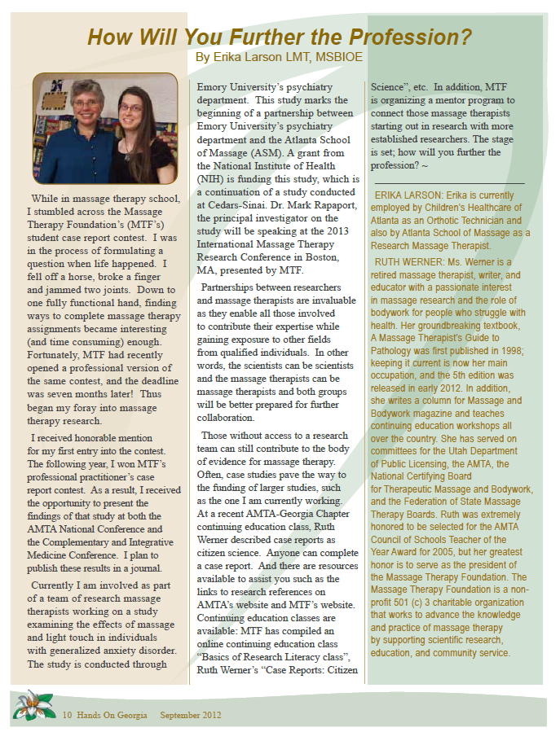
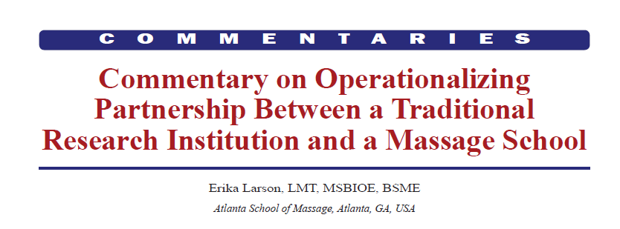
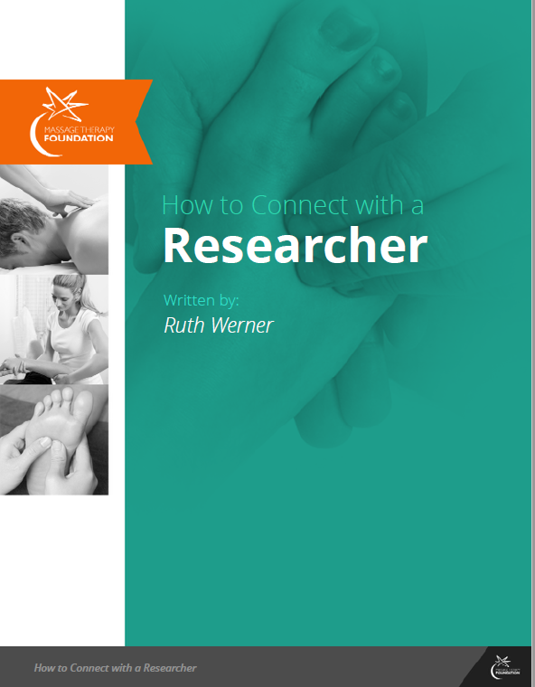
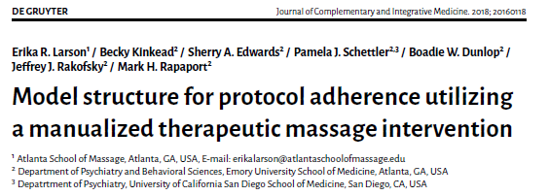
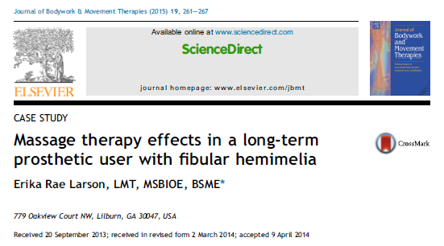
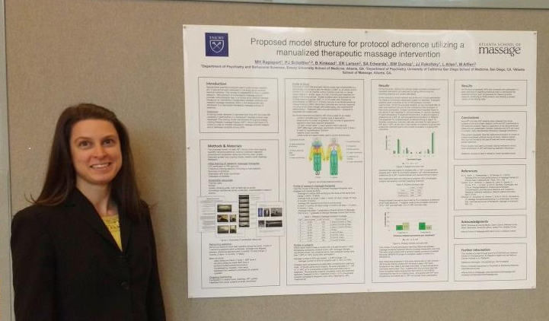
One foot in front of the other
Larson 2018a, Larson 2018b, Larson 2016, Larson 2015, Larson 2012, Werner 2013
Notes:
Larson ER. Commentary on Operationalizing Partnership Between a Traditional Research Institution and a Massage School. Int J Ther Massage Bodywork. 2018a Dec;11(4):32. https://www.ncbi.nlm.nih.gov/pmc/articles/PMC6279430/pdf/ijtmb-11-32.pdf Accessed December 10, 2018.
Larson ER, Kinkead B, Edwards SA, Schettler PJ, Dunlop BW, Rakofsky JJ, Rapaport MH. Model structure for protocol adherence utilizing a manualized therapeutic massage intervention. J Complement Integr Med. 2018b Oct 12. doi: 10.1515/jcim-2016-0118
Larson ER. Rapaport MH, Schettler PJ, Edwards SA, Dunlop BW, Rakofsky JJ, Kinkead B, Allen L, Alfieri M. Proposed model structure for protocol adherence utilizing a manualized therapeutic massage intervention. Poster session presented at: International Massage Therapy Research Conference. May 12-15, 2016; Seattle, WA, 2016. Conference sponsored by American Massage Therapy Association.
Larson ER. Massage therapy effects in a long-term prosthetic user with fibular hemimelia. J Bodyw Mov Ther. 2015;19:261-267. doi: 10.1016/j.jbmt.2014.04.005.
Larson E. How will you further the profession? Hands On Georgia. 2012; 33(17):10
Werner R. How to Connect with a Researcher [Internet]. Massage Therapy Foundation; 2013 [cited March 8, 2014]. Available from: http://massagetherapyfoundation.org/e-books/

Slide 9
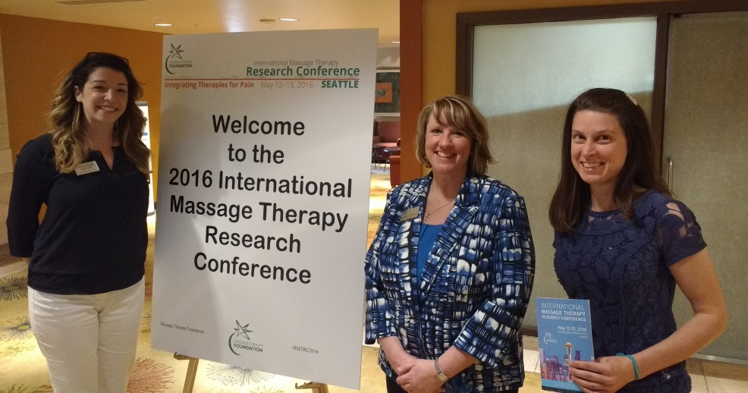
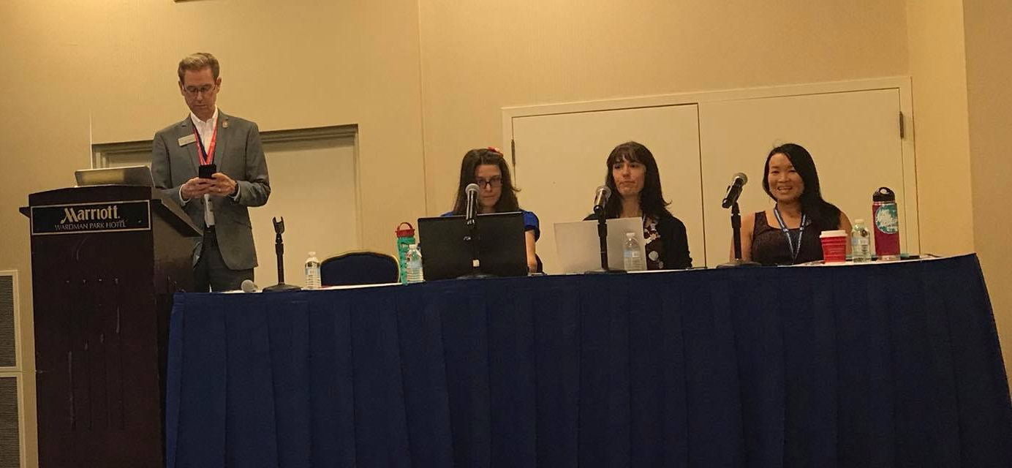
Collaboration & support

Slide 10
Pay it forward
Participate
Mentor
Share
Document
Baskwill 2013, Larson 2018a, Larson 2018b, Munk 2014, Rapaport 2018
Notes:
Baskwill A. Facilitating case studies in massage therapy clinical education. Int J Ther Massage Bodywork. 2013; 6(2):20. http://ijtmb.org/index.php/ijtmb/article/view/204/255. Accessed November 08, 2017.
Larson ER. Commentary on Operationalizing Partnership Between a Traditional Research Institution and a Massage School. Int J Ther Massage Bodywork. 2018a Dec;11(4):32. https://www.ncbi.nlm.nih.gov/pmc/articles/PMC6279430/pdf/ijtmb-11-32.pdf Accessed December 10, 2018.
Larson ER, Kinkead B, Edwards SA, Schettler PJ, Dunlop BW, Rakofsky JJ, Rapaport MH. Model structure for protocol adherence utilizing a manualized therapeutic massage intervention. J Complement Integr Med. 2018b Oct 12. doi: 10.1515/jcim-2016-0118
Munk N, Stewart K, Love MM, Carter E, Elder WG. The intersection of massage practice and research: community massage therapists as research personnel on an NIH-funded effectiveness study. Int J Ther Massage Bodywork. 2014;7(2):10. https://www.ncbi.nlm.nih.gov/pmc/articles/PMC4051806/ Accessed July 9, 2018.
Rapaport MH, Schettler PJ, Larson ER, Carroll D, Sharenko M, Nettles J, et al. Massage therapy for psychiatric disorders. Focus. 2018;16:24–31. DOI: 10.1176/appi.focus.20170043.

Slide 11
References
AMTA. AMTA 2009 National Convention. Massage Therapy Journal. 2009; 48 Suppl:6.
AMTA. Massage Therapy Foundation: Foundation News. Hands On. 2009 20(2):14.
AMTA. Massage Therapy Foundation News. Hands On. 2008; 19(3): 11.
Atlanta School of Massage. Atlanta School of Massage. Atlanta School of Massage website. http://www.atlantaschoolofmassage.com/the-program/massage-school-class-schedules/. c2016. Accessed August 21, 2016.
Atlanta School of Massage. (2006). Atlanta School of Massage student binder. Atlanta, GA: Atlanta School of Massage.
Baskwill A. Facilitating case studies in massage therapy clinical education. Int J Ther Massage Bodywork. 2013; 6(2):20. http://ijtmb.org/index.php/ijtmb/article/view/204/255. Accessed November 08, 2017.
Craig LH, Svircev A, Haber M, Juncos JL. Controlled pilot study of the effects of neuromuscular therapy in patients with Parkinson's disease. Mov Disord. 2006 Dec;21(12):2127-33. doi: 10.1002/mds.21132.
Emory Healthcare. Brain Health Center – Emory Healthcare. https://www.emoryhealthcare.org/centers-programs/brain-health-center/index.html.c2017. Modified June 19, 2017. Accessed June 20, 2017.
Fry T, Xerogeanes JW, Reeves WC. Rehabilitation of ruptured quadriceps tendon complicated by a post-operative wound infection and delayed surgical repair. J Bodyw Mov Ther. 2005 Apr 1;9(2):158-65. doi: 10.1016/j.jbmt.2004.06.005
Kennedy AB. From Skeptic to Vital Partner in Massage Therapy Research: an Interview with Mark Hyman Rapaport, MD. Int J Ther Massage Bodywork. 2018;11(2):1. https://www.ncbi.nlm.nih.gov/pmc/articles/PMC5988343/pdf/ijtmb-11-1.pdf. Accessed June 06, 2018.
Kinkead B, Schettler PJ, Larson ER, Carroll D, Sharenko M, Nettles J, Edwards SA, Miller AH, Torres MA, Dunlop BW, Rakofsky JJ. Massage therapy decreases cancer-related fatigue: Results from a randomized early phase trial. Cancer. 2018;124:546-54. doi: 10.1002/cncr.31064.
Larson E. How will you further the profession? Hands On Georgia. 2012; 33(17):10
Larson ER. Commentary on Operationalizing Partnership Between a Traditional Research Institution and a Massage School. Int J Ther Massage Bodywork. 2018a Dec;11(4):32. https://www.ncbi.nlm.nih.gov/pmc/articles/PMC6279430/pdf/ijtmb-11-32.pdf Accessed December 10, 2018.
Larson ER. Massage therapy effects in a long-term prosthetic user with fibular hemimelia. J Bodyw Mov Ther. 2015;19:261-267. doi: 10.1016/j.jbmt.2014.04.005.
Larson ER. Massage therapy effects in a long-term prosthetic user with fibular hemimelia. Conference presentation: Highlighting Massage Therapy in CIM. 2010; Seattle, WA.
Larson ER. Massage therapy effects in a long-term prosthetic user with fibular hemimelia. Conference presentation: American Massage Therapy Association National Convention. 2009; Orlando, FL.
Larson ER. Massage therapy effects in a long-term prosthetic user with fibular hemimelia. Poster session presented at: American Massage Therapy Association National Convention. September 23-26, 2009; Orlando, FL.
Larson ER, Kinkead B, Edwards SA, Schettler PJ, Dunlop BW, Rakofsky JJ, Rapaport MH. Model structure for protocol adherence utilizing a manualized therapeutic massage intervention. J Complement Integr Med. 2018b Oct 12. doi: 10.1515/jcim-2016-0118
Larson ER. Rapaport MH, Schettler PJ, Edwards SA, Dunlop BW, Rakofsky JJ, Kinkead B, Allen L, Alfieri M. Proposed model structure for protocol adherence utilizing a manualized therapeutic massage intervention. Poster session presented at: International Massage Therapy Research Conference. May 12-15, 2016; Seattle, WA, 2016. Conference sponsored by American Massage Therapy Association.
Massage Therapy Foundation. http://guest.cvent.com/EVENTS/Info/Agenda.aspx?e=3f3002ae-dfa2-457a-af5b-787a5aad8a73. Accessed March 18, 2010.
Munk N, Stewart K, Love MM, Carter E, Elder WG. The intersection of massage practice and research: community massage therapists as research personnel on an NIH-funded effectiveness study. Int J Ther Massage Bodywork. 2014;7(2):10. https://www.ncbi.nlm.nih.gov/pmc/articles/PMC4051806/ Accessed July 9, 2018.
Rapaport MH, Schettler PJ, Larson ER, Carroll D, Sharenko M, Nettles J, et al. Massage therapy for psychiatric disorders. Focus. 2018;16:24–31. DOI: 10.1176/appi.focus.20170043.
Rapaport MH, Schettler P, Larson ER, Edwards SA, Dunlop BW, Rakofsky JJ, Kinkead B. Acute Swedish Massage Monotherapy Successfully Remediates Symptoms of Generalized Anxiety Disorder: A Proof-of-Concept, Randomized Controlled Study. J Clin Psychiatry. 2016;77:883-91. doi: 10.4088/JCP.15m10151.
Werner R. How to Connect with a Researcher [Internet]. Massage Therapy Foundation; 2013 [cited March 8, 2014]. Available from: http://massagetherapyfoundation.org/e-books/

