Slide 2
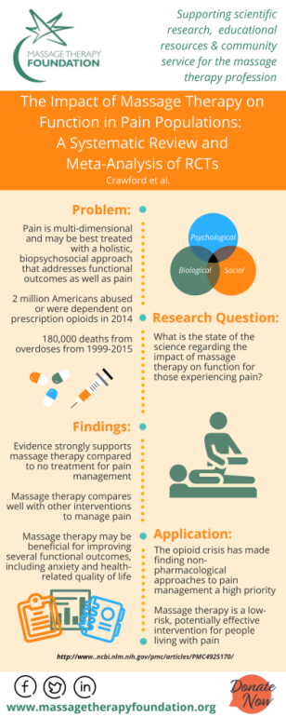
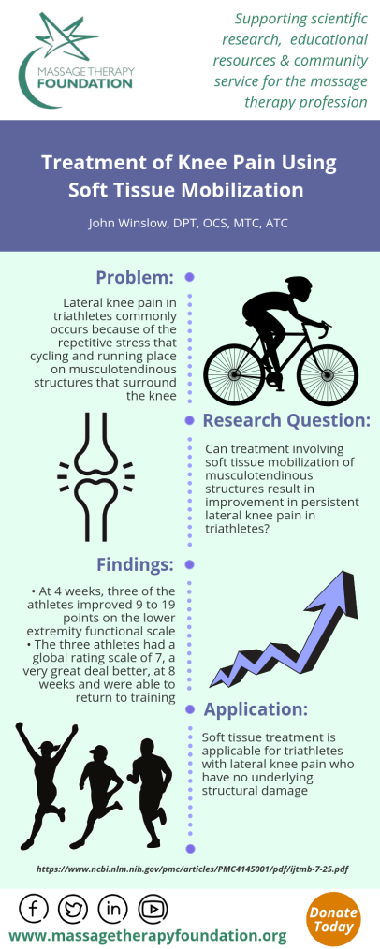
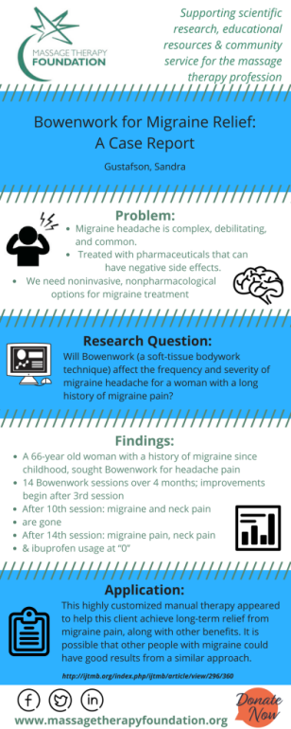
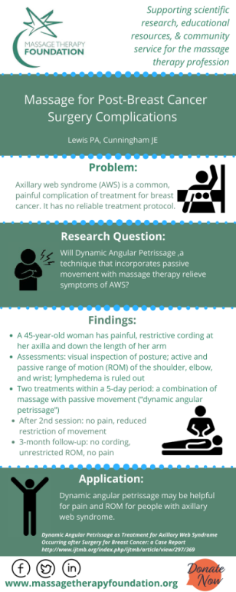
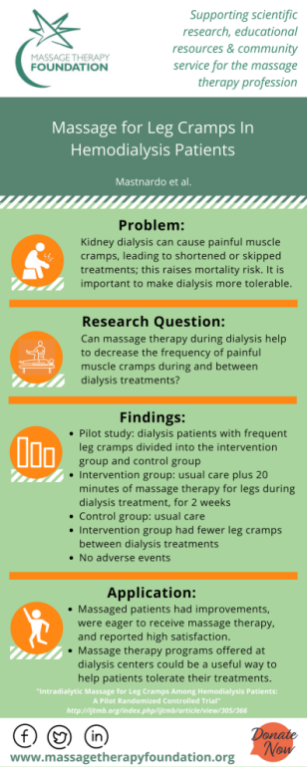
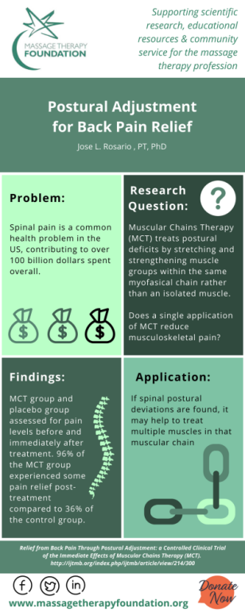
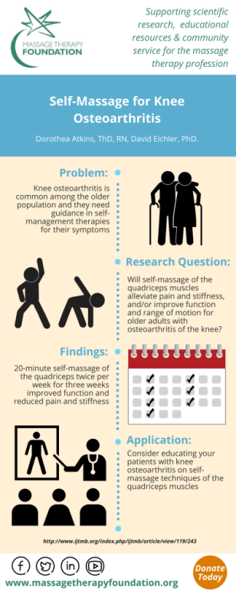
MTF Research Initiatives
Research grants
Infographics/#VisualAbstracts
International Journal of Therapeutic Massage & Bodywork (IJTMB)
Research Perch podcasts
International Massage Therapy Research Conference (IMTRC)
Research articles and blogs
Upcoming Practice-Based Research Network

Slide 3
Educational Resources
Student case report contest
Research literacy courses
Poster/abstract submissions
Student and teacher research tools
Educational blog posts
Educational webinars

Slide 4
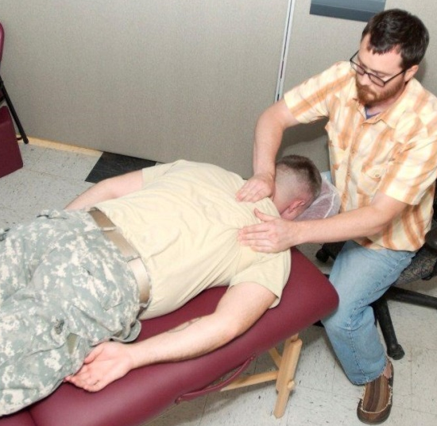
Community Service
Community Service is the heart of the Foundation. MTF has awarded over $400,000 in community service grants, bringing the benefits of massage therapy to people who typically do not have access.
Recently funded grants include:
Medically fragile children
Immigrant torture survivors
Survivors of human trafficking
Veterans
Caregivers
Hospice patients
Domestic violence survivors
People suffering chronic pain

Slide 5
Ways to Support MTF
Donate: Show you care about the work MTF does on behalf of your profession
Join the Massage Matters Giving Club: Commit to a monthly donation and receive special perks
Plan Your Legacy: Consider a gift which will support massage research, education, and community service for future generations
Spread the Word: Download and print promotional materials
www.massagetherapyfoundation.org

