Slide 1
Massingill Method for post Breast surgery scar tissue Release
MASSAGE FOR POST BREAST SURGERY
MYOFASCIAL RELEASE / MANUAL LYMPHATIC DRAINAGE
CROSS FIBER MASSAGE
Jeanne Massingill

Slide 2
Education
Vincent Institute of Massage Therapy:
(Dr. Arthenor) in Los Angeles, California
Gheinziet Therapy : Dr. Athenor
Ohio College of Massotherapy / Akron
Neuromuscular: Paul St John
Myofascial Release: John Barnes
Cranial Sacral: Dr. John Upledger

Slide 3
Education
Manual Lymphatic Drainage: Vodder
Kushi Institute Of Macrobiotic / East West Center for Macrobiotics.
Thai / Shiatsu/ Cooking for healing/ Herbal Therapy/ Cupping.
Negative Pressure Cupping: Cross Country
Kinesio Taping : Akron U: Dr. Kenzo
Chirodontics: Dr Robert Walker LVI Institute
Ayurveda: Ohio/ Fairfield Iowa / Shirodhara
16 years research in Breast Cancer Scar Tissue

Slide 4
OVER 300,00 WOMEN HAVE BREAST CANCER SURGERY PER YEAR
20 to 50% experience persistent chest wall pain and more.
Even after less aggressive surgeries / ie. Lymph node removal or biopsy
COMMON ISSSUES POST BREAST SURGERY
Loss of range of motion/ mobility painful
Loss of feeling
Handgrip issues
Axillary web Syndrome
Trouble Sleeping
Fatigue
Numbness / Tingling
Shooting Pain ( contractures)
Throbbing

Slide 5
Studies show that chronic pain affects well being and quality of life
Some patients do not discuss the problems with their physician
Women think its normal, this is there new life.
Current Treatment is medication, physical therapy and/or exercise to strengthen tissue and stretch to improve flexibility and mobility.
They may be told it may or mat not go away.
MYOFASCIAL RELEASE : Another part of the puzzle since connective tissue is key component of structural stability.
Fascia Helps the body retain it’s shape and keeps vital organs in place. Fascia also covers muscles, bones, nerves, vesicles and it continuous through out the body
MY FIRST DOUBLE BLIND POLOT STUDY WITH CASE WESTERN RESERVE,
METRO HOSPITAL & SUSAN G. KOMEN PROVED SUCESSFUL
Using modified Myofascial Techniques/ Manual Lymphatic Drainage and Cross fiber to help woman with chronic pain and mobility issues post breast surgery.

Slide 6
Why Myofascial release?
PART OF THE CONNECTIVE TISSUE SYSTEM
Reduces Adhesions
Releases Connective tissue
Increases Muscle Mobility
Reduces Stiffness
Stimulates blood flow
Encourages Lymphatic flow
Releases Fascia Restrictions
Stretching fascia influences the change in the viscosity of the collagenous fibers ( scar tissue), and increases the glide for more fluid movement of muscle tissue
Increases blood flow encouraging release of toxins allowing phagocytes to clean bacteria guarding against infection.

Slide 7
fascia 3 dimensional
Acupuncture and Massage Indigo Dragon Center. (2019). Fascia and Our “Well-ness”. Retrieved from https://www.indigodragoncenter.com/fascia-and-our-well-ness/

Slide 8
WITHIN THE CONNECTIVE TISSUE
Histocytes & Phagocytes/ Macrophages defend against bacteria
Mast cells develops what blood cell(Basophil) anticoagulant.
Pigment cells/ melanocytes
Fibroblast produce collagen fibers ( scar tissue)
Elastin, and viscus (gell) ground substance
to help heal injuries.

Slide 9
CHARISTERISTICS OF CONNECTIVE TISSUE
Connective tissue is active, fibroblast, release collagen fibers to provide strength and active growing of the tissue for wound repair. Loose/ dense made of collagen, elastin and .)
Collagen: provides strength to the fascial tissue for over extension.
Elastin: Extends runs parallel to give elasticity when needed/ found in skin/ arteries, veins and tendons & helps where elasticity is required.
Polysaccharide gell: fills the spaces between fibers ,reduces friction in muscles helps them slide over one another, lubricates, helps absorb shock of trauma. Continual trauma Sports cause the polysaccharides break down.
Components are hyaluronic acid and proteoglycans /lubrication.

Slide 10
Definition of Fascia:
A sheet or broad band of fibrous connective tissue beneath the skin around muscles and other organs of the body. Fascia has three layers and it is a three dimensional network.
Superficial:
Covers the entire body, thicker and different regions contain fat for preventing heat loss. Between layers of fascia are arteries, veins, lymph, nerves and mammary glands.
Function:
Stores fat, prevents heat loss, protects from blows and injuries and is a pathway for nerves and blood vessels.
Deep Fascia:
Lines walls of the body and extremities to hold tissue together. Separates muscle groups &holds them together. Allows free movement, Carries nerves, blood vessels and fills spaces between the muscles.

Slide 11
Deep Fascia Contains no fat / Dense connective tissue
Muscles are wrapped in dense connective /called
Epymesium: Wraps around the entire muscle
Perimysium: Wraps around Fibers
Endomysium: Wraps around the fasciles
Subserous Fascia: Located in between layers of deep visceral Fascia made of loose connective tissue that covers and supports viscera and attached to the internal body wall.
The three Components are continuous and attach muscle to the periostium of the bone.

Slide 12
Muscle fibers and the fascia
Marieb, EN and Hoehn, K. (2015). Human Anatomy & Physiology (10th ed.). New York, NY: Pearson Education, Inc.

Slide 14
Breast anatomy
COOPERS LIGAMENT: Strands of fascia found through out the breast which end at the skin
Helps give breast its shape and strength
INFRAMAMMARY FOLD: (Wikapedia)Not mentioned in breast anatomy books / BUT recognized by plastic surgeons
The line where the breast and chest meet, Immediately under the breast
Composed of collagen and condensation of superficial fascia.
Helps to shape the breast and binds to the pectoral fascia.

Slide 15
IT MAKES SENSE
Since Fascia is everywhere and a main support, shape , movement and a pathway for blood, nerves. Scaring of the tissue through surgery or injury affects the fascia.
FIBROBLST WITHIN THE SYSTEM PRODUCE SCAR TISSUE
Myofascial Release stretches the elastin and changes the viscosity of the gell substance to increase glide of the tissue.
With that and understanding it is a perfect place to start when working with post breast cancer surgery issues.

Slide 16
MANUAL LYMPHATIC DRAINAGE
Vodder MLD for Mastectomy: Reduce Edema, Fibrosis,
relieve tension and pain
Lymph System promotes movement of lymphatic fluids to nodes, trunk ducts.
Facilities removal of metabolic waste, bacteria, foreign substances.
Proven to relieve pain of fractures, sprains, tendonitis, bruises, lymphedema, cosmetic surgery, and scars.
Lymph has no valves to prevent back flow

Slide 17
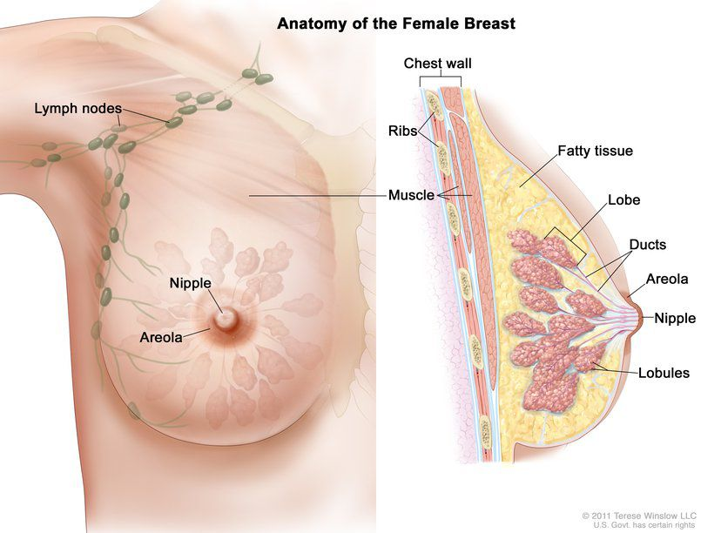
©2011. Therese Winslow, LLC. US Govt. has certain rightsc

Slide 18
Breast lymph pathway
Breast Research and Awareness LLC. (2019). The Lymph System and Your Breast Health. Retrieved from http://breastresearchawareness.com/breast-health/the-lymph-system/

Slide 19
VODDER METHOD OF LYMPHATIC DRAINAGE
Light pressure repetitive movement
Massage Techniques
Stationary circles
Rotary Circles
Pumping
Scoop
Do not slide over skin
5mm rhythmic movements
Slow rhythmic movements
20/30 minutes
Right lymphatic duct clears upper quadrant only
Left lymphatic drains right arms /legs and entire left side of
body

Slide 20
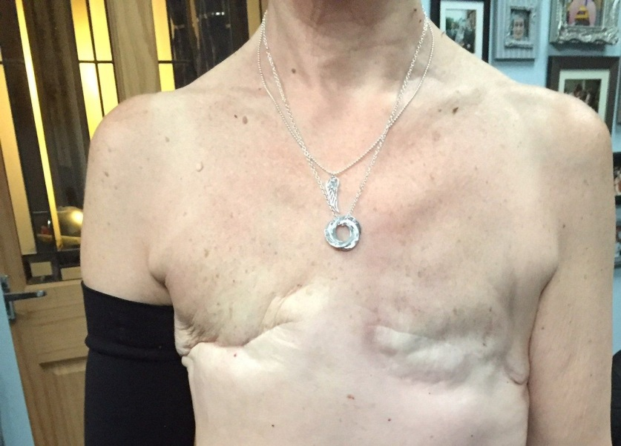
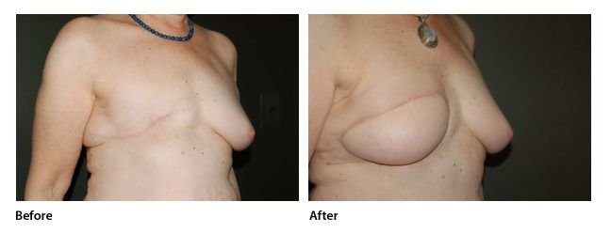
Types of Surgeries
Lumpectomy
Mastectomy
Skin Sparing Mastectomy
Grafting
Tramflaps/ With or
without blood supply
Lymph Node Removal
Implants / Expanders
Types of Tramflaps
Stomach
Latissimus Dorsi
Tug Flap: Gluteal &Thigh

Slide 21
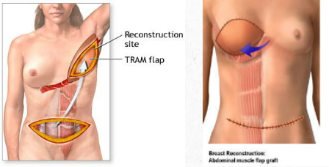
Breast Reconstruction Surgery
TRAM FREE FLAP: Involves the deep epigastric blood vessels, part of the rectus abdominus muscle is used along with the skin and fat of the abdomen to create a breast . This will cause some abdominal weakness.
TRAM FLAP: The rectus abdominus muscle is cut at the pubic insertion and tunneled under the upper abdominal skin . A vascular so the tissue may become hard and necrotic from loss of blood supply.
Baylor College of Medicine. (2019). Breast reconstruction. Retrieved from https://www.bcm.edu/healthcare/care-centers/plastic-surgery/procedures/breast-reconstruction

Slide 22
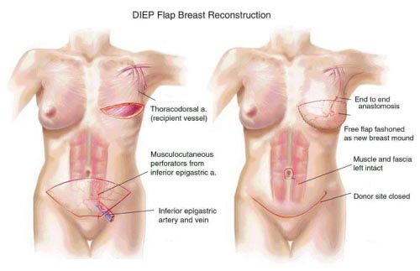
Breast Reconstruction Surgery
DIEP FLAP: Deep Inferior epigastric perforator artery & vein are taken from the bottom of the rectus abdominus without removing the muscle and attached to the chest wall blood vessels to provide a blood supply and the abdominal tissue is used to make a breast . Less pain.
SIEA FLAP: Superior inferior epigastric blood vessels are used without incisions to muscles or deep incisions in abdomen and the abdominal tissue is used to create a breast.
Not all patient’s are candidates to this surgery because these vessels are small , or if they have had a C section or hysterectomy.
PRMA Plastic Surgery. (2019). DIEP Flap Breast Reconstruction. Retrieved from https://www.pinterest.com/pin/4292562116626792/?lp=true

Slide 23
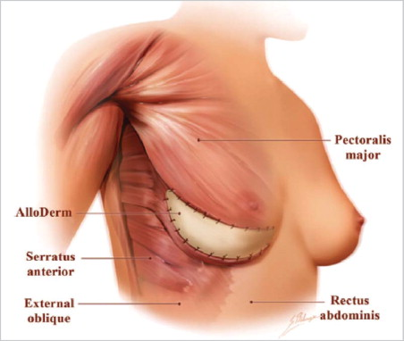
Breast Reconstruction Surgery
Alloderm: Derived from skin donated from cadavers.
Tavallali Plastic Surgery. (2013). Complicated Breast Augmentation. Retrieved from https://www.tavmd.com/2013/09/08/complicated-breast-augmentation-surgery/

Slide 24
AREAS OF CONSIDERATINODE IN LYMPH REMOVAL SURGERY
Pectoral muscle
Latissamus Dorsi
Axillary Vein
Large Thoracic Nerve /inserts in Serratus
Thoraco Dorsi Nerve / Innervates Latissamus Dorsi
Intercostal Brachial Nerve / Arm and Axilla
Lateral Pectoral Nerve / Innervates Pectoral Muscle

Slide 25
Muscles Considered in Mastectomy
Aibolita.com. (n.d.). Technique of a Radical Mastectomy. Retrieved from https://aibolita.com/womens-diseases/40572-technique-of-radical-mastectomy.html#z4992

Slide 26
WHAT IS SCAR TISSUE ?
Scar tissue is a form connective tissue.
Fibroblast generate collagen for tissue regeneration.
Scar tissue can attach to muscle fibers, prevent sliding ,causes mobility issues.
Adheres to nerves and blocks blood flow causing pain.

Slide 27
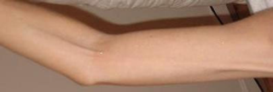
Types of Scar Tissue
AXILLARY WEB SYNDROME OR CORDING:
Traumatized hardened connective tissue near bundles of blood vessels, nerves and lymph nodes. Generally travels down the arm, axillary region and pectoral area. Causes chronic pain and immobility.
ADHESIONS: Scar tissue that binds to parts of other organs or muscles. Cording, post tram-flap, ports, & drainage tubes. Can cause obstructions/ mobility loss
& chronic pain.

Slide 28
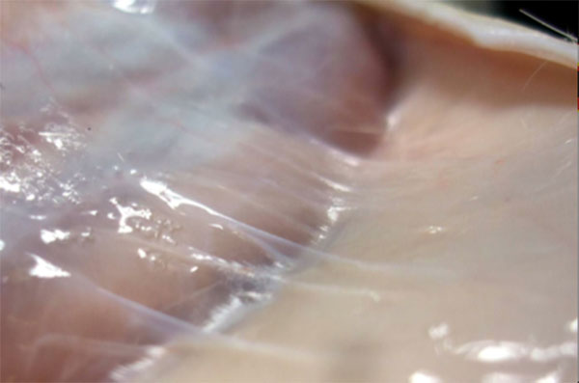
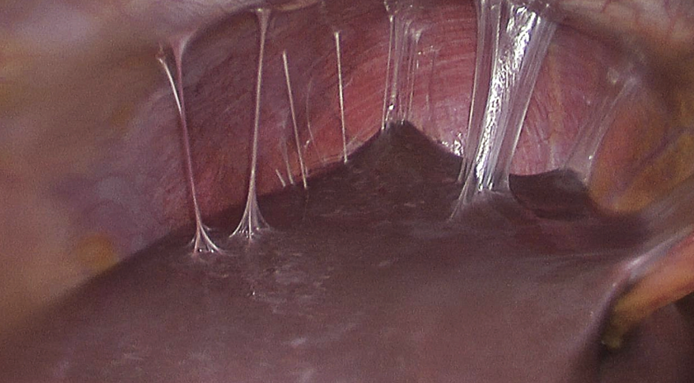
Types of Scar Tissue
ADHESIONS: Scar tissue that binds to parts of other organs or muscles. Cording, post tram-flap, ports, & drainage tubes. Can cause obstructions/ mobility loss
& chronic pain.
Fascia & Fitness. (2018). The Best Way to Prevent and Reduce the Risk of Postoperative Adhesions is to be Proactive Both Before and After Surgery. Retrieved from http://www.fascialfitness.net.au/articles/the-best-way-to-prevent-and-reduce-the-risk-of-postoperative-adhesions-is-to-be-proactive-both-before-and-after-surgery/
Wikimedia Commons. (2013). Perihepatic Adhesions. Retrieved from https://commons.wikimedia.org/wiki/File:Perihepatic_adhesions_2.jpg

Slide 29
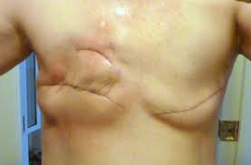
Types of Scar Tissue
ATROPHIC SCAR: Sunken down into the skin where muscle is removed. Acne Scars.
CONTRACTURE: Scar tissue pulls the skin toward the
injury site causing cramping, pinching and chronic pain.

Slide 30
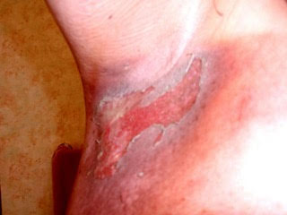
Types of Scar Tissue
RADIATION SCARS AND BURNS: Damage blood supply to normal skin causes hardening of tissue, discoloration change in color of skin redness, or brownish necrotic looking tissue.

Slide 31
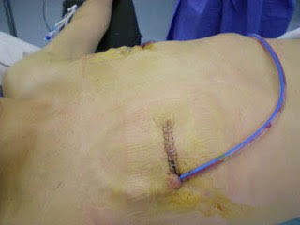
Types of Scar Tissue
DRAINAGE TUBE and PORT SCARS: The insertion and removal of drainage tube and ports cause twisting of fascia.

Slide 32
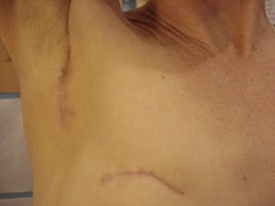
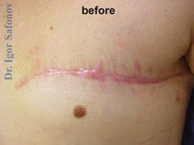
Types of Scar Tissue
Seromas: A collection of
serous fluid under the
skin post surgery in
empty space created by
tissue removal.
Keloids: Elevated red or
dark scar tissue that can
grow larger then than the
wound.

Slide 33
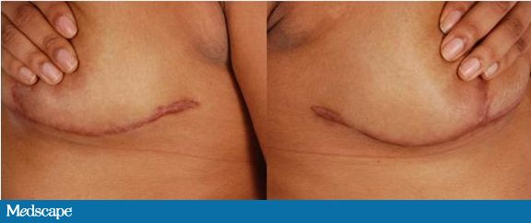
Types of Scar Tissue
HYPERTROPHIC SCAR: Red or purple coloring slightly raised from the skin but flattens and fades in time.

Slide 34
Physical trauma post surgery
Fatigue
Lymphedema
Insomnia
Weakness
Mobility
Chronic Pain
Tightness in the chest and difficulty breathing
Infections
Radiation Burns
Axillary Web Syndrome

Slide 35
Contra Indications
Skin burns from radiation
Open incisions ALWAYS PROTECT NEW INCISIONS
Leakage of the areola
No heat applied to radiated patients
Separating tissue/ Petechiae
Sores/Blisters
Bruising
Inflammation/Heat in tissue (dark red color of tissue)

Slide 36
Emotional Trauma Post Surgery
Fear
Sadness
Anger
Withdrawn
Protectiveness
Shyness

