Slide 1
Overview of the Cardiovascular System
Anatomy Supplement to the MTF Research Perch podcast episode, Massage Therapy Restores Peripheral Vascular Function Following Exertion

Slide 2
Objectives:
Identify the functions of the cardiovascular system
Describe the layers of blood vessels
Identify arteries of the body

Slide 3
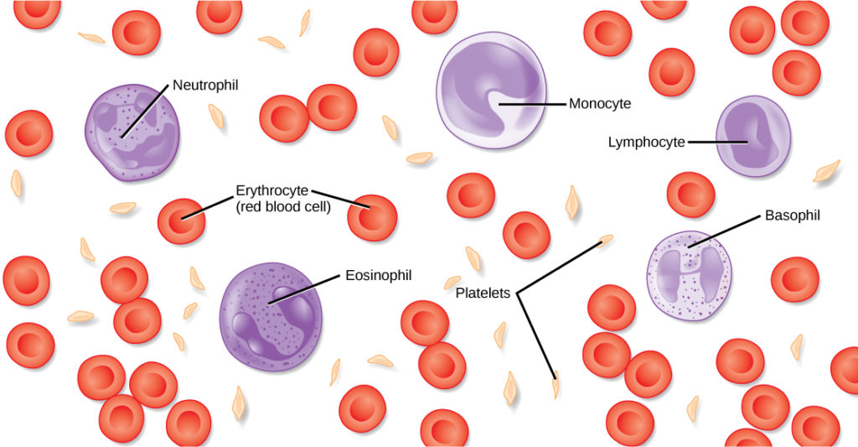
Major Functions of the Cardiovascular System:
Transport gases and nutrients through the body via a system of blood vessels and via red blood cells (erythrocytes)
Help combat pathogens via immunity through various white blood cells (leukocytes)
Combat hemorrhage via platelets (thrombocytes) and coagulation
This Photo by Unknown Author is licensed under CC BY

Slide 4
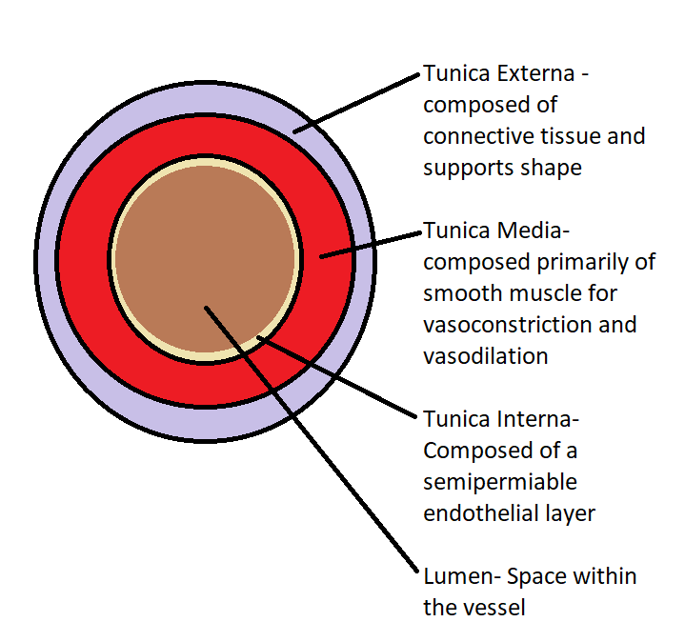
Basic Layers of Blood Vessels:

Slide 5
Blood Vessels:
Arteries
Vessels that transport blood from the heart to the capillaries
Arterioles are smaller branches of arteries
Typically have the thickest walls of the types of vessels due to higher pressure
Capillary beds
Typically have thinnest walls to aid in transfer of nutrients
Site of internal respiration in tissues
Veins
Vessels that transport blood from the capillaries back to the heart
Equipped with one-way valves to prohibit back flow

Slide 6
Cardiovascular Circuits:
Systemic Circuit
transports blood from the heart to the tissues throughout the body
Pulmonary Circuit
Transports blood from the heart through the lungs to aid in external respiration and gas exchange with the external environment
Coronary Circuit
Transports blood through the tissues of the heart such as the myocardium

Slide 7
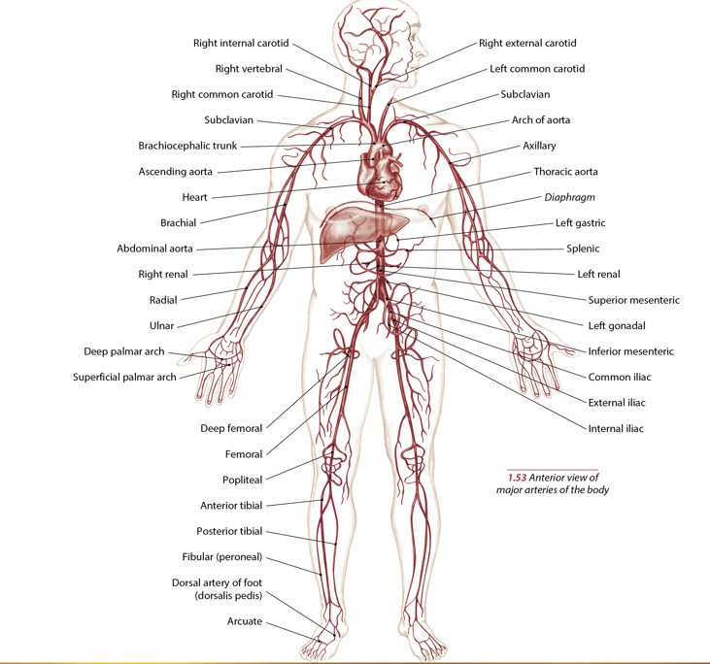
Arteries of the Body
Image Copyright 2019 Books of Discovery

