Slide 1


Department of Psychiatry and Behavioral Sciences
Faculty Meeting, April 24, 2019
AGENDA
    4:30 pm Introduction and Chair Overview
    Strategic Plan Update
    Risk Management Discussion ??
    Research Update
    Administrative Update
    Clinical Services (including EVP)
    Question and Answers
Department of Psychiatry and Behavioral Sciences, Emory University School of Medicine

Slide 2
Acute Swedish Massage monotherapy successfully remediates symptoms of Generalized anxiety disorder
Mark Hyman Rapaport MD
Department of Psychiatry and behavioral sciences
Emory University School of Medicine

Slide 3
Collaborators
Pamela Schettler PhD
Ericka Larson MS
Sherry Edwards BS,
Boadie Dunlop MD, MS
Jeffery Rakofsky MD
Becky Kinkead PhD
Leticia Allen BA
Dedric Carroll BA
Laureen Dietrick BA
Grace Prior BA
Brittney Turner BA

Slide 4

Collaboration
Collaborative partnership between
  Emory University School of Medicine
  Atlanta School of Massage

Slide 5
“You gotta know the territory”
The Music Man

Slide 6
Massage Therapy
  Many different forms of massage therapy, different lengths of massage treatment, most outcome measures are not well defined, and most studies do not employ a control or placebo intervention.
  Meta-analyses suggest that massage may decrease anxiety, depression, and somatic pain acutely but the data are weak. Acute massage may decrease salivary cortisol but data are unclear with longer periods of evaluation Van der Watt, G (2008) Curr Opin Psych 21: 37-42
  There is emerging evidence that massage has localized anti-inflammatory properties in exercise models of muscle damage
.

Slide 7
Therapeutic Touch
No well controlled trials of therapeutic touch for the treatment of anxiety or depressive disorders
No evidence that therapeutic touch can enhance wound healing
Robinson J, et al (2009) The Cochrane Database of Systematic Reviews Issue 1; O Mathuna DP et al (2003) The Cochrane Database of Systematic Reviews Issue 4

Slide 8
Challenges with Somatic Therapies
Limited research/systematic studies
Effectiveness, superiority to what?
“Alternative” does NOT mean “safe”
Adverse effects not well characterized
Different techniques
Insurance companies do not cover them
How to do you factor “opportunity costs” into this equation?
8

Slide 9
Other Challenges
“I would not have seen it, if I had not believed it” (Yogi Berra) or How do you deal with expectancy and credibility beliefs of the therapists, investigators, and subjects?
How do you deal with the melding of different cultures- massage therapists and investigators?

Slide 10
Research vs. community practice
 | research massage therapy | community massage practice
provider | research massage therapist | massage therapist
recipient of treatment | study subject | massage client
type of treatment | standardized intervention | individualized treatment
session length | standardized | varies
boundary negotiation | individuals unwilling to receive the entire protocol are not chosen for participation | ongoing and adaptive
provider-recipient relationship | mediated by script and research coordinator; constant over time | therapeutic and interpersonal; built over time
Larson 2018a
Notes:
Why Model needed. We’re asking rMTs to do something special
Traditional structure for TMB efficacy trials may limit generalizability.(1,9,17) However, there may be
merit to testing a TMB protocol as the practice of medicine is based in protocol. MGAD design reflects
previous studies conducted by the PI,(3,15,16) thereby creating continuity.

Slide 11
Research personnel
Brookman-Frazee 2016 , Larson 2018a
Notes:
It takes a village (takes a lot of people to make it work)
The study depends on each person involved in the study working together with the common goal of success of the study
Skew toward Emory/ balance of power
Research personnel included people from an array of backgrounds
The massage therapists hired for the study completed training in both the intervention protocols and standard operating procedures of the study. As a result, specialized skill set developed, so I’ll be referring to these massage therapists as research massage therapists throughout the presentation.

Slide 12
Our Approach to research

Slide 13
Interventions
Manualized, 45-minutes, weekly for 6 weeks
  The Massage Therapy Pressure Scale
  SMT: effleurage, petrissage, tapotement; primarily pressure level 3 [level 1 – level 3]; unscented, hypoallergenic lubricant
  LT: light contact (pressure level 1), each position held 5 seconds
Kinkead 2018, Walton
Notes:
Intervention protocol specifics were informed by previous work with study team, Massage Therapy Pressure Scale, & Industry expertise & standards
Reference for massage therapy pressure scale
All rMTs were trained in both SMT & LT
Tried to keep rMT with subject for all six visits

Slide 14
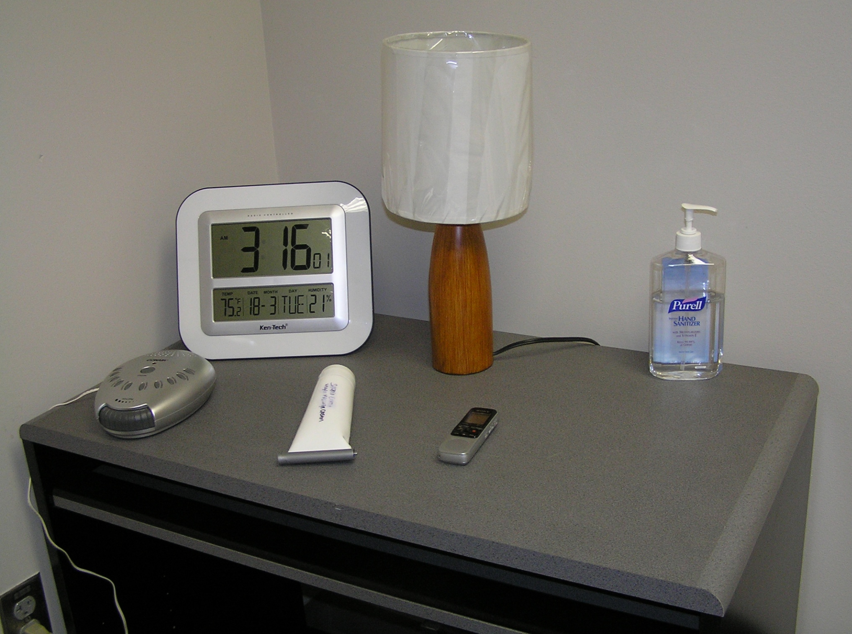
Intervention environment
Emory Brain Health Center
Private, dimly lit treatment room
Kinkead 2018
Notes:
Interventions took place in private, dimly lit tx room at Emory BHC
Control ambient env with white noise & space heater
Room and table were set up according to guide
white noise in the form of running stream is played during the session
a space heater is used to help modulate room temperature
Verbal interaction with subject is scripted and kept to a minimum
Sessions are audio-recorded
the rMT uploads the recorded sessions into an electronic folder.

Slide 15
Quality control measures
Review of session audio recordings
Quarterly research massage therapist retraining sessions
Discussions at weekly research personnel meetings
  Treatment notes from research massage therapist
  Subject comments
  Research coordinator feedback
Rapaport 2016
Notes:
Continued from MGAD
Form basis of ongoing monitoring
Protocol fidelity useful in interpreting results
Continued quality control measures from a previous study (build on past successes; value communication)
rMT signed tx notes indicating whether or not deviation

Slide 16
What does massage do ?
Our Initial Studies

Slide 17
The Acute and Longer Term Physiological Effects of Swedish Massage
Implications for the treatment of Anxiety disorders

Slide 18
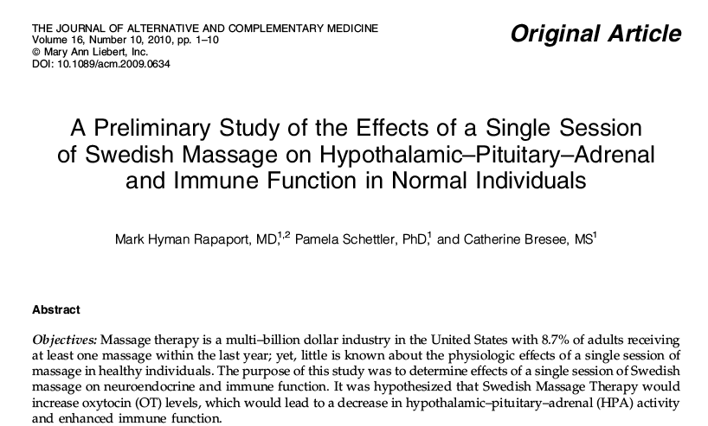

Slide 19
Timeline for the Session
Relative to Intervention (min)
-30 | Disrobe and IV placement
-5 | Blood sampling HPA
-1 | Blood sampling HPA/Immune, Salivary Cortisol
Intervention | 45 min Swedish massage or light touch
+1 | Blood sampling HPA
+ 5 | Blood sampling HPA/Immune
+10 | Blood sampling HPA
+15 | Blood sampling HPA
+20 | Salivary Cortisol
+60 | Blood sampling for HPA/Immune
Rapaport et al (2010) J Alter Comp Med 16(10) 1-10.

Slide 20
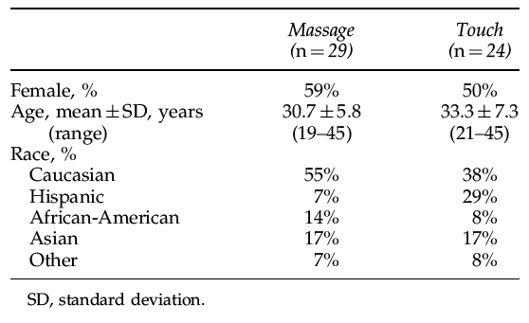
Demographic Characteristics of Study Participants
Rapaport et al (2010) J Alter Comp Med 16(10) 1-10.

Slide 21
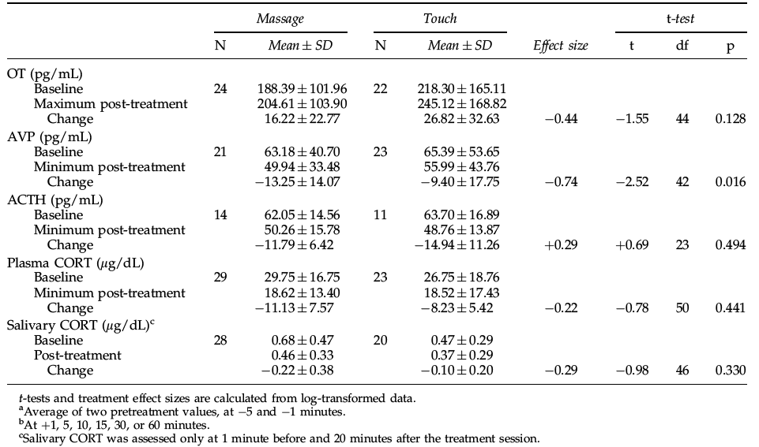
Group Means and SDs for HPA Axis Variables for Swedish Massage Therapy and Light Touch Subjects at Baseline,ª Maximum/Minimum Post-Treatment Value,^{b} and Post-Minus-Baseline Difference (change)
Rapaport et al (2010) J Alter Comp Med 16(10) 1-10.

Slide 22
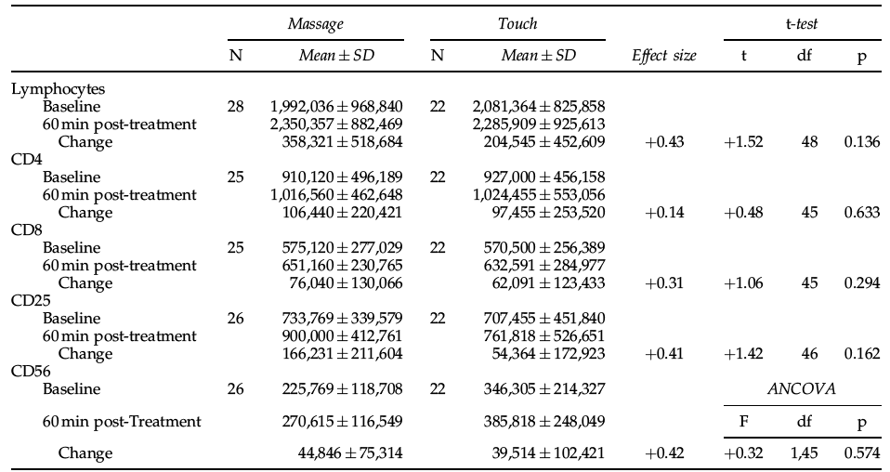
Group Means and SDs for Lymphocyte and CD Subtypes in Swedish Massage Therapy and Light Touch Subjects (Cells/mL)
Rapaport et al (2010) J Alter Comp Med 16(10) 1-10.

Slide 23
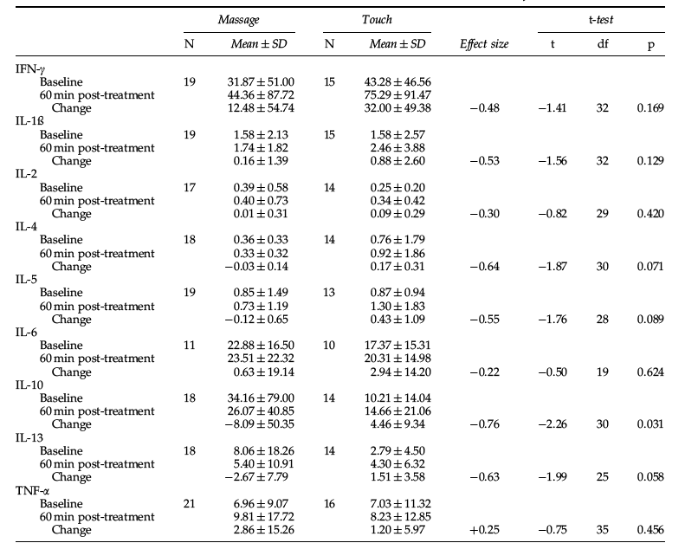
Group Means and SDs for Cytokine Concentrations from in vitro Mitogen-Stimulated Cell Cultures from Swedish Massage Therapy and Light Touch Subjects
Rapaport et al (2010) J Alter Comp Med 16(10) 1-10.

Slide 24
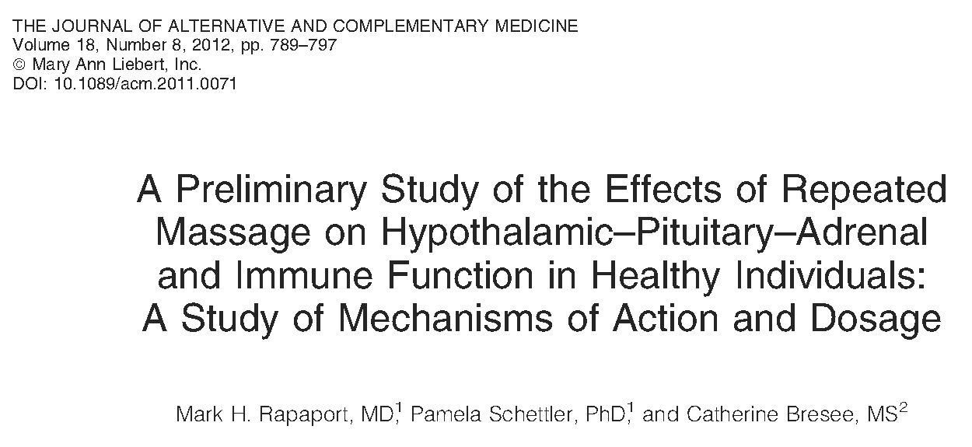

Slide 25
A Preliminary Study of the Effects of Repeated Massage on Hypothalamic-Pituitary-Adrenal and Immune Function in Healthy Individuals: A Study of Mechanisms of Action and Dosage
Hypothesis: Repeated massage therapy potentiates the biological changes identified in our study comparing a single session of massage therapy versus light touch.
We postulated:
(1) That there would be cumulative effects of five weeks of massage versus light touch interventions on biological measures
(2) That these effects would be sustained beyond the end of the intervention session
(3) That twice-weekly interventions would enhance the cumulative effects of weekly massage or light touch
Rapaport et al (2012) J Alter Compl Med 18(8):789-797.

Slide 26
Timeline for the Session
4 intervention groups
5 weeks of Swedish massage 1x/week
5 weeks of Swedish massage 2x/week
5 weeks of light touch control 1x/week
5 weeks of light touch control 2x/week
Relative to Intervention (min)
-30 | Disrobe and IV placement
-5 | Blood sampling HPA
-1 | Blood sampling HPA/Immune, Salivary Cortisol
Intervention | 45 min Swedish massage or light touch
+1 | Blood sampling HPA
+ 5 | Blood sampling HPA/Immune
+10 | Blood sampling HPA
+15 | Blood sampling HPA
+20 | Salivary Cortisol
+60 | Blood sampling for HPA/Immune
Biological samples were collected prior to and following the first and last therapy sessions.
Rapaport et al (2012) J Alter Compl Med 18(8):789-797.

Slide 27
Demographic Characteristics of Study Participants
 | Study Participants
 | N = 45
Age, Mean (SD) [Range] | 31.3 (6.4) [19-44]
Female, N (%) | 23 (51.1)
Ethnicity, N (%)
Caucasian | 22 (48.9)
Asian | 9 (20.0)
Hispanic | 8 (17.8)
African American | 5 (11.1)
Other | 1 (2.2)
Rapaport et al (2012) J Alter Compl Med 18(8):789-797.

Slide 28
Biological measures at baseline (prior to first intervention)
 | 1x/wk |  |  |  |  |  |  |  |  | 2x/wk
 | Massage |  |  |  | Touch |  |  |  |  | Massage |  |  |  | Touch
Variable | N | Mean | SD |  | N | Mean | SD |  |  | N | Mean | SD |  | N | Mean | SD
Endocrine measures
OT^{†a} | 10 | 180.4 | 89.6 |  | 12 | 179.3 | 160.8 |  |  | 10 | 180.9 | 79.7 |  | 9 | 273.7 | 173.7
AVP^{†a} | 9 | 63.53 | 42.51 |  | 12 | 76.47 | 67.87 |  |  | 8 | 69.91 | 48.06 |  | 9 | 53.77 | 33.91
ACTH^{†a} | 6 | 64.43 | 20.65 |  | 7 | 57.66 | 16.74 |  |  | 5 | 62.07 | 10.80 |  | 3 | 79.02 | 9.94
Plasma Cortisol^{†b} | 11 | 26.28 | 7.41 |  | 12 | 26.34 | 17.18 |  |  | 13 | 28.43 | 16.46 |  | 9 | 29.34 | 23.08
Salivary Cortisol^{b} | 10 | 0.613 | 0.337 |  | 11 | 0.457 | 0.316 |  |  | 13 | 0.629 | 0.438 |  | 8 | 0.521 | 0.241
Lymphocyte subset counts^{c}
Total lymphocytes | 10 | 1,801,000 | 623,760 |  | 11 | 2,249,091 | 777,399 |  |  | 12 | 2,200,583 | 1,181,110 |  | 9 | 1,768,889 | 894,350
CD4 | 10 | 724,700 | 265,321 |  | 10 | 854,300 | 292,234 |  |  | 11 | 1,036,000 | 590,346 |  | 9 | 851,111 | 529,919
CD8 | 10 | 535,100 | 278,375 |  | 10 | 617,600 | 301,879 |  |  | 11 | 607,364 | 298,152 |  | 9 | 477,889 | 213,737
CD25 | 10 | 668,700 | 311,511 |  | 10 | 671,200 | 311,313 |  |  | 11 | 719,455 | 280,984 |  | 9 | 668,222 | 632,808
CD56 | 10 | 199,580 | 78,079 |  | 10 | 395,400 | 278,000 |  |  | 12 | 254,317 | 152,689 |  | 9 | 275,078 | 143,030
In vitro cytokine levels^{d}
IFN-γ | 6 | 16.83 | 16.81 |  | 7 | 57.22 | 58.12 |  |  | 12 | 40.32 | 62.57 |  | 8 | 31.09 | 32.81
IL-1β | 6 | 1.06 | 0.76 |  | 7 | 2.38 | 3.54 |  |  | 12 | 1.25 | 1.56 |  | 8 | 0.89 | 1.13
IL-2 | 5 | 0.185 | 0.163 |  | 7 | 0.278 | 0.182 |  |  | 11 | 0.453 | 0.693 |  | 7 | 0.214 | 0.223
IL-4 | 6 | 0.311 | 0.103 |  | 8 | 1.056 | 2.379 |  |  | 11 | 0.383 | 0.421 |  | 6 | 0.355 | 0.286
IL-5 | 6 | 0.690 | 0.824 |  | 8 | 0.790 | 0.930 |  |  | 12 | 0.926 | 1.814 |  | 5 | 0.993 | 1.049
IL-6 | 4 | 31.31 | 15.19 |  | 4 | 18.92 | 14.40 |  |  | 7 | 18.06 | 16.25 |  | 6 | 16.34 | 17.15
IL-10 | 6 | 31.88 | 48.30 |  | 7 | 13.40 | 16.07 |  |  | 11 | 37.43 | 96.84 |  | 7 | 7.02 | 12.05
IL-13 | 6 | 3.98 | 6.34 |  | 7 | 2.59 | 3.18 |  |  | 11 | 10.62 | 22.99 |  | 7 | 2.98 | 5.81
TNF-α | 8 | 5.26 | 4.90 |  | 8 | 8.67 | 12.64 |  |  | 12 | 5.56 | 6.86 |  | 8 | 5.39 | 10.43
No significant differences observed among the 4 randomized groups. †Values are the average between two pre-treatment samples collected. ªIn pg/mL. ^{b}In μg/dL. ^{c}In cells/mL. ^{d}In pg/10⁴ lymphocytes.
Rapaport et al (2012) J Alter Compl Med 18(8):789-797.

Slide 29
Cumulative change between pre-treatment levels at first and final session of therapy
 | 1x/wk |  |  |  |  |  |  |  | 2x/wk |  |  |  |  |  |  | Treatment Effect Size^{e} |  |  | Dose Effect Size^{f}
 | Massage |  |  |  | Touch |  |  |  | Massage |  |  | Touch
Variable | Mean | SD |  |  | Mean | SD |  |  | Mean | SD |  | Mean | SD |  |  | 1x | 2x |  | Mass. | Touch
Endocrine measures
OTª |  | -11.2 | 39.9 |  | -13.9 | 63.6 |  |  | 0.9 | 28.1 |  | -24.7 | 21.9 | * |  | 0.05 | 0.92 |  | 0.35 | -0.22
AVPª |  | -3.99 | 10.17 |  | -7.79 | 18.96 |  |  | -7.13 | 8.65 |  | 1.82 | 4.00 |  |  | 0.24 | -1.14 |  | -0.34 | 0.64
ACTHª |  | 0.15 | 8.75 |  | 2.06 | 8.51 |  |  | -2.47 | 11.08 |  | -14.88 | 14.28 |  |  | -0.23 | 0.95 |  | -0.28 | -1.34
Plasma Cortisol^{b} |  | -2.96 | 9.60 |  | -1.25 | 7.10 |  |  | 0.06 | 11.84 |  | 2.11 | 4.49 |  |  | -0.21 | -0.22 |  | 0.28 | 0.54
Salivary Cortisol^{b} |  | -0.066 | 0.383 |  | -0.090 | 0.403 |  |  | -0.106 | 0.411 |  | 0.089 | 0.556 |  |  | 0.06 | -0.42 |  | -0.10 | 0.38
Lymphocyte subset counts^{c}
Total |  | 438,100 | 522,278 | * | -267,273 | 416,103 |  |  | -193,083 | 559,928 |  | 30,667 | 636,666 |  |  | 1.21 | -0.38 |  | -1.02 | 0.56
CD4 |  | 203,600 | 278,723 | * | -73,300 | 267,206 |  |  | -127,091 | 255,990 |  | 9,333 | 326,238 |  |  | 0.92 | -0.47 |  | -1.07 | 0.28
CD8 |  | 174,610 | 262,462 |  | -107,300 | 144,760 | * |  | -34,000 | 182,542 |  | -26,111 | 170,851 |  |  | 1.12 | -0.05 |  | -0.86 | 0.51
CD25 |  | 69,600 | 210,079 |  | -51,000 | 305,815 |  |  | -45,273 | 215,767 |  | 43,222 | 293,124 |  |  | 0.46 | -0.35 |  | -0.53 | 0.32
CD56 |  | 28,000 | 77,957 |  | -60,330 | 105,918 |  |  | 26,433 | 121,609 |  | -46,878 | 83,851 |  |  | 0.87 | 0.66 |  | -0.02 | 0.14
In vitro cytokine levels^{d}
IFN-γ |  | -1.58 | 12.04 |  | -11.94 | 42.81 |  |  | 31.95 | 56.44 |  | 10.22 | 69.32 |  |  | 0.33 | 0.36 |  | 0.69 | 0.38
IL-1β |  | 0.19 | 1.02 |  | 1.01 | 2.55 |  |  | 0.87 | 3.01 |  | -0.04 | 1.25 |  |  | -0.42 | 0.37 |  | 0.27 | -0.54
IL-2 |  | -0.075 | 0.145 |  | 0.072 | 0.278 |  |  | 0.145 | 0.592 |  | -0.011 | 0.260 |  |  | -0.62 | 0.32 |  | 0.44 | -0.31
IL-4 |  | -0.008 | 0.186 |  | -0.396 | 1.385 |  |  | 0.006 | 0.258 |  | -0.047 | 0.232 |  |  | 0.37 | 0.22 |  | 0.06 | 0.34
IL-5 |  | -0.345 | 0.546 |  | 0.071 | 0.363 |  |  | -0.035 | 0.861 |  | -0.481 | 0.722 |  |  | -0.87 | 0.54 |  | 0.40 | -0.96
IL-6 |  | 1.80 | 24.29 |  | 0.16 | 31.32 |  |  | 1.33 | 12.00 |  | 3.36 | 10.23 |  |  | 0.06 | -0.19 |  | -0.03 | 0.16
IL-10 |  | -14.32 | 23.35 |  | 21.35 | 25.41 |  |  | -8.83 | 63.34 |  | 2.42 | 11.12 |  |  | -1.19 | -0.23 |  | 0.11 | -0.89
IL-13 |  | -1.72 | 2.62 |  | 4.33 | 5.35 |  |  | -2.43 | 12.60 |  | -0.32 | 0.98 |  |  | -1.16 | -0.22 |  | -0.07 | -1.05
TNF-α |  | -2.17 | 4.19 |  | -0.37 | 7.16 |  |  | 3.46 | 7.84 |  | -1.89 | 7.19 |  |  | -0.31 | 0.68 |  | 0.80 | -0.22
Change is computed as the pre-treatment values at the final visit minus baseline levels prior to the first visit (Table 2). ªIn pg/mL. ^{b}In μg/dL. ^{c}In cells/mL., ^{d}In pg/10⁴ lymphocytes.^{e}Treatment effect sizes are computed for the effect massage contrasted with touch, within once-a-week or twice-a-week dose groups. ^{f}Dose effect sizes are computed for the effect of twice-a-week contrasted with once-a-week sessions, within massage or touch treatment groups. *Change value significantly non-zero, p < 0.05.

Slide 30
Cumulative change between baseline (pre-treatment) levels at first session and post-treatment levels after final session of therapy
 | 1x/wk |  |  |  |  |  |  |  | 2x/wk |  |  |  |  |  |  | Treatment Effect Size^{e} |  |  | Dose Effect Size^{f}
 | Massage |  |  |  | Touch |  |  |  | Massage |  |  | Touch
Variable | Mean |  | SD |  | Mean | SD |  |  | Mean | SD |  | Mean | SD |  |  | 1x | 2x |  | Mass. | Touch
Endocrine measures
OTª | 16.7 | 44.0 |  |  | 22.9 | 46.5 |  |  | 27.6 | 35.5 | * | 8.1 | 42.0 |  |  | -0.14 | 0.50 |  | 0.28 | -0.33
AVPª | -15.03 | 16.85 |  | * | -16.45 | 26.35 |  |  | -10.94 | 22.86 |  | -5.21 | 12.76 |  |  | 0.06 | -0.32 |  | 0.21 | 0.51
ACTHª | -13.93 | 4.48 |  | * | -9.86 | 8.88 | * |  | -14.73 | 16.54 |  | -13.52 | 6.49 |  |  | -0.56 | -0.09 |  | -0.07 | -0.45
Plasma Cortisol^{b} | -12.55 | 7.96 |  | * | -11.96 | 8.99 | * |  | -8.31 | 9.51 | * | -7.60 | 4.20 | * |  | -0.07 | -0.09 |  | 0.48 | 0.58
Salivary Cortisol^{b} | -0.265 | 0.275 |  | * | -0.194 | 0.291 |  |  | -0.276 | 0.337 | * | -0.064 | 0.236 |  |  | -0.26 | -0.67 |  | -0.04 | 0.48
Lymphocyte subset counts^{c}
Total lymphocytes | 716,000 | 432,286 |  | * | -206,364 | 667,717 |  |  | 182,750 | 748,594 |  | 341,250 | 928,539 |  |  | 1.27 | -0.20 |  | -0.80 | 0.67
CD4 | 292,400 | 207,087 |  | * | -86,100 | 359,759 |  |  | 14,455 | 344,471 |  | 160,250 | 572,441 |  |  | 1.10 | -0.33 |  | -0.88 | 0.53
CD8 | 230,000 | 241,410 |  | * | -72,400 | 191,147 |  |  | 75,091 | 224,935 |  | 68,375 | 218,601 |  |  | 1.15 | 0.03 |  | -0.64 | 0.67
CD25 | 162,100 | 189,023 |  | * | -43,778 | 309,379 |  |  | 32,700 | 145,960 |  | 161,125 | 517,070 |  |  | 0.77 | -0.36 |  | -0.73 | 0.49
CD56 | 83,480 | 80,403 |  | * | -57,410 | 133,018 |  |  | 73,767 | 89,264 | * | 34,075 | 110,237 |  |  | 1.09 | 0.41 |  | -0.12 | 0.71
In vitro cytokine levels^{d}
IFN-γ | -3.86 | 10.70 |  |  | -0.95 | 72.86 |  |  | 51.57 | 76.48 | * | 31.09 | 89.99 |  |  | -0.06 | 0.26 |  | 0.82 | 0.40
IL-1β | 0.32 | 0.62 |  |  | 0.84 | 2.25 |  |  | 4.44 | 13.76 |  | 0.52 | 0.95 |  |  | -0.33 | 0.36 |  | 0.37 | -0.20
IL-2 | -0.055 | 0.114 |  |  | 0.099 | 0.375 |  |  | 0.179 | 0.701 |  | 0.104 | 0.119 |  |  | -0.54 | 0.14 |  | 0.40 | 0.02
IL-4 | -0.002 | 0.103 |  |  | -0.683 | 1.936 |  |  | 0.096 | 0.315 |  | 0.042 | 0.380 |  |  | 0.48 | 0.17 |  | 0.38 | 0.50
IL-5 | -0.333 | 0.519 |  |  | 0.322 | 0.608 |  |  | 0.083 | 1.394 |  | 0.118 | 1.306 |  |  | -1.02 | -0.03 |  | 0.35 | -0.22
IL-6 | -2.98 | 35.02 |  |  | -0.75 | 16.66 |  |  | 6.04 | 9.55 |  | 9.56 | 12.91 |  |  | -0.09 | -0.33 |  | 0.43 | 0.70
IL-10 | -13.64 | 24.77 |  |  | 40.83 | 88.70 |  |  | -8.23 | 68.46 |  | 2.11 | 3.14 |  |  | -0.80 | -0.20 |  | 0.10 | -0.64
IL-13 | -1.91 | 3.53 |  |  | 2.56 | 2.09 | * |  | -3.73 | 15.11 |  | -0.56 | 3.53 |  |  | -1.24 | -0.27 |  | -0.15 | -0.96
TNF-α | -2.51 | 4.51 |  |  | 1.53 | 9.56 |  |  | 6.41 | 12.65 |  | -1.04 | 4.92 |  |  | -0.57 | 0.68 |  | 0.81 | -0.36
Change is computed as the post-treatment values at the final visit minus baseline levels prior to the first visit. ªIn pg/mL. ^{b}In μg/dL. ^{c}In cells/mL. ^{d}In pg/10⁴ lymphocytes. ^{e}Treatment effect sizes are computed for the effect massage contrasted with touch, within once-a-week or twice-a-week dose groups. ^{f}Dose effect sizes are computed for the effect of twice-a-week contrasted with once-a-week sessions, within massage or touch treatment groups. *Change value significantly non-zero, p < 0.05.

Slide 31
Conclusions
Weekly and twice-weekly interventions differ from one another for both massage and touch- both interventions are active.
Weekly massage is biologically similar to a single session of massage but there is a cumulative enhance of immune system effects- this enhancement is sustained over 7 days between sessions.
Twice-weekly massage had greater hormonal effects: moderate ES increase in oxytocin and decrease in AVP but the effects on immune system were no longer significant.
The sample size for this proof of concept study is small and so all of the findings must be considered preliminary and requiring replication with a larger study.
Floor effects may limit the biological difference of the interventions in unstressed healthy volunteers.
Rapaport et al (2012) J Alter Compl Med 18(8):789-797.

Slide 32
These data suggested to us that twice-weekly massage might be a good treatment for anxiety disorders
Let’s think about GAD!

Slide 33
Generalized Anxiety Disorder (GAD)
A. Excessive anxiety and worry occurring more days than not for at least 6 months about a number of events or activities
B. The individual finds it difficult to control the worry
C .The anxiety and worry are associated with at least 3 of the following symptoms more days than not for at least 6 months:
  Restlessness or feeling keyed up, fatigued, difficulty concentrating, irritability, muscle tension, sleep disturbance
D. The anxiety, worry or physical symptoms cause significant distress or impairment
DSM 5, 2013; APA

Slide 34
GAD is
Prevalent: 2-3% annual and 5% lifetime
Persistent: patients with GAD spend the majority (up to 74%) of time after onset with persistent symptoms
Disabling: 72% of respondents to an Australian study of GAD had SF-12 scores in the moderate to severe range
Associated with suicide risk
Weisberg J Clin psychiatry 2009:70[suppl2]; 4-9;Bruce et al AM J Psychiatry
2005;162:1179-1187; Sanderson & Andrews Psychiatr Serv 2002;53:80-86/

Slide 35
Current Treatments for GAD
Medications: SSRIs, SNRIs, hydroxyzine, TCAs, MAOIs
Psychotherapies: CBT, CT, Relaxation therapy, ACT, Mindfulness therapy

Slide 36
Efficacy of Massage Therapy for the Treatment of Generalized Anxiety Disorder
NCCAM R21AT004208
Clinicaltrials.gov NCT01337713

Slide 37
Efficacy of Massage Therapy for the Treatment of Generalized Anxiety Disorder
Hypothesis 1 – Six weeks of massage therapy will decrease symptoms of GAD and enhance feelings of wellbeing more than a light touch control condition.
Hypothesis 2 - Individuals receiving 12 weeks of Swedish massage therapy will have a greater reduction in symptoms of anxiety than individuals receiving 6 weeks of Swedish massage therapy.
Hypothesis 3 - Six weeks of Swedish massage therapy will increase oxytocin secretion, decrease secretion of arginine vasopressin (AVP), decrease serum and salivary cortisol levels, and decrease ACTH levels more than 6 weeks of light touch for subjects with GAD.

Slide 38
Efficacy of Massage Therapy for the Treatment of Generalized Anxiety Disorder
Inclusion:
Between the ages of 18 and 65
Medically healthy (normal history/physical examination)
Meet criteria for a primary diagnosis of current GAD
- structured clinical interview for DSM-IV (SCID), with HRSA >14
Subjects with comorbid but secondary anxiety disorders (excluding OCD), major depressive disorder, and dysthymic disorders will be included.
NCCAM R21AT004208, Clinicaltrials.gov NCT01337713

Slide 39
 | Screening Visit | Visit 1 | Visits 2-11 | Visit 12 | Visit 13-23 | Visit 24 | 1 week Follow-up Phone Call
Office Visits | 2 Treatment Visits per week for 12 weeks
Massage or Touch Therapy |  | x | x | x | x | x
Initial Psychiatric Evaluation | x
Physical Exam/ Medical History | x
BP & Pulse | x | x | x | x | x | x
Clinician Rated Assessments | x | x | x | x | x | x | x
Self Report Assessments | x | x | x | x | x | x
Blood draw for clinical labs | x
Blood draw for research labs |  | x |  | x |  | x
Urine collection | x *
Saliva collection |  | x | x° | x | x° | x
* Urine drug screens may be performed at other visits should the study physician deem it necessary.
° Saliva will be collected at every even number visit (i.e. 2, 4, 6…) during Visits 2-11 and 13-23.
NCCAM R21AT004208, Clinicaltrials.gov NCT01337713

Slide 40
Efficacy of Massage Therapy for the Treatment of Generalized Anxiety Disorder
Diagnostic & Symptomatic Measures:
Structured Clinical Interview for DSM-IV Axis I Disorders - Patient Edition (SCID)
Hamilton Rating Scale for Depression (HRSD)
Hamilton Rating Scale for Anxiety (HRSA)
Credibility – Expectancy Questionnaire
Profile of Mood States(POMS) - Brief
Quick Inventory of Depressive Symptomatology – Self Report (QIDS-SR)
Quality of Life Enjoyment and Satisfaction Questionnaire (Q-LES-Q)
Spielberger State Anxiety Inventory (STAI-State)
Spielberger Trait Anxiety Inventory (STAI-Trait)
Visual Analogue Scale (VAS)
Research labs: oxytocin, arginine vasopressin (AVP), serum and salivary cortisol, ACTH, CRP, IL-6, TNF-a, IL-1RA
NCCAM R21AT004208, Clinicaltrials.gov NCT01337713

Slide 41
Demographics
 |  |  | Swedish Massage (N=21) | Light Touch (N=19) | Significance
Age (Years) |  | Mean (sd) [Range] | 36.0 (13.8) [21 – 68] | 37.4 (13.1) [20 – 65] | t df P -0.33 38 0.742
Sex | Female Male | N (%) N (%) | 17 (81.0) 4 (19.0) | 15 (78.9) 8 (20.0) | FET^{b} P = 1.000
Race | Caucasian African/African- Amer/Haitian Asian | N (%) N (%) N (%) | 13 (61.9) 6 (28.6) 2 (9.5) | 13 (68.4) 3 (15.8) 3 (15.8) | FET^{b} P = 0.641
Ethnicityª | Hispanic Non-Hispanic | N (%) N (%) | 0 (0.0) 21 (100.0) | 1 (5.6) 17 (94.4) | FET^{b} P = 0.462
Marital Statusª | Married or Living Together Separated/Divorced/Widowed Never Married | N (%) N (%) N (%) | 8 (40.0) 2 (10.0) 10 (50.0) | 6 (31.6) 3 (15.8) 10 (52.6) | FET^{b} P = 0.824
Educationª | High School College Graduate School | N (%) N (%) N (%) | 1 (5.0) 9 (45.0) 10 (50.0) | 2 (11.1) 7 (38.9) 9 (50.0) | FET^{b} P = 0.894
Employment Statusª | Student Employed – Professional Employed – Other Other | N (%) N (%) N (%) N (%) | 4 (20.0) 8 (40.0) 5 (25.0) 3 (15.0) | 3 (16.7) 6 (33.3) 5 (27.8) 4 (22.2) | FET^{b} P = 0.968
a. Information is missing for some subjects, as indicated by sum of Ns. b. Fisher Exact Test (FET) probability (two-tailed) was calculated for 2 x 2 tables, and the Freeman-Halton extension was used for tables larger than 2 x 2.

Slide 42
Clinical Measures
 |  | Swedish Massage (N=21) | Light Touch (N=19) | Significance
Hamilton Anxiety Rating Scale |  |  |  | t df P
Total Score^{c} | Mean (sd) [Range] | 20.05 (3.34) [15 - 25] | 19.58 (4.90) [15 - 31] | 0.36 38 0.724
Psychic Anxiety^{d} | Mean (sd) [Range] | 9.29 (2.03) [7 – 13] | 9.00 (2.56) [5 – 16] | 0.39 38 0.696
Somatic Anxiety^{e} | Mean (sd) [Range] | 9.33 (2.44) [5 – 13] | 9.47 (2.93) [5 – 16] | -0.17 38 0.870
STAI – State Anxiety | Mean (sd) [Range] | 51.62 (11.26) [30 - 74] | 50.90 (11.12) [34 – 73] | 0.20 38 0.839
STAI – Trait Anxiety | Mean (sd) [Range] | 50.86 (11.20) [26 – 69] | 52.37 (8.02) [38 – 71] | -0.49 38 0.630
Hamilton Depression Rating Scale - Item Version (HAM-D17) | Mean (sd) [Range] | 16.95 (5.11) [8 – 26] | 15.05 (4.31) [10 – 23] | 1.26 38 0.214
Quick Inventory of Depressive Symptomatology – QIDS-SR16 | Mean (sd) [Range] | 10.62 (3.88) [6 - 17] | 9.63 (3.99) [3 - 18] | 0.79 38 0.433
Profile of Mood States (POMS) – Total Negative Affect Score^{f} | Mean (sd) [Range] | 35.19 (17.49) [4 – 63] | 28.32 (15.21) [2 – 62] | 1.32 38 0.195
c. Sum of 14 items, rated 0-4, for a possible score of 0 to 56. d. Sum of items 1, 2, 3, 5, and 14 (anxious mood, tension, fears, intellectual difficulties, and anxious behavior at interview) with a possible range of 0 to 20. e. Sum of items 4, 7, 8, 9, 10, 11, 12, and 14 (insomnia, somatic-muscular, somatic-sensory, cardiovascular, respiratory, gastrointestinal symptoms, genito-urinary, and autonomic symptoms) with a possible range of 0 to 32. f. POMS Negative Affect score is the sum of Tension-Anxiety, Depression, Anger-Hostility, Fatigue-Inertia, and Confusion-Bewilderments, minus Vigor-Activity, with a total possible range of -20 to 100.

Slide 43
Co-morbid Diagnoses
 |  |  | Swedish Massage (N=21) | Light Touch (N=18)^{g} | Significance (FET^{b} P)
Major Depression | Current Lifetime | N (%) N (%) | 2 (9.5) 13 (61.9) | 1 (5.6) 8 (44.4) | 1 0.343
Dysthymia | Current | N (%) | 1(4.8) | 2 (11.1) | 0.586
Depression – NOS | Current Lifetime | N (%) N (%) | 0 (0.0) 1 (4.8) | 0 (0.0) 0 (0.0) | 1 1
Any Depression Dx | Current Lifetime | N (%) N (%) | 2 (9.5) 14 (66.7) | 2 (11.1) 9 (50.0) | 1 0.342
Alcohol Abuse Drug Abuse Dx Either of Above | Past ^{h} Past ^{h} Past ^{h} | N (%) N (%) N (%) | 4 (19.0) 2 (9.5) 4 (19.0) | 3 (16.7) 0 (0.0) 3 (16.7) | 1 0.49 1
Body Dysmorphic Disorder | Current | N (%) | 1 (4.8) | 0 (0.0) | 1
Binge Eating | Lifetime | N (%) | 0 (0.0) | 3 (16.7) | 0.089
Other Anxiety Dx besides GAD ^{i} | Current Lifetime | N (%) N (%) | 10 (47.6) 15 (71.4) | 6 (33.3) 13 (72.2) | 0.516 1
b. Fisher Exact Test (FET) probability (two-tailed) was calculated for 2 x 2 tables, and the Freeman-Halton extension was used for tables larger than 2 x 2. g. SCID form cannot be located for 1 subject in the Touch group, so information was not entered into the database. h. Subjects with substance abuse disorder within the past 6 months were excluded from the study. i. Other Anxiety Disorder diagnoses include Panic Disorder, Agoraphobia, Social Anxiety, Specific Phobias, OCD, PTSD, and Anxiety-NOS. The most frequent were Social Anxiety (lifetime rate for 33.3% for both treatment groups) and Specific Phobias (lifetime rate of 38.1% for Massage and 33.3% for Touch group).

Slide 44
At the end of 6 weeks, subjects with GAD who received twice-weekly SMT demonstrated greater statistically and clinically significant improvement in HRS-A than subjects receiving LT (MMRM, *=p<0.05)
Visit Number
LS Mean (Sem)
*
Light Touch
*
*
Swedish Massage Therapy
*
*
*
*

Slide 45
Further analyses of Anxiety Findings
HRSA psychic anxiety ( ES=-.429) and somatic anxiety(ES= -.552) subscales demonstrated greater improvement with SMT vs. LT.
The STAI-sate anxiety scale demonstrated greater improvement for SMT than LT ( ES=-.675; p=0.065)
Response rates were: 52.4% SMT vs. 36.7% for LT; p=.324

Slide 46
At the end of 6 weeks, subjects with GAD who received twice-weekly SMT demonstrated greater statistically and clinically significant improvement in the self rated QIDS than subjects receiving LT (MMRM, *=p<0.05)
Visit Number
LS Mean (Sem)
*
*
*
Light Touch
*
*
*
Swedish Massage Therapy
*
*

Slide 47
Further analysis of Ratings
SMT significantly decreased the HDRS more for SMT than LT : -11.67 (1.09) vs -8.41 ( 1.01); ES=-.8443; p=.027)
POMS total negative affect scores were significantly improved by SMT vs. LT ( ES=-.767; p=.047)
SMT ( vs. LT) caused significant decreases in several relevant POMS subscales: anger- hostility ( ES= -.819; p=.034), fatigue-inertia ( ES= -.657; p.009) and depression (ES-645; p=.091)

Slide 48
What about credibility/expectancy bias?
At baseline, SMT had significantly higher CEQ credibility and expectancy scores than LT:
1.39 (1.68) vs. -1.54 (2.77) p<.001; and 1.18 ( 2.36) vs. -1.31 (2.55) p=.003
Credibility measures did not correlate with response to SMT or LT
Expectancy measures only weakly correlated with response r² = .075 to SMT.
Neither credibility nor expectancy scores influenced drop out rates

Slide 49
How long do we have to treat?
Hypothesis 2 - Individuals receiving 12 weeks of Swedish massage therapy will have a greater reduction in symptoms of anxiety than individuals receiving 6 weeks of Swedish massage therapy.
Although individuals receiving 24 sessions of SMT over 12 weeks had slightly lower total scores, they did not clinically nor statistically differ from those receiving 12 sessions over 6 weeks

Slide 50
Is there any long term durability of effect?
MAYBE….

Slide 51
Preliminary follow-up data about the durability of effect of SMT. Forty percent of subjects remained symptom free at the time of the follow-up call (6-18 months after treatment stopped). Of subjects who had a recurrence of symptoms of GAD, 64% indicated that a life event contributed to a return of symptoms.
In the last 7 days, have you -
Always
Often
Sometimes
Rarely
Never
Data are mean +/- SD

Slide 52
Preliminary Data about the richness of subjects lives at 6-18 month follow-up
In the last 7 days, how would you rate your-
Poor
Not very
good
So-So
Good
Very Good
Data are mean +/- SD

Slide 53
Biological data and treatment
Hypothesis 3 - Six weeks of Swedish massage therapy will increase oxytocin secretion, decrease secretion of arginine vasopressin (AVP), decrease serum and salivary cortisol levels, and decrease ACTH levels more than 6 weeks of light touch for subjects with GAD.
We lost the OT and AVP data because of assay problems, but SMT caused a moderate effect size (ES= -0.534) decrease in resting pulse, and….

Slide 54
Improvement in HRSA was correlated with changes in cortisol levels for SMT but not LT
Change in HRSA
SMT
Change in Cortisol

Slide 55
Conclusions: for subjects with GAD
12 sessions of SMT decreased symptoms of anxiety, depression, fatigue, and irritability more than LT
24 sessions of SMT was not statistically better than 12 sessions in our pilot study
Preliminary follow-up data suggest that there may be some lasting benefits to acute treatment with SMT
SMT caused a decrease in resting pulse and the decrease in HRSA correlated with a decrease in cortisol levels.

Slide 56
Overall Conclusions
A well integrated team of investigators with training from a variety of disciplines can work together to move forward research about the biological, psychological and treatment effects of massage therapy.
The future is bright if we can get the funds to pursue the work!

Slide 57
Thank you NCCIH for funding this work

