Slide 1


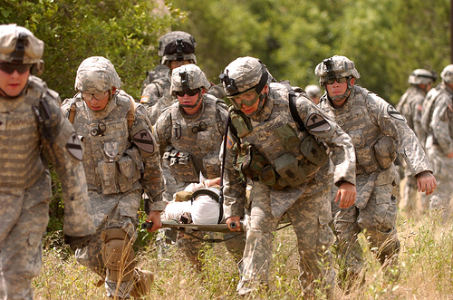
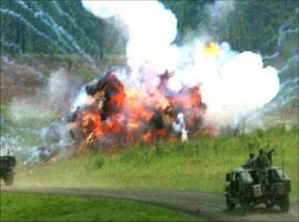
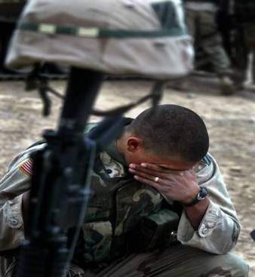
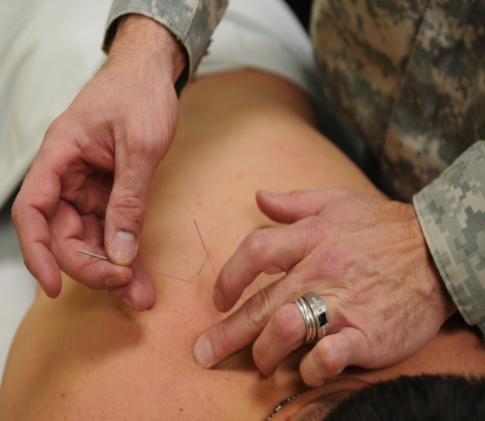
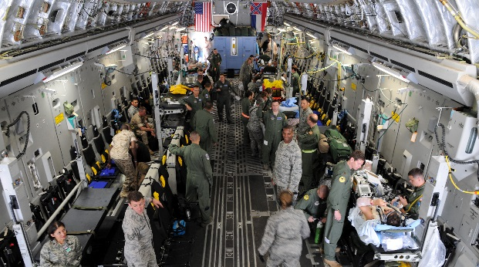

“ Comprehensive Pain Management: DoD, DVA, DHHS—A Whole of Government Approach”
International Massage Therapy Research Conference
9 MAY 2019
Eric B. Schoomaker, MD, PhD, FACP, Lieutenant General US Army (retired)
42nd Army Surgeon General and Former Commanding General,
US Army Medical Command

Slide 2
Disclosures
Financial relationships with commercial interests:
    Eric B. Schoomaker, MD, PhD has documented that he has nothing personal to disclose. His spouse is a yoga therapist, mindfulness teacher and co-owner of Myndwell, a mindfulness training program.
This presentation does not contain off-label or investigational use of drugs or products
The opinions expressed represent solely the views of the presenter and do not reflect official policy of the DoD or USU.

Slide 3
Brief Overview of Roles & Missions of DoD Medicine:
Military Health System (MHS)
Executes a vertically integrated health promotion & healthcare delivery system for 9.5 M beneficiaries: prevention; health promotion; acute care thru rehabilitation—garrison and deployed
Funds and conducts requirements-based research
Directs care through policy development and implementation
Part of a continuum of healthcare delivery with the Veterans Health Administration (VHA) and other elements of Federal Medicine

Slide 4
Research Initiatives and Priorities in
DoD Pain Management
Translational/implementation science—evidence-based, effective care into practice
Focus on pain management while tackling opioid overuse, abuse and use disorder
Alignment with other Federal Medicine partners, esp. VA
Enhancing a “whole of Government” approach to pain management

Slide 5

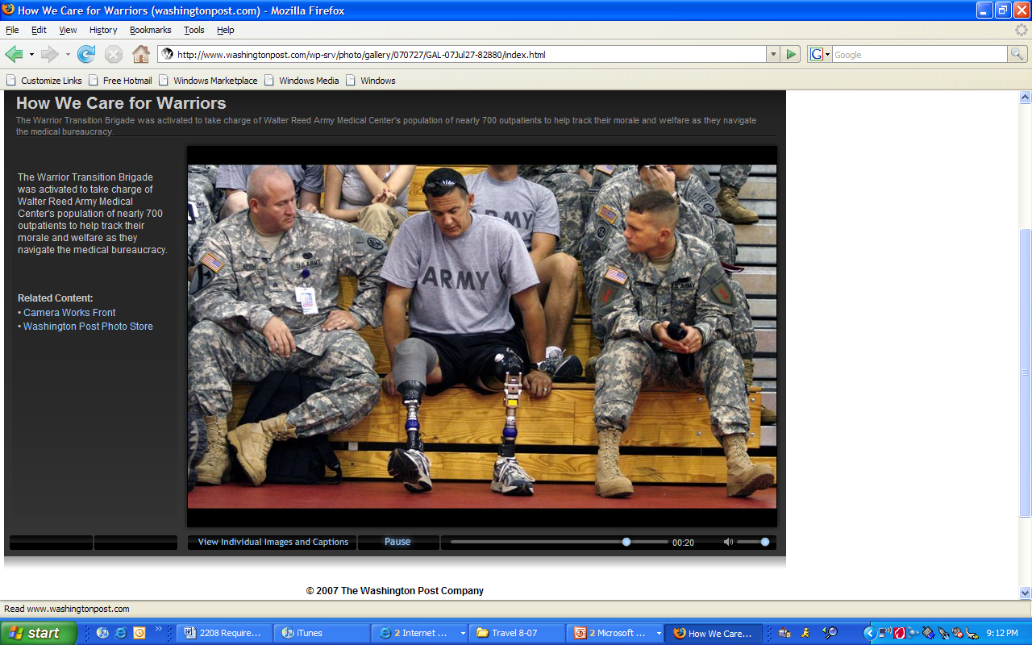

Unprecedented Battlefield Survival
Improvements on the battlefield
  Better trained medics
  Improved equipment
  Far forward emergency & surgical care
Improvements in evacuation
Improvements in recovery & rehabilitation

Slide 6
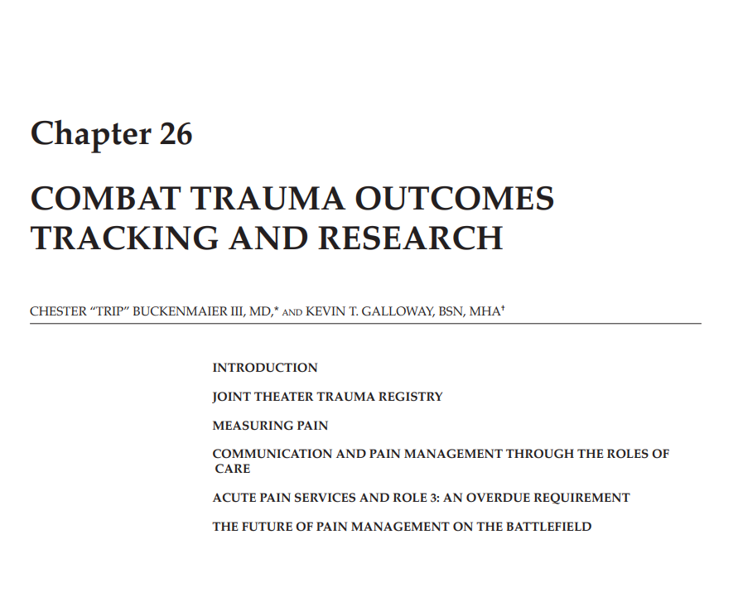
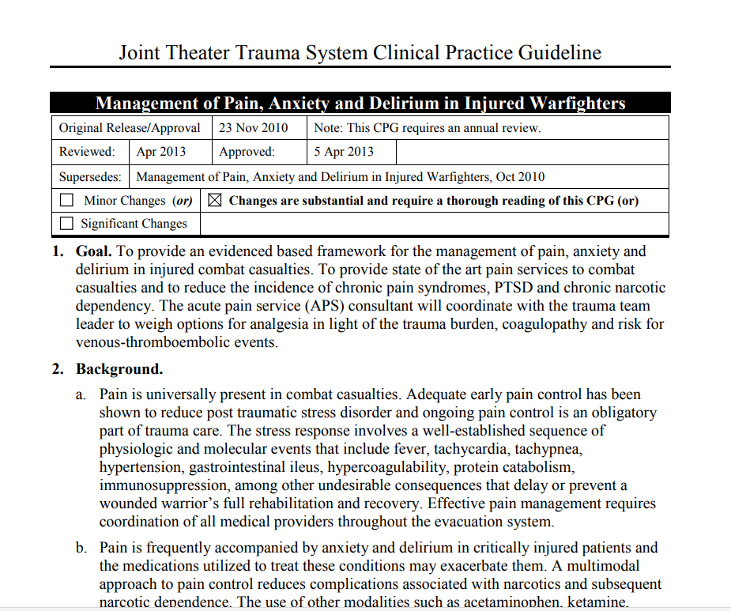
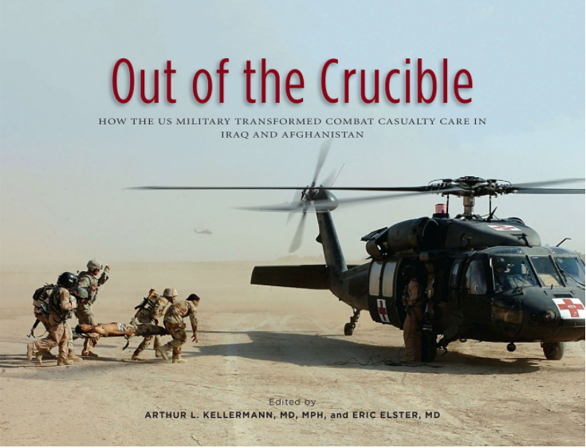

Slide 7
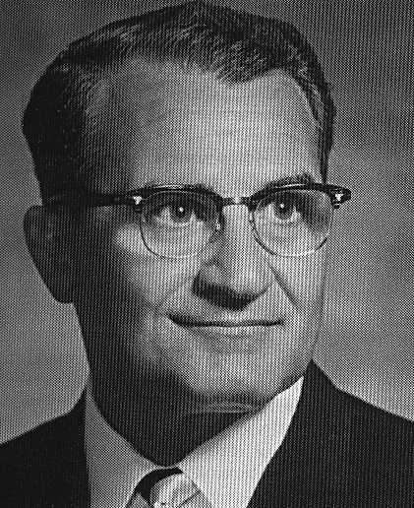
The proper management of pain remains, after all, the most important obligation, the main objective, and the crowning achievement of every physician.
John J. Bonica, M.D. in The Management of Pain (1953)
[Former Chief of Anesthesiology, MAMC 1944-1947]
Treating pain is one of medicine’s oldest and most fundamental responsibilities, yet modern medicine continues to be challenged in its efforts to understand and treat acute and chronic pain.
DoD Pain Management Task Force Report (2010)
Notes:
7

Slide 8
The Pain Challenge in VHA: DoD is the Gateway
In Veterans, chronic pain is common.
  Veterans: more than 50% of older Veterans experience chronic pain
    60% of Veterans from Middle East conflicts;
    Up to 75% of female Veterans
  More than 2 Mil Veterans with chronic pain diagnosis (In 2012, 1/3 on opioids)
National Health Interview Survey (NHIS) (2016)
    66% of Veterans vs. 56% of non-veterans with pain in prior 3 month
    Most common pain conditions in Veterans (as % of all Veterans):
      Joint pain (43.6%)
      Back pain (32.8% - axial 20.5%, sciatica 12.2%)
      Neck pain (15.9%)
      Migraine (10.0%)
      Jaw pain (3.6%)
NHIS: interview of 67,696 US adults in 2010-14
}
Musculoskeletal pain conditions
    Nahin RL, J. Pain 2016

Slide 9
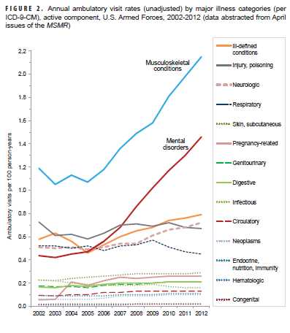
Rising Musculoskeletal & Mental Disorders—Ambulatory Visits

Slide 10
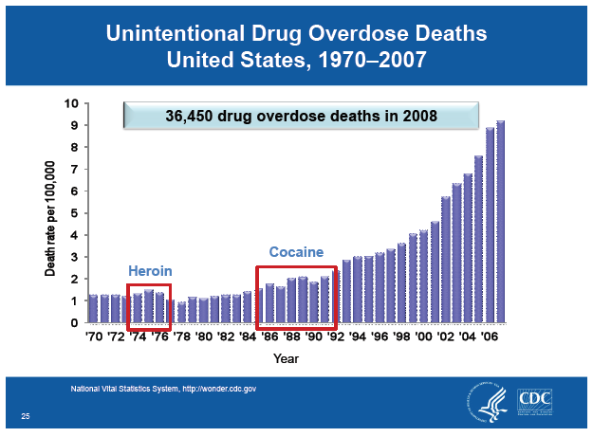
Problems of Polypharmacy and
Prescription Drug Deaths
Prescription Opioids

Slide 11

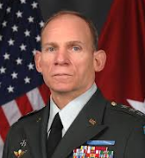
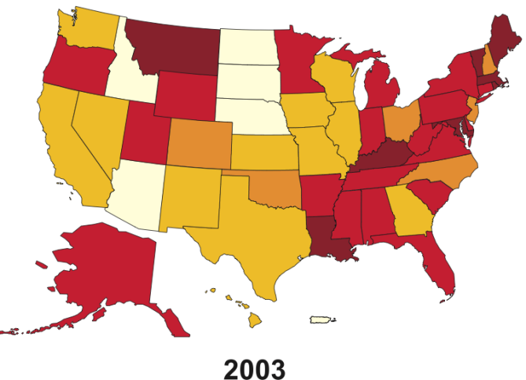
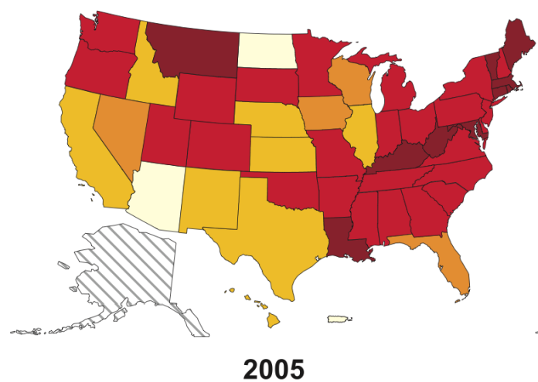
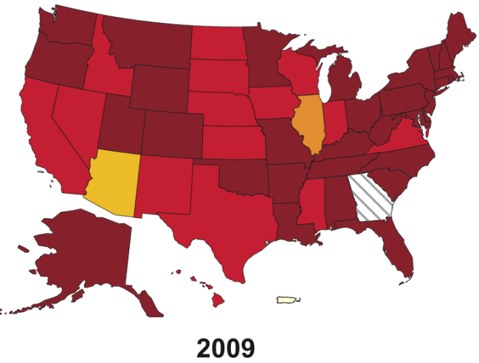
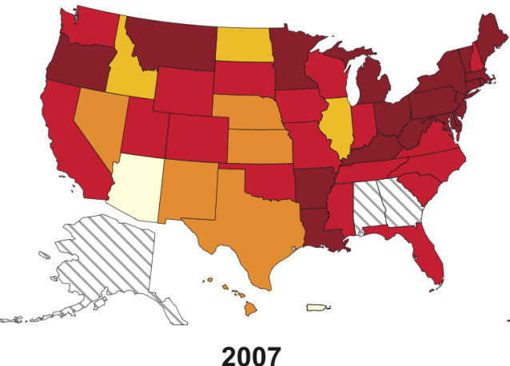
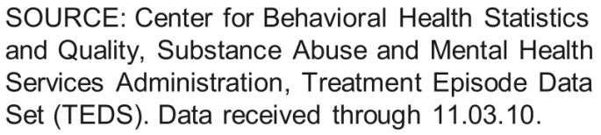
An Epidemic in Opioid Problems in the US

Slide 12
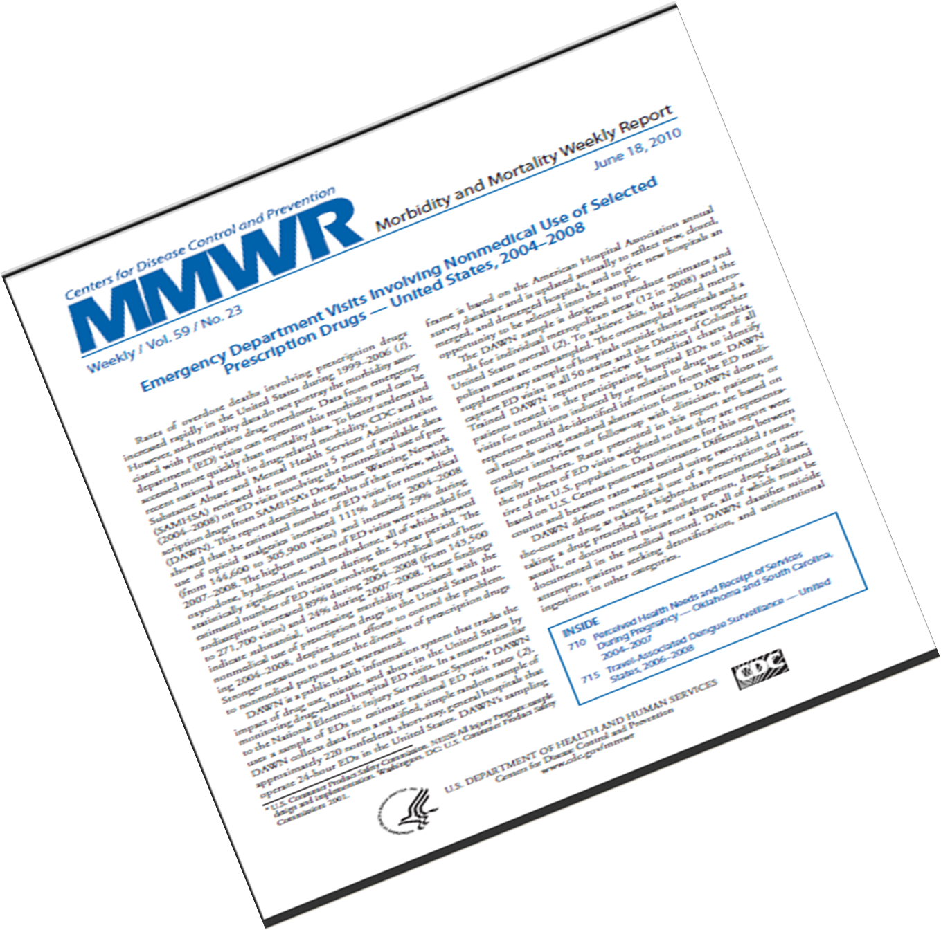
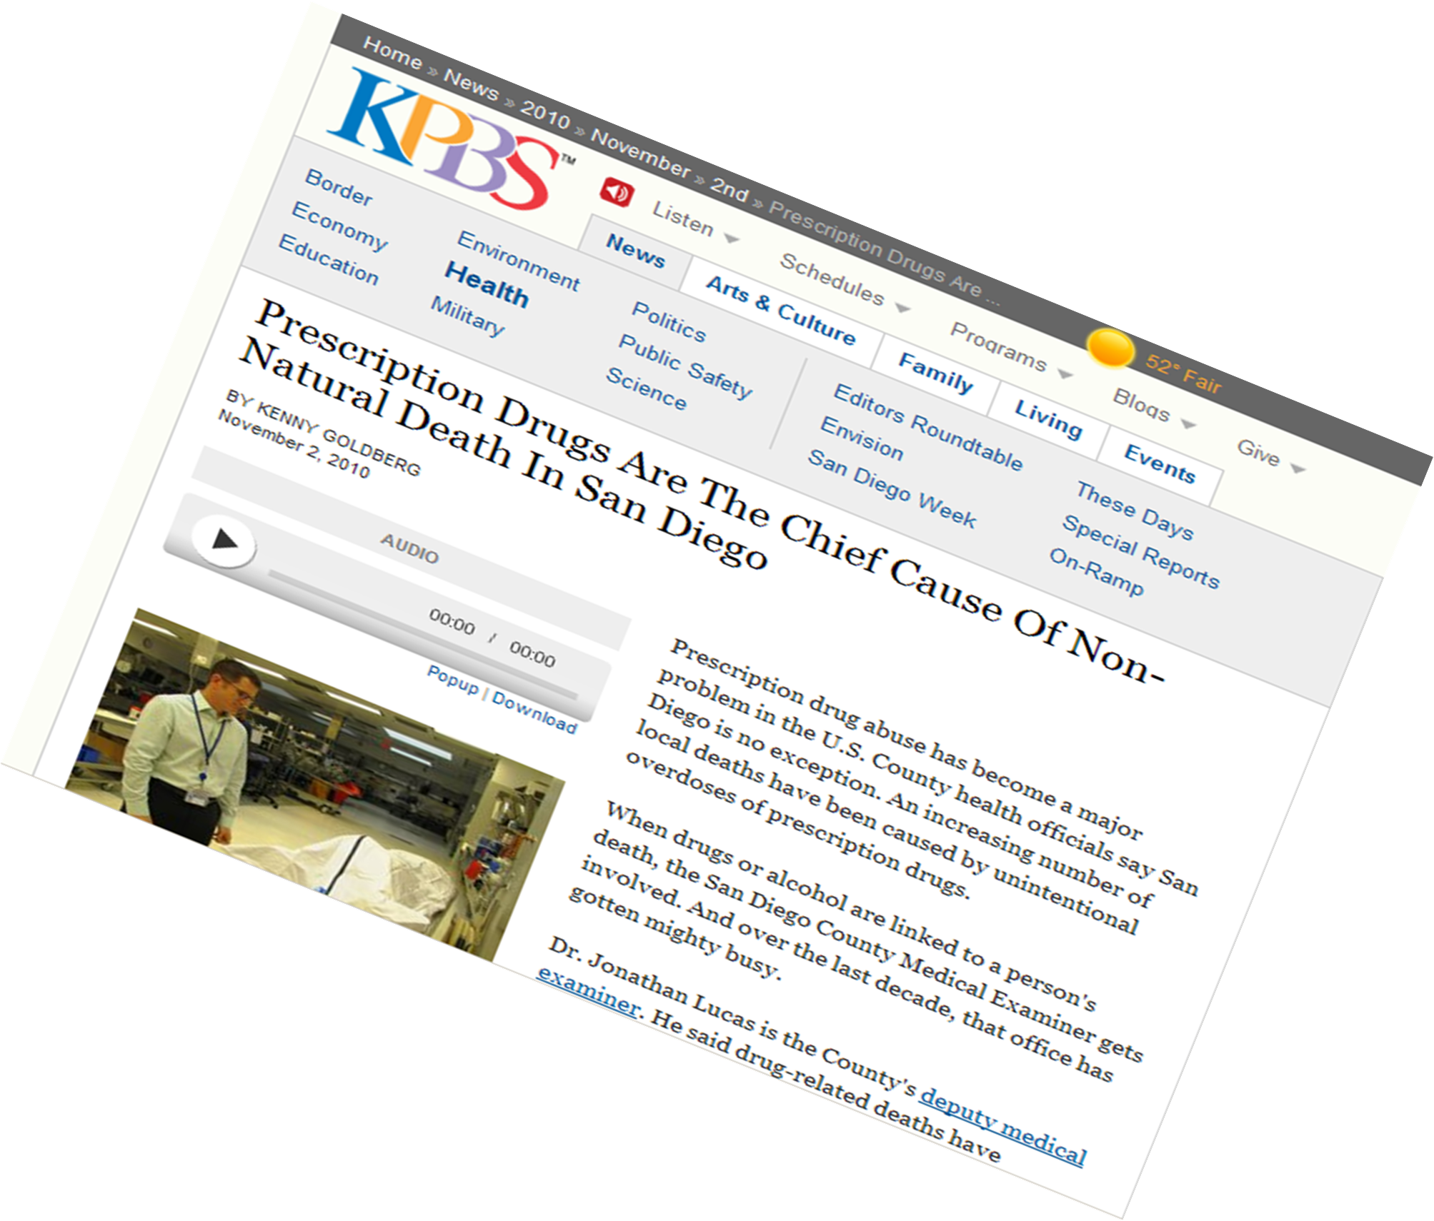
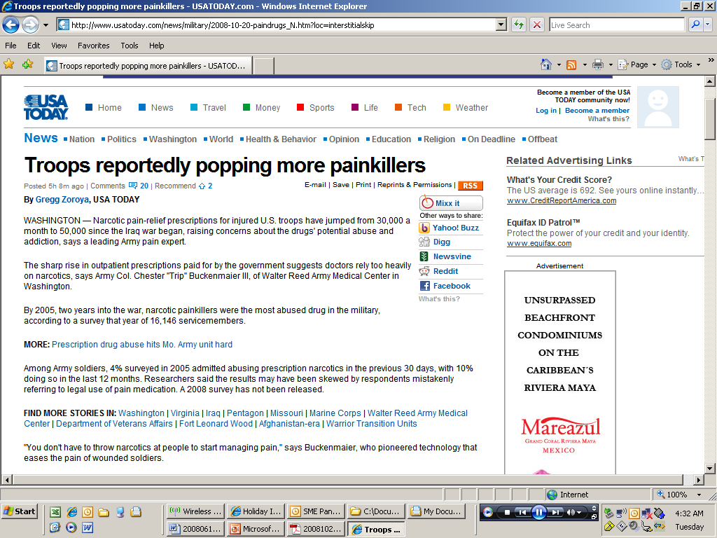
And we weren’t exempt

Slide 13
We do not have an epidemic of opioid overuse, misuse, abuse, diversion and use disorder (addiction).
We have an epidemic of epidemics.

Slide 14


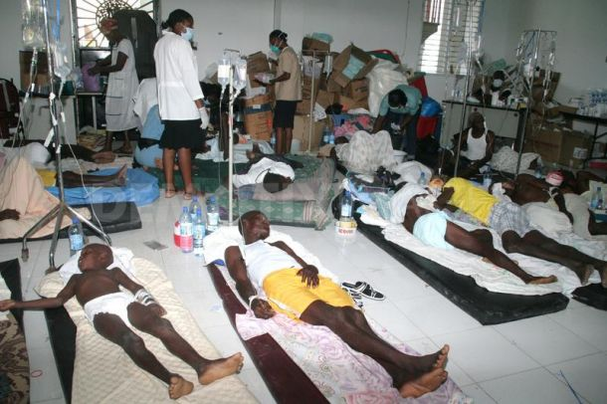
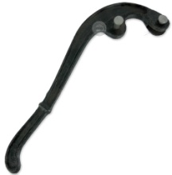

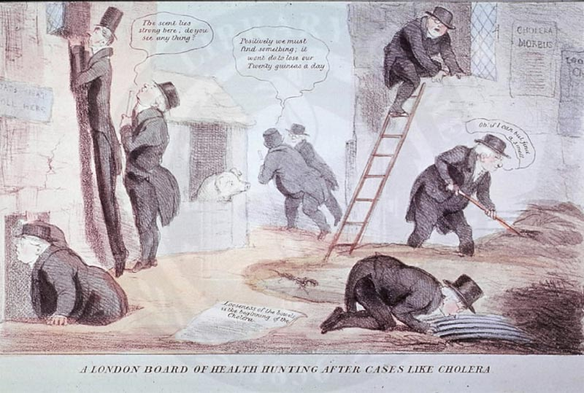
Another epidemic: Cholera
Managing An Epidemic
London, 1854:
Cholera, John Snow and the Broad Street Pump

Slide 15
The intersection of mind & body
Prevalence of Chronic Pain, PTSD and TBI in
a sample of 340 OEF/OIF veterans with polytrauma
Chronic Pain
N=277
81.5%
PTSD
N=232
68.2%
16.5%
2.9%
10.3%
42.1%
12.6%
6.8%
TBI
N=227
66.8%
5.3%
Lew, Otis, Tun et al., (2009). Prevalence of Chronic Pain, Post-traumatic Stress Disorder and Post-concussive Symptoms in OEF/OIF Veterans: The Polytrauma Clinical Triad. JRRD.
Slide 15

Slide 16
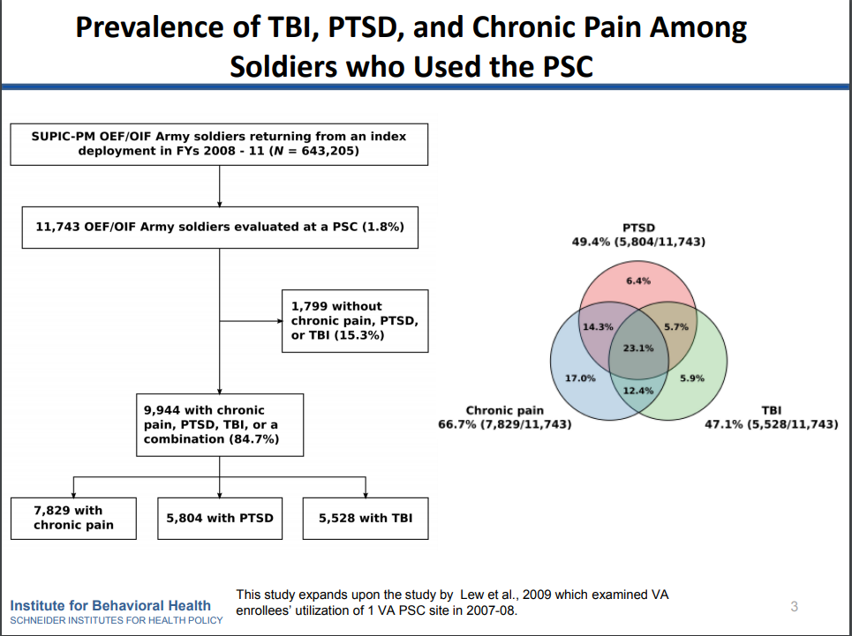

Slide 17
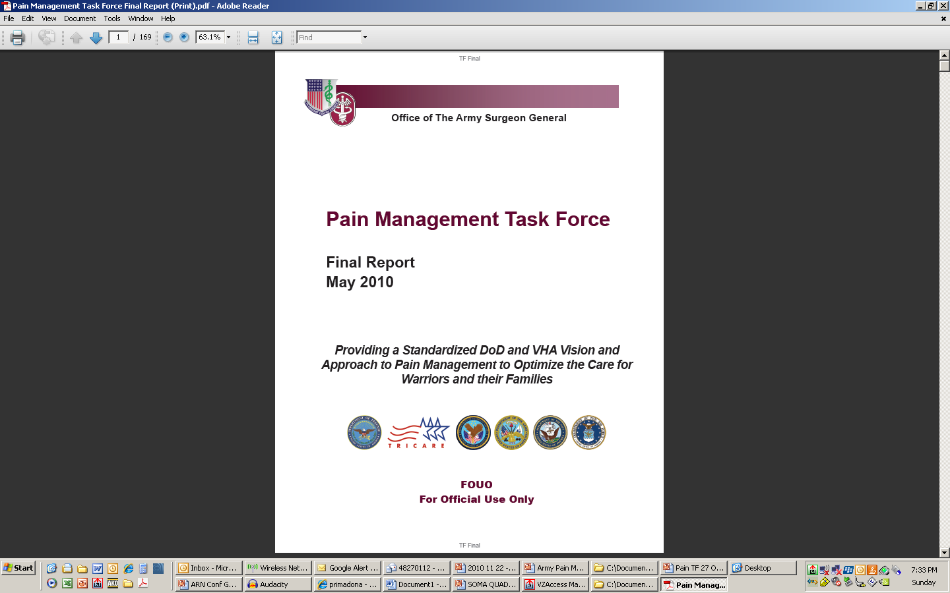

Pain Management Task Force
  Provide recommendations for a DoD comprehensive pain management strategy that is holistic, multidisciplinary, and multimodal in its approach, utilizes state of the art/science modalities and technologies, and provides optimal quality of life for Soldiers and other patients with acute and chronic pain.
  Army Pain Management Task Force Charter; signed 21 Aug 2009
      Relieving Pain in America: A Blueprint for Transforming Prevention, Care, Education and Research
        Institute of Medicine; June 2011

Slide 18


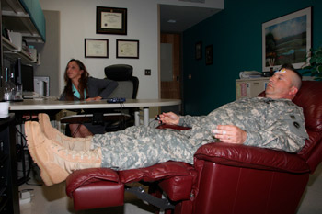
Comprehensive
Pain Management
Evidence-Based Complementary and
Alternative Therapeutic Modes
  Acupuncture
  Biofeedback
  Yoga
  Meditation
Standardizes Pain Management
Services at echelons of care across
our Medical Treatment Facilities:
Team-Based
Provides optimal quality of life for
Soldiers and patients with acute and
chronic pain
Interdisciplinary
Since PMTF Report have added:
Music therapy
Mindfulness Meditation
Medical Massage
Chiropractic
Tai Chi/Qi Gung
Holistic
Multimodal

Slide 19
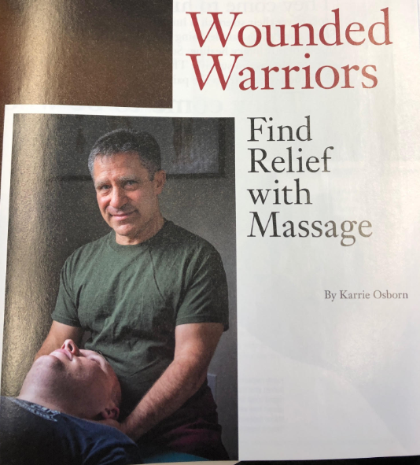
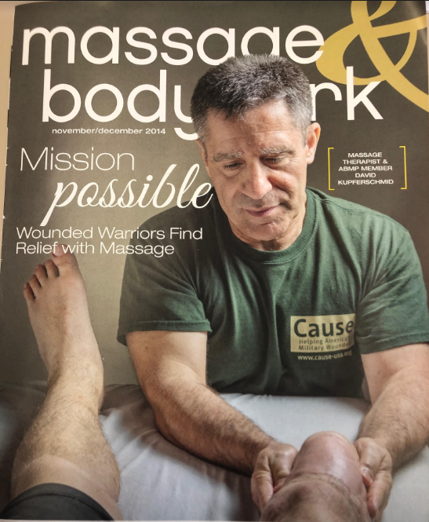


Proven value of massage therapy in wounded, ill and injured warrior care…

Slide 20
Evolution of Federal Medicine Pain Management & Opioid Safety
NIH Interagency Pain Research Coordinating Committee
DVCIPM designated as
DoD CoE for Pain Mgt
FEB 2016
HEC Pain Mgt Work Group Chartered
Mandate/Organizations
Institute of Medicine:
IAW Affordable Care Act
Comprehensive Addiction and Recovery Act (CARA)
Army/DoD Pain Mgt Task Force
NCCIH National Advisory Council
Presidential Memorandum: Prescription Med and Heroin Abuse
DoD PMWG Chartered
2009 - 2010
2011 - 2012
2013
2014 - 2015
2016 - 2018
Products/Deliverables
DoD Battlefield Pain Mgt CPG
Pres Memo Directed: DoD Opioid Prescriber Training
VHA Pain Mgt Directive: 2009-053
IOM “Pain in America” Report
CDC: Opioid Guidelines
MHS Policy Comprehensive Pain Management
DoD/VA Opioid Clinical Practice Guideline
Pain Management Task Force Report
DHA PI: Pain Mgt and Opioid Safety
NCCIH Report: Strengthening Collaborations w/ DoD and VA on CIH Pain Therapies
HHS National Pain Strategy
Army Comprehensive Pain Management Campaign
Navy Comprehensive Pain Management Program
NCCIH/DoD/VA Pain Research Collaboratory
Notes:
2009
• VHA publishes Pain Management Directive
• Army Surgeon General Charters Pain Management Task Force (August 2009)
o PMTF includes representatives from Army, Navy, Air Force, Health Affairs, and VHA
• NDAA 2010 directs SECDEF to develop and implement a comprehensive policy on pain management by the military health care system nlt 31 March 2011
2010
• PMTF Report published (May 2010)
o Report includes 109 Recommendations for a comprehensive pain management strategy
• As directed by Affordable Care Act, Institute of Medicine publishes “Pain in America” Report
o IOM report acknowledges the DoD PMTF Report and makes recommendations very similar to the DoD PMTF
o NIH charters Interagency Pain Research Coordinating Committee (IPRCC) to transform “Pain in America” Report recommendations into a National Pain Strategy
• Health Executive Council charters the HEC Pain Management Work Group to align DoD and VA pain management strategies
• Army operationalizes PMTF recommendations in the Army Comprehensive Pain Management Campaign: OPORD 10-76 (September 2010)
o Synchronize a Culture of Pain Awareness, Education, and Proactive Intervention (Patients, Medical Staff, and Leaders).
o Provide Tools and Infrastructure that Support and Encourage Clinical Practice and Research Advancements in Pain Management.
o Build a Full Spectrum of Best Practices for the Continuum of Acute and Chronic Pain, Based on a Foundation of Best Available Evidence
2011
• MHS Publishes Policy on Comprehensive Pain Management, 11-003 (March 2011)
o Operationalizes recommendations from PMTF
• CDC declares “epidemic” of opioid overuse, abuse, diversion, and overdoses in the U.S.
2012
•
2013
• Navy BUMED establishes Navy Comprehensive Pain Management Program
• DoD Publishes Battlefield Pain Management Guideline
• National Advisory Council on Complementary and Integrative Health (NACCIH) convenes a working group to advise on the potential for development of a large-scale initiative to examine the effectiveness of mind and body practices in military and Veterans’ health care settings
2014
• NCCIH Publishes Report: “Strengthening Collaborations with the U.S. Department of Defense and U.S. Department of Veterans Affairs: Effectiveness Research on Mind and Body Interventions
• DHA charters MHS Pain Management Work Group
2015
• Presidential Memorandum: Addressing Prescription Drug Abuse and Heroin Use (Oct 2015)
o Directs DoD to develop and deploy opioid prescriber safety training nlt April 2016
2016
• CDC releases Opioid Prescribing Guidelines
• DoD/VA releases Updated Clinical Practice Guideline for Opioid Therapy for Chronic Pain
• ASD (HA) approves designation of the Defense and Veterans Center for Integrative Pain Management as the Military Health System’s Center of Excellence for Pain Management (February 2016)
• HHS Publishes National Pain Strategy (March 2016)
o ASD(HA) submits letter of support to HHS during public comment period (May 2015)
• Comprehensive Addiction and Recovery Act signed into law (July 2016)
o Addresses the opioid epidemic through six major lines of effort: prevention, treatment, recovery, law enforcement, criminal justice reform, and overdose reversal
o Directs DoD and VA to coordinate opioid safety and pain management strategies
o Directs HHS to establish Interagency Pain Management Best Practices Task Force
o Directs VA to establish Creating Options for Veterans' Expedited Recovery (COVER) Commission to examine the evidence-based treatment model incorporating complementary and integrative health approaches as standard practice throughout the Department.
• HEC PMWG completes Acupuncture Across Clinical Settings (ATACS) JIF project
o Developed standardized educational and training on a basic acupuncture (Battlefield acupuncture/BFA) protocol that can be used to decrease use of prescription pain medications
o Trained over 2000 providers across DoD and VA
o Developed DoD/VA consensus document for acupuncture training, privileging, clinical practice, and coding.
2017
• HEC PMWG completes Joint Pain Education (JPEP) JIF Project
o 32 Modules of standardized, evidence-based pain management content developed for providers in the Departments of Veterans Affairs and Defense health care systems
o Supplemented by 12 educational videos for providers and patients
• NIH announces Pain Research Collaboratory Initiative, a NIH/DoD/VA supported, multi-year, pain research initiative to implement cost-effective large-scale clinical research in military and veteran health care delivery organizations focusing on non-pharmacological approaches to pain management
2018
• DHA published DHA-PI for Pain Management and Opioid Safety (April 2018)
• DHA begins deployment of Pain Assessment Screening Tool and Outcomes Registry (PASTOR)
o Scheduled

Slide 21
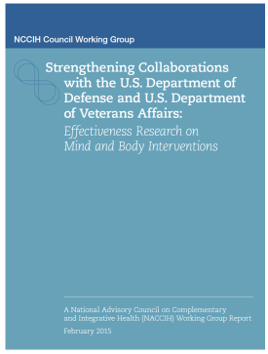

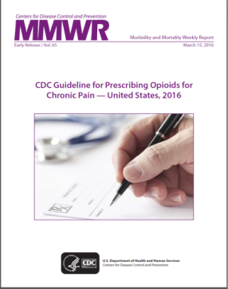









HHS: National
Pain Strategy
(2014)
Presidential Memo:
Rx Medication and
Heroin Abuse
(2015)
NCCIH: DoD and VA Effectiveness Research on Complementary Integrative Medicine Interventions(2014)
CDC Opioid
Prescribing Guidelines
(2016)
IOM: Pain Report
(2011)
Comprehensive Addiction and Recovery Act (2016)
Working Together
DoD: PMTF Report
(2010)
US Surgeon General’s Report:
Facing Addiction in America(2016)
Notes:
The Military Health System has been extremely engaged in the national dialogue regarding pain management and related opioid overuse, abuse and diversion. The 2010 DoD Pain Management Task Force predated the 2011 IOM “Pain in America Report” with both documents recognizing the need to radically change the way we assess, discuss and treat pain. In addition to developing a DoD Pain Strategy, the MHS was involved in development of the National Pain Strategy. DVCIPM , the DoD Center of excellence for pain, is spearheading efforts to address requirements and mandates from 2015 Pres Memo on Rx Medication Overuse, implementation of the CDC Opioid Prescribing Guidelines and 2016 Comprehensive Addiction and Recovery Act. Please Visit the DVCIPM website for more info on our pain initiatives, tools and opportunities for collaboration.

Slide 22

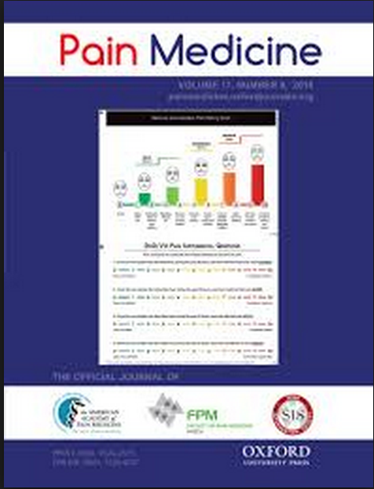
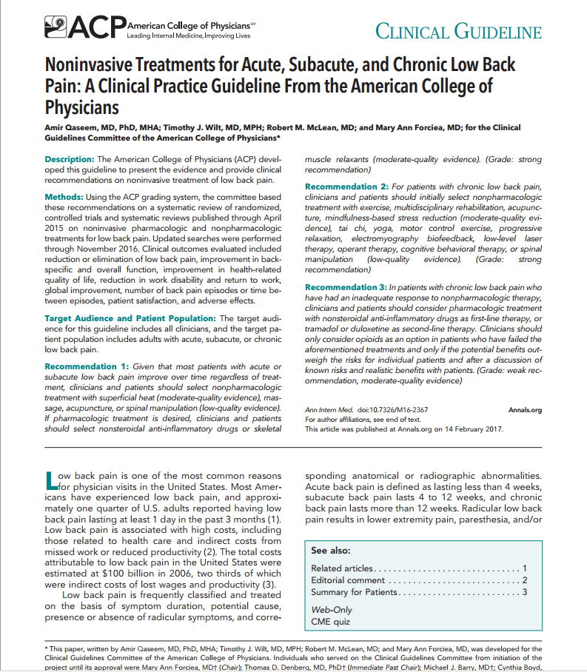
Advancing Evidence-Based Complementary & Integrative Practices and Consensus Guidelines

Slide 23
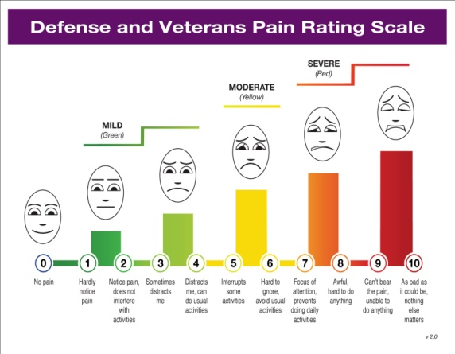
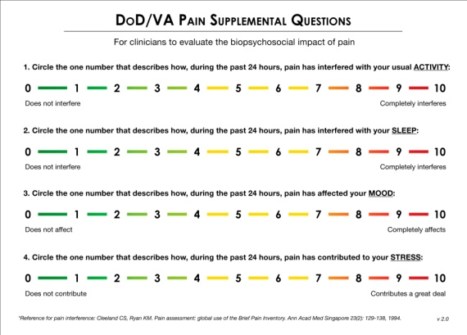
Defense and Veterans Pain Rating Scale (DVPRS): Changing the Culture of Pain Care
Validated: Measures pain intensity AND biopsychosocial and functional impact of pain (sleep/stress/mood/activity) Pain Medicine. 2012:14;110-123
Improved objective components to evaluate treatment effectiveness
  Provides greater insight on treatment progress and improvements in function and quality of life
Adaptable to multiple clinical settings and scenarios throughout the continuum of care and research
  (e.g. battlefield, transport, Primary Care, specialty services)
Since its initial validation in 2012, the DVPRS has been integrated into clinical practice in a variety of clinical settings across the MHS and in growing number of clinicians/organizations in civilian practice.
Formerly designated as the MHS pain scale for adolescents and adults per the DHA PI for Pain Management and Opioid Safety (April 2018)
Defense and Veterans Pain Rating Scale (DVPRS)
Download DVPRS at: http://www.dvcipm.org/clinical-resources/pain-rating-scale

Slide 24

RESEARCH l OUTCOMES REGISTRY l CLINICAL DECISION TOOL
Web application served from MAMC
  Clinical Assessment
    Using validated computer adaptive testing (CAT) PROMIS instruments
  Clinical Report/Decision Tool
    Longitudinal pt pain/function/alert data in concise format
  Patients Enter Information Prior to Appointments
    Using the web capable device of their choice

Slide 25
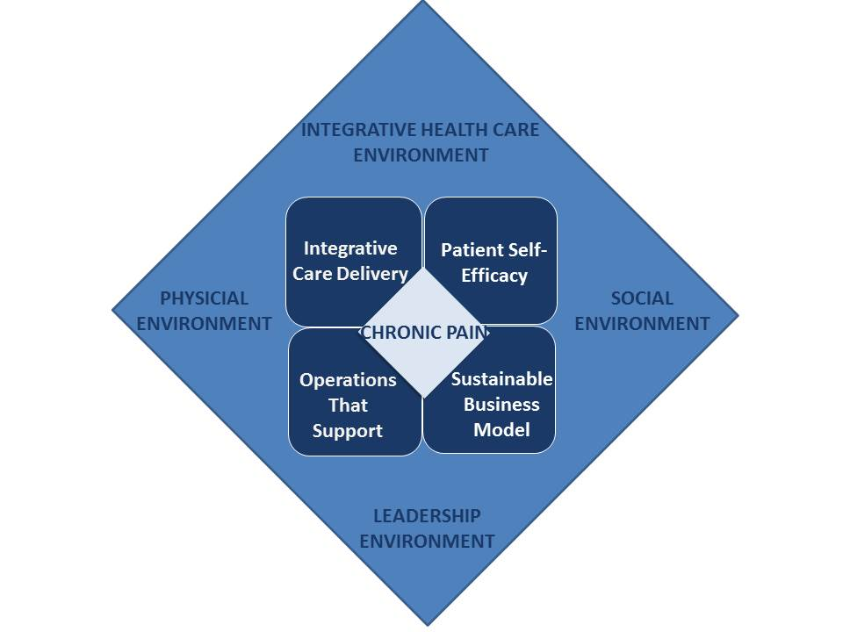
Lessons from the Samueli
Chronic Pain Breakthrough Collaborative
From “Chronic Pain Care Model”, 2013-2016; Samueli Institute Chronic Pain Breakthrough Collaborative, Alexandria, VA

Slide 26
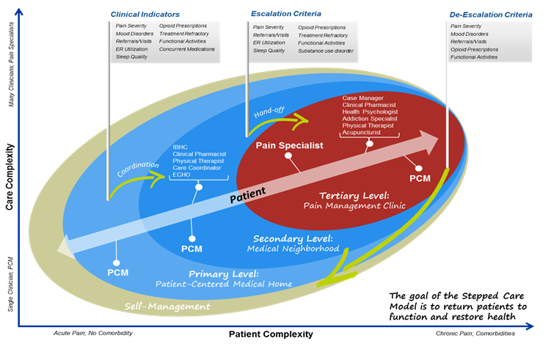
Military Health System Stepped Care Model (Based on VA Model)

Slide 27

Thank you!
Questions?
DVCIPM.org
Eric.schoomaker@usuhs.edu

Slide 28

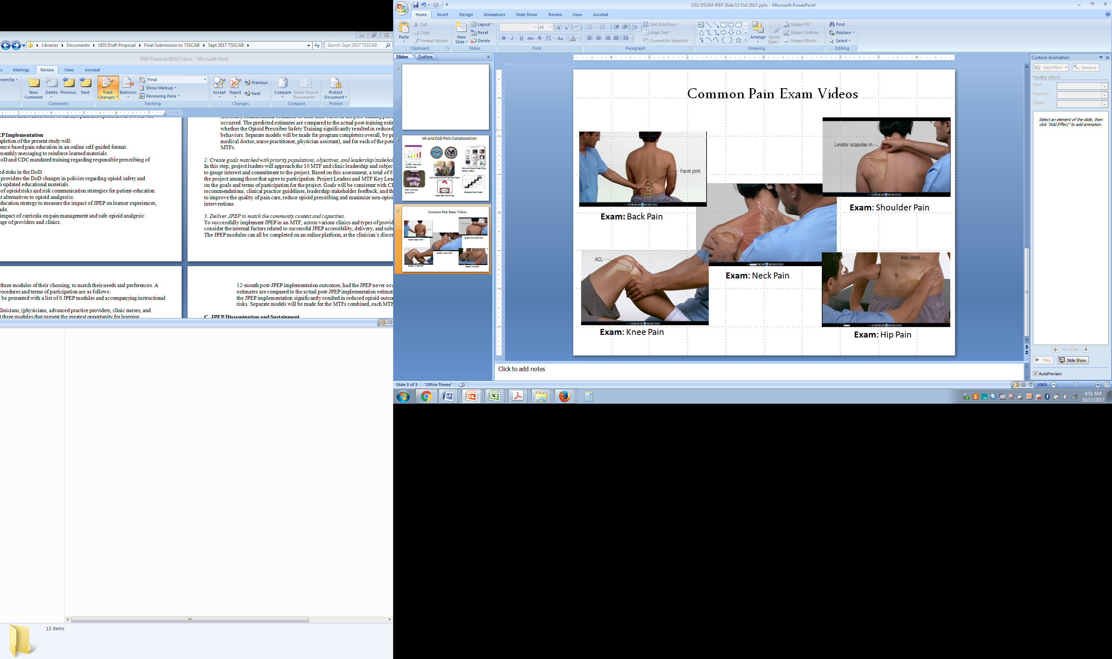

Joint Pain Education Project (JPEP)
Our teams, Our Centers, Our Departments , Our Shared Model of Quality Pain Care
Didactic Modules*
Video adjuncts
31 Modules
Each module structured to be delivered or viewed in 20-30 mins
How to Examine
Red Flags
How to Treat
When to Refer
*Version 2.0 coming soon
Understanding Pain
New Pain Paradigm
Chronification of Pain
Safe Opioid Prescribing
Initiating Collaborative
Opioid Tapering
Pain Assessment
Stepped Care Pain Model
6 Essentials of Good Pain Management
Most Common Musculoskeletal Pain Exams
(Back, Neck, Hip, Shoulder, Knee)
9.6 million Healthcare Beneficiaries
Annual budget of approx. $50 billion
Worldwide network of 59 military hospitals, and 360 health clinics,
Cares for 8.9 million Veterans each year
Annual budget of approx. $68 billion
168 VA Medical Centers
1,053 outpatient sites of care
JPEP Goals and Objectives:
  Develop a basic curriculum to promote a synchronized approach to pain management across DoD & VA
  Improve pain care transitions between DoD and VA healthcare systems
  Streamline process for integrating new and emerging pain management medical evidence and prescribing guidelines into clinical practice education and training

Slide 29
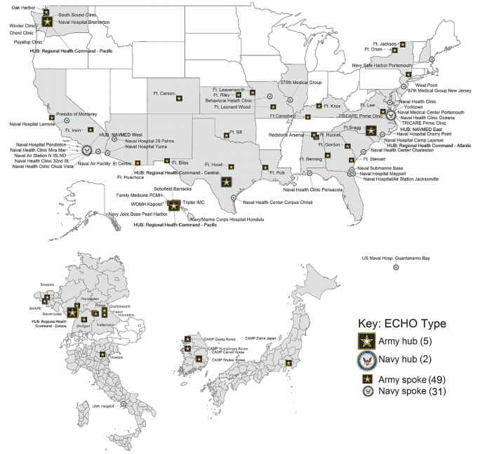
JG. Katzman, et al. (2018) Army and Navy ECHO Pain Telementoring Improves Clinician Opioid Prescribing for Military Patients: an Observational Cohort Study. J Gen Intern Med DOI: 10.1007/s11606-018-4710-5

Slide 30
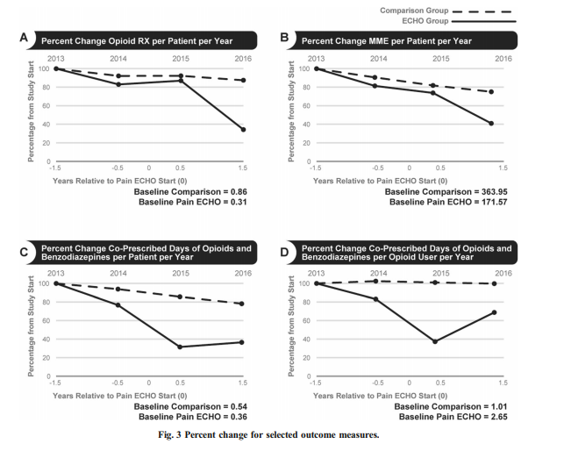
Annualized Patients
seen per year
Comparison group 1,187,945
ECHO group 52,941
JG. Katzman, et al. (2018) Army and Navy ECHO Pain Telementoring Improves Clinician Opioid Prescribing for Military Patients: an Observational Cohort Study. J Gen Intern Med DOI: 10.1007/s11606-018-4710-5

