Slide 1
Massage and Low Back Pain
Kathryn Stewart BS LMT RCST

Slide 2
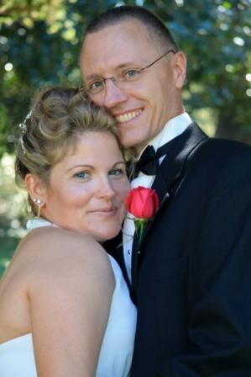
Notes:
’93 Miami U Ed degree
Grad 98 and licensed in Ohio moved to Ky no licensure at the time
Teaching in 99 and creating curriculum 2006 at LHAA
Doula 2001
Celebrating 21 yrs in practice full time
Voluntary Faculty

Slide 3
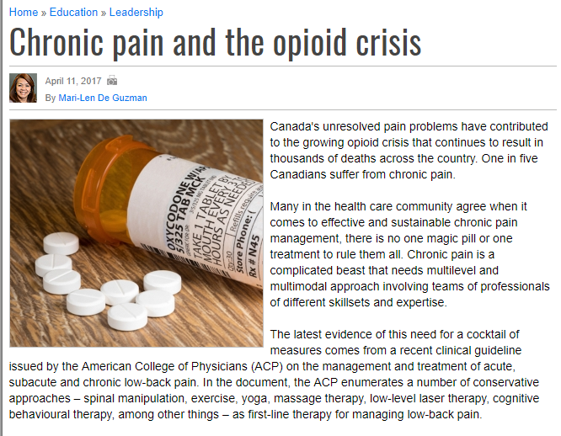
The latest evidence of this need for a cocktail of measures comes from a recent clinical guideline issued by the American College of Physicians (ACP) on the management and treatment of acute, subacute and chronic low-back pain. In the document, the ACP enumerates a number of conservative approaches – spinal manipulation, exercise, yoga, massage therapy, low-level laser therapy, cognitive behavioral therapy, among other things – as first-line therapy for managing low-back pain.

Slide 4
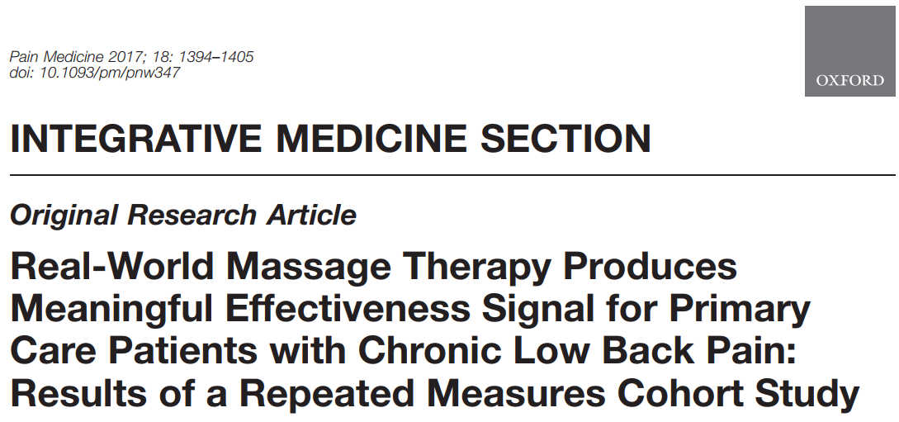
Notes:
2005 asked to participate
2007 asked to write massage protocol
2009 Funded Cherkin funded shared data collection forms
2010 docs started referring
2012 ended study
2017 published

Slide 5
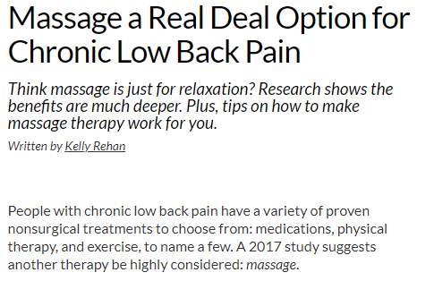
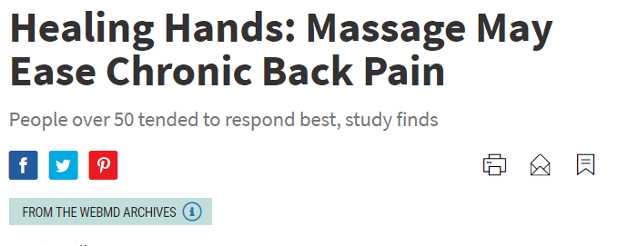
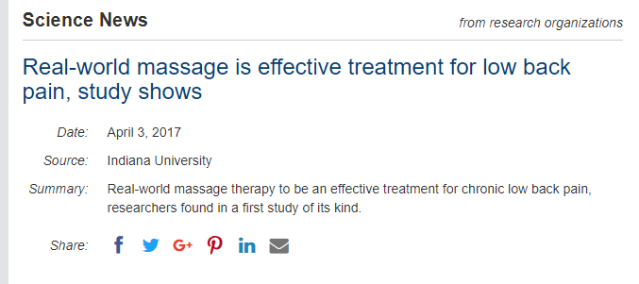

Slide 6
Massage Therapy Evidence for Pain
“Based on the evidence, massage therapy, compared to no treatment, should be strongly recommended as a pain management option.”
Crawford et al. (2016). The impact of massage therapy on function in pain populations-A systematic review and meta-analysis of RCTs: Part I. Pain Medicine, 17(7), 1353-1375.
We have very little confidence that massage is an effective treatment for LBP. Acute, sub-acute and chronic LBP had improvements in
pain outcomes with massage only in the short-term follow-up. Functional improvement was observed in participants with sub-acute
and chronic LBP when compared with inactive controls, but only for the short-term follow-up. There were only minor adverse effects
with massage.
Furlan er al. (2015). Massage for Low Back Pain (Review). http://www.thecochranelibrary.com
Back and Low-back (Furlan et al., 2008)
Cherkin et al., 2001, 2009, 2011
Walach et al., 2003
Related to cancer (Ernst, 2009)
Corbin, 2005
Hernandez-Reif & Field, 2005
Musculoskeletal issues (Tsao, 2007)
Neck (Ezzo, 2007; Sherman et al., 2012)
Shoulder (Mok & Woo, 2004)
Arthritis (Kaboli et al., 2001; Field et al., 2007, 2013)
Osteoarthritis (Perlman et al., 2006)
Carpel-tunnel & related (Moraska, 2008; Elliott, 2013)
Headache (Moraska, 2009)
Fibromyalgia (Terry, 2012, Kalichman, 2010)
Field et al., 2002
Sunshine et al., 1996
Collectively, the studies “suggest that massage can alleviate a wide range of symptoms: pain, nausea, anxiety, depression, anger, stress and fatigue. However, the methodological quality of the included studies was poor, a fact that prevents definitive conclusions.”
Ernst. (2009). Massage therapy for cancer palliation and supportive care: a systematic review of RCTs. Support Care Cancer, 17, 333-337.
“There is strong evidence that massage is effective for non-specific CLBP…in terms of improving symptoms and function. Although massage therapy may appear costly, it may save money by reducing health-care provider visits, use of pain medications, and costs of back-care serves.”
Imamura et al. (2008). Evidence-informed management of CLBP with massage. The Spine Journal, 8(1), 121-133.
Notes:
Some holes…
Lead to KYPROS

Slide 7
Chronic Low Back Pain (CLBP)
Real-World Massage Therapy for Chronic Low Back Pain
Low back pain
One of the most prevalent health conditions in the world
Leads all conditions in years lost to disability in the U.S.
Most acute cases improve rapidly; 1/3 report persistence & 15% develop CLBP
Odds for CLBP increase with:
Increased age
Lower education and/or income
Depressions, abuse, sleep disturbances, and/or comorbidities
Result in more frequent health care visits
High proportion have government-sponsored health insurance
Shmagel, Foley, Ibrahim. (2016). Epidemiology of Chronic Low Back Pain in US Adults. Data from the 2009-2010 National Health and Nutrition Examination Survey. Arthritis Care Res, 68(11); 1688-1694.

Slide 8
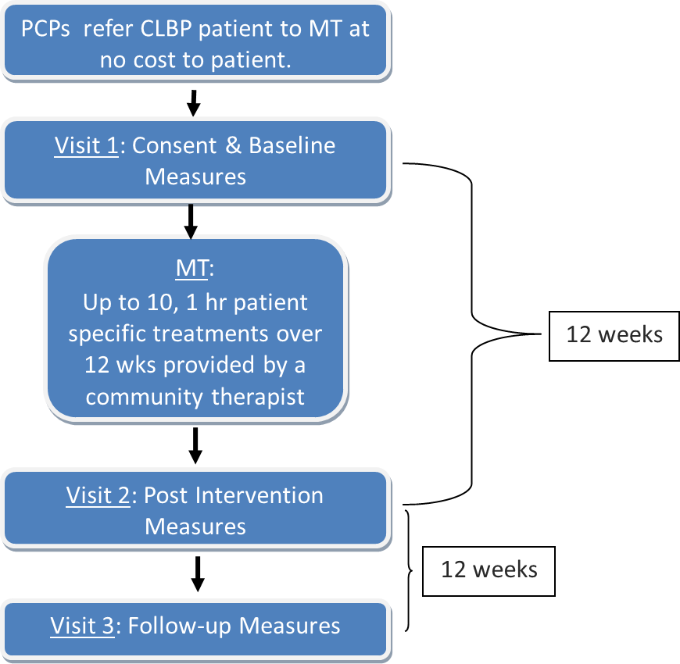
KYPROS Design & Measures
Real-World Massage Therapy for Chronic Low Back Pain
Primary Outcomes
ODI - Oswestry Disability Index
SF-36v2
Chiarotto A, Terwee CB, Kamper SJ, Boers M, Ostelo RW, Evidence on
the measurement properties of health-related quality of life instruments is largely missing in patients
with low back pain, a systematic review, Journal of Clinical Epidemiology (2018), doi: 10.1016/
j.jclinepi.2018.05.006.
Notes:
Systematic review SF 36 showed low reliability due to design for use as measure for LBP

Slide 9
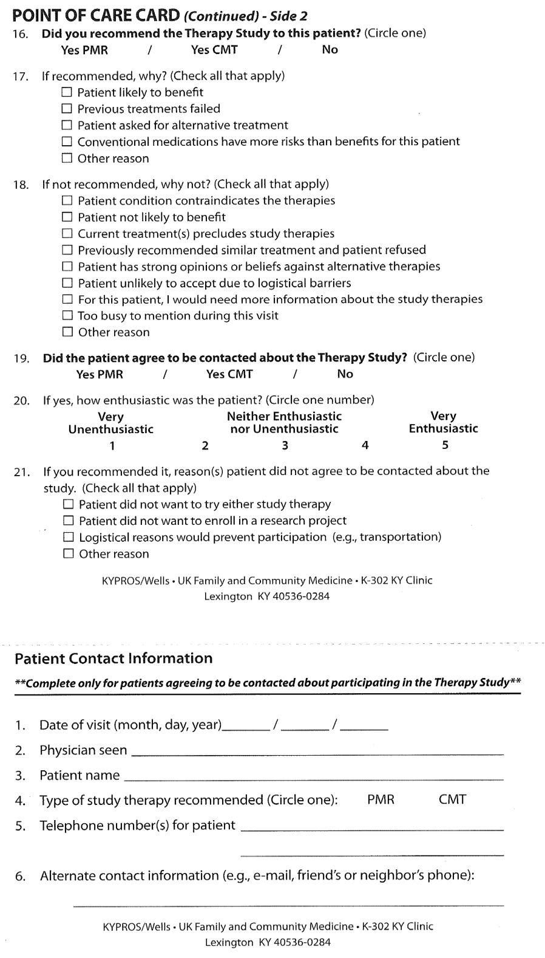
Inclusion Criteria | Exclusion Criteria
Currently have CLBP | Pregnant at referral point
Patient in referring practice for 3+months | Current/past history of psychosis
Has visit with participating PCP during study referral window (visit for any reason) | Presence of nonconsolidated fracture, deep vein thrombosis, or advanced osteoporosis
21+ years old with life expectancy of 6+ months | Course of PMR or MT in the past 6 months for any reason (spa visits or occasional massage or PMR was acceptable)
 | Presence of skin wounds or infections, eczema, active cancer tumor, or advanced kidney disease
Notes:
Show pocket card.
{click} Included the inclusion/exclusion criteria
{click} Blow up of criteria : Allowed for Real World Patients
Comorbidities
Range of treatment plans
Scheduled medications

Slide 11
KYPROS: Subjects
Real-World Massage Therapy for Chronic Low Back Pain
 | N | Attrition
Baseline | 104 | -
12-Weeks | 85 | 18%
24-Weeks | 76 | 27%
Baseline Characteristics
LFU: higher # Rx; younger
Mean Age 48.7 (±13.2)
Mean BMI 31 (±7.3)
Female 68%
Non-White 10%
Rural 25%
CLBP Duration 10.6 (±9.0) years
Outcome Variables | Baseline
Oswestry Disability Index (ODI) Mean (SD) | 38.0 (16.4)
SF-36v2 (Component Scores) Physical Health Component Score Mean (SD) Mental Health Component Score Mean (SD) | 34.5 (8.5) 44.4 (12.7)
SF-36v2 (Domain Scores) Bodily Pain Mean (SD) | 33.4 (6.4)
Notes:
Of the 104 patients referred to the MT arm of the study, 102 were assigned to study CMPs.
8 withdrew/dropped from the study before receiving their first treatment.
3 of these withdrawing patients could not be identified
5 discontinued their participation in the study due to life events (e.g., house fire, surgery, and unrelated illness).
Ninety-four patients remained in the study through at least one massage treatment .
1 report of CMT canceling for garage sale and
1 change therapist Buddah statue

Slide 12
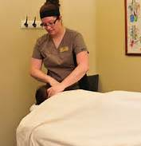
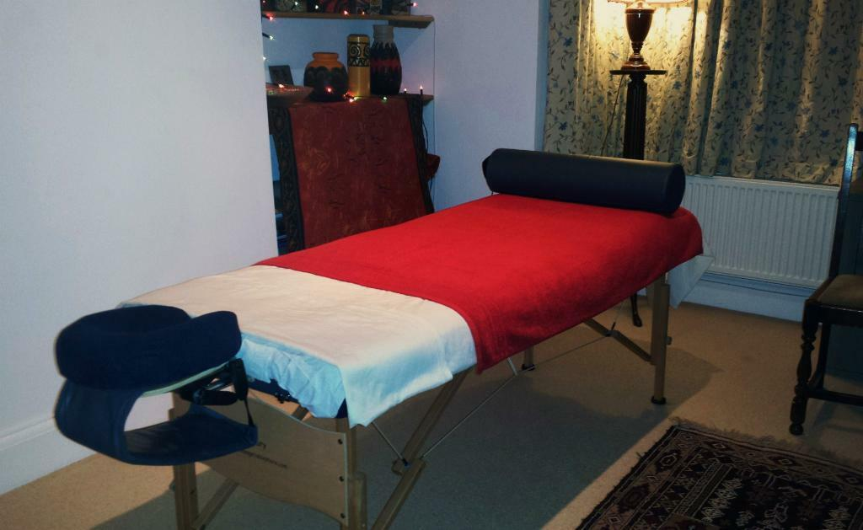
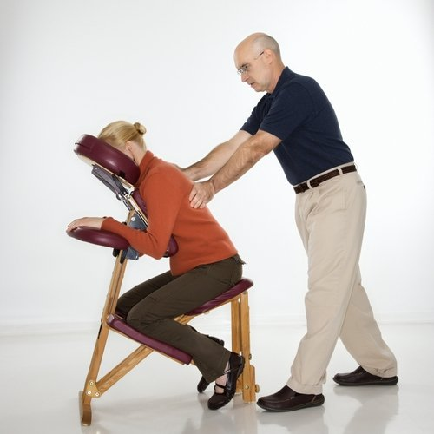
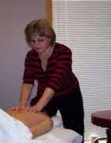
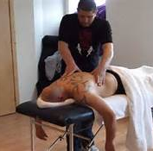
Real-World Massage
Notes:
Real-world means just what it sounds like

Slide 13
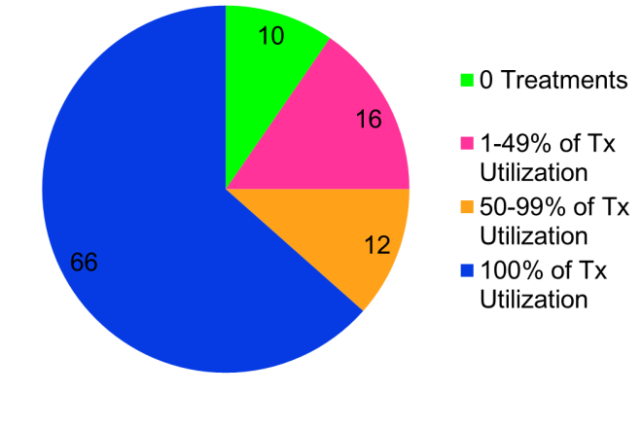
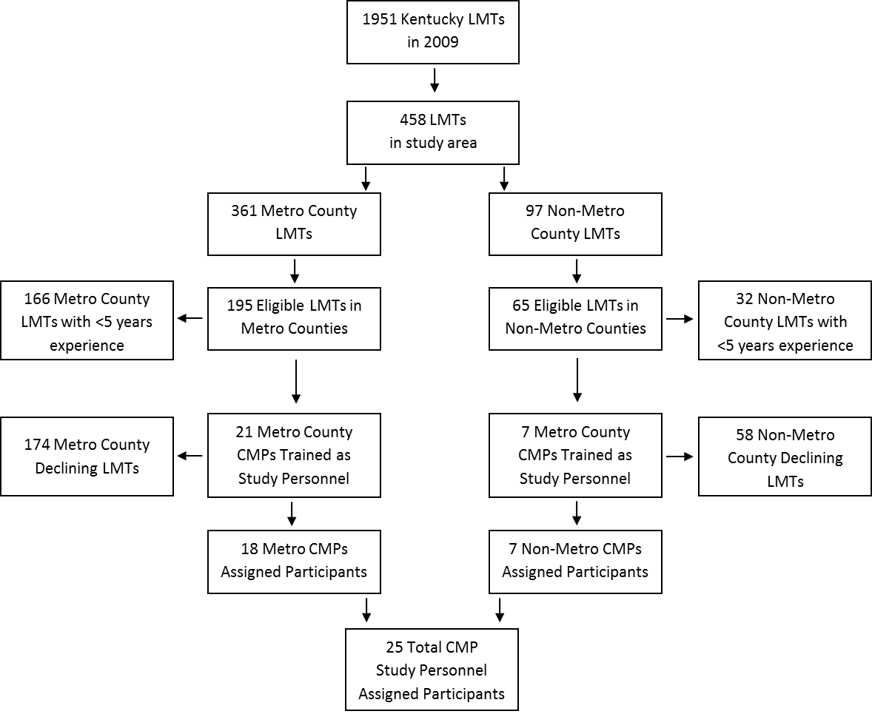
Role of Study CMP’s
Schedule and maintained all contact and treatment documentation for study subjects.
Complete and submit treatment forms for all visits.
97% Compliance
Notes:
first to rely completely on CMPs to schedule, provide, and document study interventions.
many unknowns in regards to practitioner compliance existed.
could CMPs, individuals not specifically trained in research
and practitioners from a field with few encompassing clinical practice guidelines
be relied upon to meet the requirements of a research protocol?
We trained 28 CMPs as study personnel; 25 of whom were assigned patients (Figure 2).
33% of patients who had at least one MT treatment in the study received their initial session within one week of baseline collection and 69% within two weeks.
Aspects that hindered prompt initial treatment scheduling included schedule conflicts/compatibility, life events, vacations, holiday seasons, and in a couple of instances, difficulty with patient’s returning CMP contact attempts.
Of the possible 1040 MT treatments that could have been provided to PCP referred patients (104 patients referred by PCP to up to 10 treatments each),
73% were utilized
and a majority of patients (63%) received all 10 treatments.
Study data collection forms were retrieved from CMP study personnel for 97% of the 759 completed MT treatments.
In other words, CMPs submitted completed treatment forms for 736 of the 759 provided treatments demonstrating high reliability in CMPs adherence to research protocol in this regard.

Slide 14
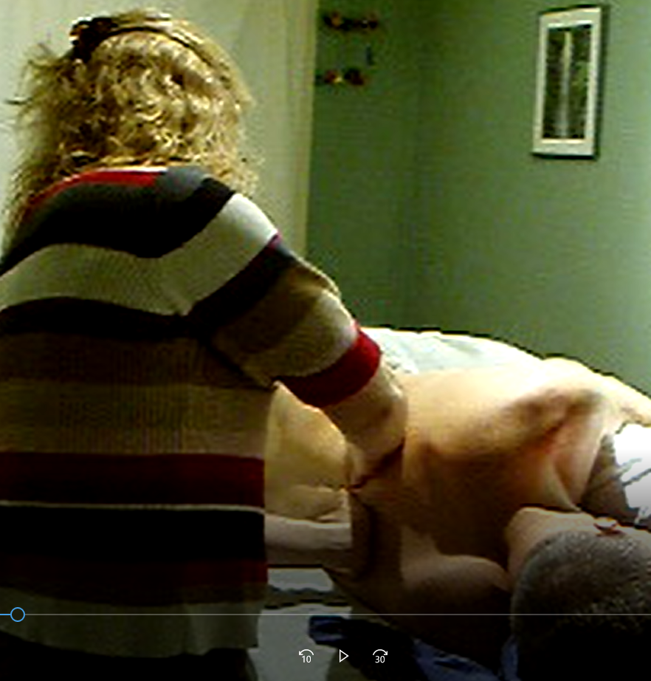
Community Massage Therapists
Kentucky licensed CMTs with 5+ years experiences invited – in Kentucky study areas
Years of experience range = 5-35+ years
No specific massage training or experience required
26 CMTs assigned participants (7 rural)
Notes:
Therapists were paid $25.00 per treatment
They also received 6 CE’s
3 ethics credits for The human subjects protection training
3 for study training session

Slide 15
Pragmatic Protocol
Dose (partial) and duration - set
Treatment lengths, dose schedules, and delivery – flexible
CMT developed individualized treatment plans
Interventions applied in therapist treatment location environment.
CMTs utilized whatever modalities within which they were trained/specialized.
Notes:
Protocol
CMTs handled all patient related contact as in clinical practice: scheduling, appointment reminders, etc.
Up to 10 sessions 12 weeks –75 min intake and at least 50 minutes of table time
Allowed time for teaching a stretch
No specific protocol set regarding techniques or time w/in treatments
Swedish as transition
First 5 sessions treated patients positioned supine or side-lying unless CMT clinical judgment deemed otherwise appropriate
6-10 prone with support under pelvis

Slide 16
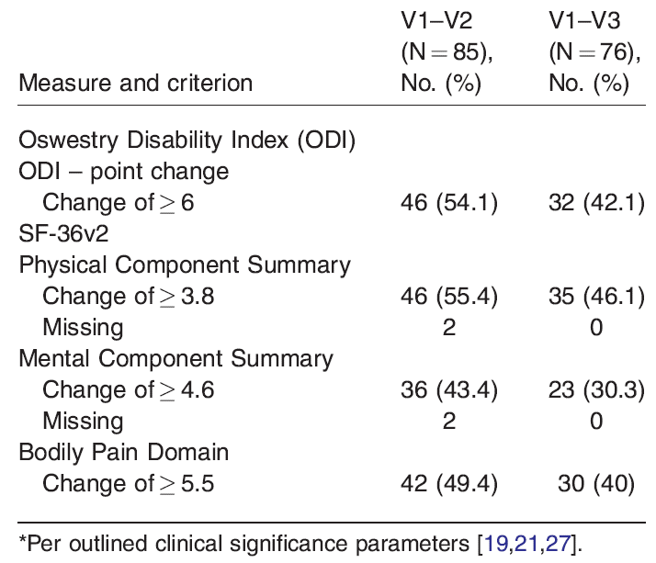
KYPROS: Results
Real-World Massage Therapy for Chronic Low Back Pain
Notes:
Like many studies improvements declined over time
Some patients are still seeing the therapists they were assigned to in the study.
12 years later

Slide 17
KYPROS: Results – Predictor Analysis
Real-World Massage Therapy for Chronic Low Back Pain

Slide 18
KYPROS: Primary Outcome Measures
Real-World Massage Therapy for Chronic Low Back Pain
At a Glance: Oswestry Disability Index (ODI)
Assesses:
pain intensity, personal care, lifting, walking, sitting, standing, sleeping, sex life, social life, travelling
ODI Score = x% disabled
↑score = ↓outcome
Low Back Pain w/ Disability: ODI=12⁺%
Minimal Clinically Important Difference (MCID): 6+
Notes:
10 item survey that when scored quantifies the percentage of disability experienced by the individual.
Effective method for measurement of disability from back pain with a wide degree of severity and causes – is a better suited measure for patients with persistent, severe disability.
It is validated, sensitive, and consistent. Best of all it takes less than 5 minutes to take and < 1 minute to score.
It essentially looks at how trouble from low back pain has affected the ability to manage in everyday life and assesses things like personal care, lifting, sitting, sleeping, and sex.
It has an established cut off for what is considered low back pain with disability, which is an ODI score of 12 or more.
And it’s minimal clinically important difference is set at a 6 pt improvement.

Slide 19
ODI: What Clinical Benefit Looks Like…
Real-World Massage for Chronic Low Back Pain
Some added perspective
Start: 40% disability
30pt change = 75% Improvement
Starting Point: ODI=40 | After Massage:
Normal but painful personal care
No sitting > 1 hour
No standing > 1 hour
< 6 hours of sleep
No sex life at all due to pain
Normal but painful social life
Limited travels due to pain

Slide 20
ODI: What Clinical Benefit Looks Like…
Real-World Massage for Chronic Low Back Pain
Some added perspective
Start: 40% disability
30pt change = 75% Improvement
Starting Point: ODI=40 | After Massage: ODI=10 ; Δ=75%
Normal but painful personal care | Normal personal care, no pain
No sitting > 1 hour
No standing > 1 hour
< 6 hours of sleep
No sex life at all due to pain
Normal but painful social life
Limited travels due to pain

Slide 21
ODI: What Clinical Benefit Looks Like…
Real-World Massage for Chronic Low Back Pain
Some added perspective
Start: 40% disability
30pt change = 75% Improvement
Starting Point: ODI=40 | After Massage: ODI=10 ; Δ=75%
Normal but painful personal care | Normal personal care, no pain
No sitting > 1 hour | Sit in any chair as long as I like
No standing > 1 hour
< 6 hours of sleep
No sex life at all due to pain
Normal but painful social life
Limited travels due to pain

Slide 22
ODI: What Clinical Benefit Looks Like…
Real-World Massage for Chronic Low Back Pain
Some added perspective
Start: 40% disability
30pt change = 75% Improvement
Starting Point: ODI=40 | After Massage: ODI=10 ; Δ=75%
Normal but painful personal care | Normal personal care, no pain
No sitting > 1 hour | Sit in any chair as long as I like
No standing > 1 hour | Standing as long as I like w/ no pain
< 6 hours of sleep
No sex life at all due to pain
Normal but painful social life
Limited travels due to pain

Slide 23
ODI: What Clinical Benefit Looks Like…
Real-World Massage for Chronic Low Back Pain
Some added perspective
Start: 40% disability
30pt change = 75% Improvement
Starting Point: ODI=40 | After Massage: ODI=10 ; Δ=75%
Normal but painful personal care | Normal personal care, no pain
No sitting > 1 hour | Sit in any chair as long as I like
No standing > 1 hour | Standing as long as I like w/ no pain
< 6 hours of sleep | Sleep never disturbed by pain
No sex life at all due to pain
Normal but painful social life
Limited travels due to pain

Slide 24
ODI: What Clinical Benefit Looks Like…
Real-World Massage for Chronic Low Back Pain
Some added perspective
Start: 40% disability
30pt change = 75% Improvement
Starting Point: ODI=40 | After Massage: ODI=10 ; Δ=75%
Normal but painful personal care | Normal personal care, no pain
No sitting > 1 hour | Sit in any chair as long as I like
No standing > 1 hour | Standing as long as I like w/ no pain
< 6 hours of sleep | Sleep never disturbed by pain
No sex life at all due to pain | Normal sex life w/ no extra pain
Normal but painful social life
Limited travels due to pain

Slide 25
ODI: What Clinical Benefit Looks Like…
Real-World Massage for Chronic Low Back Pain
Some added perspective
Start: 40% disability
30pt change = 75% Improvement
Starting Point: ODI=40 | After Massage: ODI=10 ; Δ=75%
Normal but painful personal care | Normal personal care, no pain
No sitting > 1 hour | Sit in any chair as long as I like
No standing > 1 hour | Standing as long as I like w/ no pain
< 6 hours of sleep | Sleep never disturbed by pain
No sex life at all due to pain | Normal sex life w/ no extra pain
Normal but painful social life | Normal social life w/ no pain
Limited travels due to pain

Slide 26
ODI: What Clinical Benefit Looks Like…
Real-World Massage for Chronic Low Back Pain
Some added perspective
Start: 40% disability
30pt change = 75% Improvement
Starting Point: ODI=40 | After Massage: ODI=10 ; Δ=75%
Normal but painful personal care | Normal personal care, no pain
No sitting > 1 hour | Sit in any chair as long as I like
No standing > 1 hour | Standing as long as I like w/ no pain
< 6 hours of sleep | Sleep never disturbed by pain
No sex life at all due to pain | Normal sex life w/ no extra pain
Normal but painful social life | Normal social life w/ no pain
Limited travels due to pain | Can travel anywhere w/ some pain

Slide 27
ODI: What Clinical Benefit Looks Like…
Real-World Massage for Chronic Low Back Pain
Some more added perspective
Start: 54% disability
14pt change = 26% Improvement
Starting Point ODI=54 | After MT ODI=40 ; Δ=26%
Severe pain intensity | Mild pain intensity
Only able to lift light – medium weights | Able to lifts heavy weights if conveniently placed
Only able to walk 100 yards | Can walk up to ¼ mile
Severely restricted sex life | Nearly normal but painful sex life
Travel no more than 1 hour due to pain | Can travel anywhere with some extra pain

Slide 28
Expectations of Helpfulness
Notes:
Simple linear regression indicated that
those who had clinically meaningful improvement in their ODI from baseline to V2 and V3 perceived massage to be more helpful for their CLBP than did those who did not have clinically meaningful improvement at the respective time point.

Slide 29
KYPROS: Feasibility Discussion
Notes:
PCP’s are being asked to prescribe massage but many are not sure who and how etc…. The studies show little to no injuries other than some soreness after the sessions so few negative side effects for massage
Cost of course is and issue
Finding LMT’s depending on locations of the physicians.

Slide 30
This “pragmatic” study delivers the weakest possible evidence that back pain patients benefit from massage therapy, “a meaningful signal of massage effect.” Better than nothing? Only slightly. Unfortunately, pragmatic studies like this cannot (by design) actually demonstrate efficacy, and the use of the word “meaningful” in the title and abstract is optimistic editorializing. This study can only show that back pain patients who saw massage therapists did well … but not why they did well, or even if it had anything to do with the massage specifically.

Slide 31
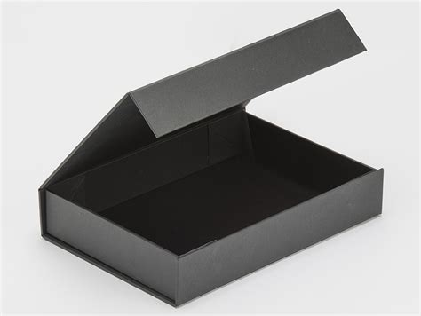
Something Happened

Slide 33
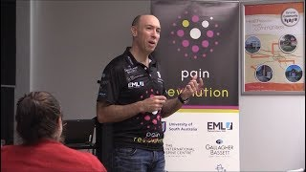
Notes:
Novel input
Whole person

