Slide 1
+

Slide 2
Evidence-based nonpharmacologic pain medicine as culture change in practice, education and policy: How do we get there from here?
Heather Tick, MD

Slide 3
Overview
Pain crisis in US
Burden of pain including economic impact
Opioid epidemic
Adverse effects and addiction liability
Continued inadequate pain care
Evidence-based nonpharmacologic options
Acute pain inpatient setting
Acute pain outpatient setting
Cancer pain
Chronic pain

Slide 4
Burden of pain including economic impact
$560-635 billion annual cost of pain care
Exceeds annual expenditures for heart disease, cancer, diabetes combined
11-47% of US population have chronic pain
Low back, neck, OA, headache most common
Leading cause of disability globally
Expected to rise with increase in diabetes, obesity and surgeries
17.8% GDP spent on healthcare; significant portion on pain
$78.5 billion annual opioid overdose, abuse, dependency
2015 private insurers and employer self-funded plans pain $16,000 more per patient w/dx opioid abuse or dependence than for any other diagnosis

Slide 5
Pain Task Force White Paper Accessed by 5000+ colleagues
www.nonpharmpaincare.org
Researchgate
Including DoD, VA, CMS, NIH, multiple professional organizations and researchers around the world
Tick H, Nielsen A, Pelletier KR, Bonakdar R, Simmons S, Glick R, Ratner E, Lemmon RL, Wayne PM, Zador V. Evidence-based Nonpharmacologic Strategies for Comprehensive Pain Care: The Consortium Pain Task Force White Paper. Explore (NY). 2018.

Slide 6
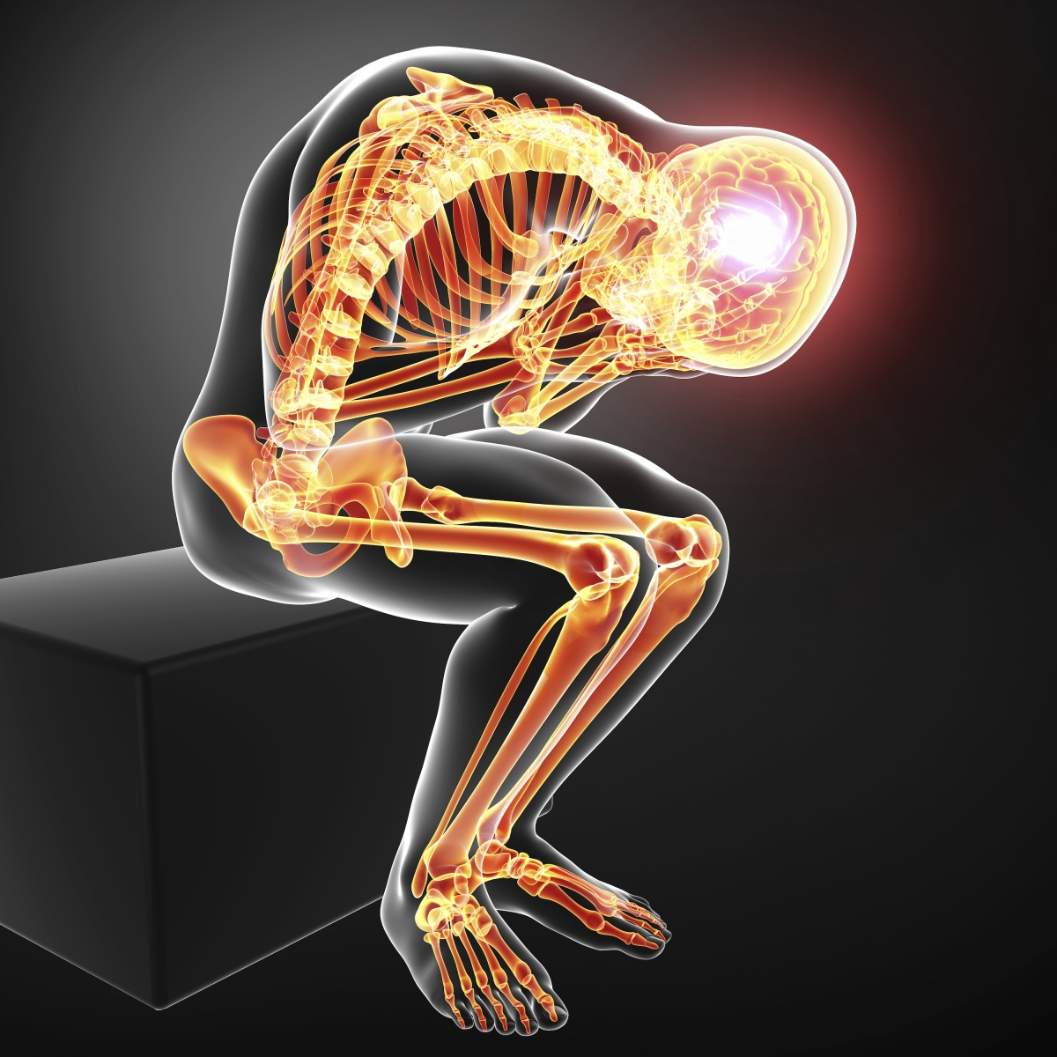
CHRONIC
ACUTE
Notes:
What is the heuristic we use- how do we solve our problems. It works for acute care acute -silver bullet model of medicine
Algorhythms- dx and treat
What is a diagnosis- concept; indiv variability - chronic

Slide 7
ACUTE PAIN
A DANGER alert system
A signal of potential life threatening injury
A brain process (no brain no pain)
A need for urgent action
Subject to modification by the CNS

Slide 8
NON-LIFE THREATENING PAIN
A brain process modifies our sense of urgency
Inhibitory central and peripheral pathways
No need for urgent
action

Slide 9
WHAT IS CHRONIC PAIN?
Possibly ongoing nociception
A change in brain processes
The failure of descending inhibitory pathways
A chronic disease
An urgent need for drugs?

Slide 10
WHAT FACILITATES CHRONIC PAIN
Peripheral and central sensitization (Mense) Ongoing nociception sensitizes (Mense)
Descending inhibitory pathways augment pain-microglia
Adaptive movement disorders-somatsensory cortex (Barbe)
Chronic stress, PTSD, adrenal activation
Adverse childhood events
Opioids
Chronic inflammation

Slide 11
WHAT IS PAIN
A sensation
A signal of injury
A chronic disease
A brain process
A need for drugs

Slide 12
CHRONIC DISEASE
Chronic diseases cause 7 in every 10 deaths each year in the United States.
About 133 million Americans—nearly 1 in 2 adults—live with at least one chronic illness.
More than 75% of health care costs are due to chronic conditions.
http://www.cdc.gov/chronicdisease/resources/publications/aag/chronic.htm (accessed 9.15.13))
Notes:
90% of my education studying to treat 5% of what we will end up seeing in the office
Ask how many hours people spent on nutrition,

Slide 13
Medicine is like a game of connect the dots
Notes:
What about those connectors-Connection is how the universe works- from the micro level to the macro-
Let me diverge a bit into physics- now don’t groan…
On a micro level…

Slide 16
Tree

Slide 17
Medicine is like a game of connect the dots
What about the connectors?
Notes:
What about those connectors-Connection is how the universe works- from the micro level to the macro-
Let me diverge a bit into physics- On a micro level…

Slide 18
Notes:
It is the connections that hold it all together animate the parts, move them, transform them
This is science driving the revolution –paradigm shift in medicine.

Slide 19
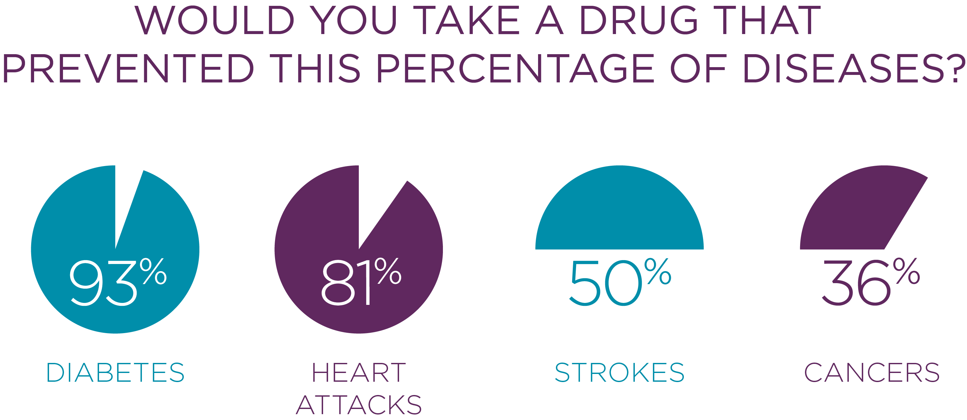
THE KEY TO HEALTH:

Slide 20
FASCIA
Body-wide force signaling system
More of a connector than a tissue demarcation
Notes:
What we know about fascia is such a tiny little bit

Slide 21
Connective tissue, stretching, inflammation & musculoskeletal pain
Helene M. Langevin, MD-
Dr. Langevin is Professor in Residence of Medicine at Harvard Medical School, Senior Scientist in the Department of Medicine Division of Preventative Medicine at the Brigham and Women’s Hospital, and Director of the Osher Center for Integrative Medicine at Harvard Medical School and Brigham and Women’s Hospital, Boston MA. She is also Visiting Professor of Neurological Sciences at the University of Vermont, Burlington VT.

Slide 22
MYOFASCIAL PAIN
Engell S, Triano JJ, Fox JR, Langevin HM, Konofagou EE. Differential displacement of soft tissue layers from manual therapy loading. Clin Biomech (Bristol, Avon). 2016 Mar; 33:66-72. PMID: 26954891.
Tesarz J, Hoheisel U, Wiedenhöfer B, Mense S. Sensory innervation of the thoracolumbar fascia in rats and humans. Neuroscience. 2011 Oct 27;194:302-8. doi: 10.1016/.

Slide 23
O.O Caudal
Rostral
Dermis
O.O Caudal
Rostral
Dermis
0.5
3000 µm
2000
1000
0
-1000
-2000
-3000µm
0.5
E_{u}
1.0
20%
10%
E_{u}
0%
1.0
-10%
-20%
Muscle
C
1.50.0
1.50.0
0.5
1.0
0.5 1.0
cm
cm
Ux>OII
Positive shear
Ill Ux<O
111 ux<O
Negative shear
Ux>OII

Slide 24
MOVEMENT AS PAIN RELIEF
Movement Disorders in Chronic Pain
Mary Barbe Temple University, (Peripheral and central changes combine to induce motor behavioral deficits in a moderate repetition task. Experimental Neurology. 2009;220(2):234–245. doi:10.1016/j.expneurol.2009.08.008.)
Vitaly Napadow, Harvard (Somatosensory cortical plasticity in carpal tunnel syndrome treated by acupuncture. Human Brain Mapping. 2006;28(3):159–171. doi:10.1002/hbm.20261.)
Shirley Sahrmann, Washington University St Louis, (The Human Movement System: Our Professional Identity, Phys Ther, March 13, 2014, doi: 10.2522/ptj.20130319

Slide 25
A CONT
B MRNF
Lateral
1 mm
-
-
NR : No Response
- -
NCR: NonCutaneous Response
-
GL.ABROUS
NAIL MOVEMENTS
HAIRY
D MRNF
Digit 1
Digit 1
Digit 2
Digit 3
Digit 4
Digit 5
-
DigU
Digil2
Digit 2
Digit 3
- D,glt3
D Digit4
Diglt4
D
DigitS
!ml Digit 5
Palm
!ill Dorsum
D Wrist
C
10mm

Slide 26
BIOCHEMICAL and HORMONAL DYSREGULATION: PAIN
Low endorphins
High inflammatory biomarkers
Sleep disruption with low melatonin
Cortisol high then low
Cortical changes
Cognitive changes

Slide 27
TREATMENT WITH OPIOIDS
Master disruptor of all hormonal and inflammatory systems
Endogenous opioid system dysregulation
Attachment
Reward
pain pathways
hormones
Ballantyne, Jane C, and Mark D Sullivan. "Discovery of Endogenous Opioid Systems: What It Has Meant for the Clinician's Understanding of Pain and Its Treatment." Pain. 158, no. 12 (2017): 2290-300.

Slide 28
The 6 Principles of Naturopathic Medicine:
First, do no harm – utilize the most natural, least invasive and least toxic therapies
The healing power of nature –trust in the body's inherent wisdom to heal itself
Identify and treat the causes
Doctor as teacher
Treat the whole person
Prevention
THERAPEUTIC
ORDER
https://aanmc.org/naturopathic-medicine/

Slide 29
INADEQUATE PAIN CARE
Even with prescribed opioids,
70% patients still complain of
moderate to severe post-op pain
Lack of evidence for safety or
effectiveness of opioids for chronic
non-cancer (CNCP) pain.
Unimodal pain care with opioids
as the cornerstone can be
considered disadvantaged care

Slide 30
Evidence confirms:
Nonpharm Options
Clinically effective
Professions regulated by States
Regulated scopes of practice
consistent standard that uses evidence-based benefits and harms for inclusion of medical/health practices

Slide 31
The Joint Commission (TJC)
Revised 2000 pain mandate
Clarified to include nonpharm Jan 1, 2015
Effective January 1, 2018
‘Hospitals provide nonpharmacologic options for patients with pain’
Scorable Element of Performance
https://www.jointcommission.org/assets/1/18/Joint_Commission_Enhances_Pain_Assessment_and_Management_Requirements_for_Accredited_Hospitals1.PDF

Slide 32
Acute pain inpatient setting
Post-operative pain
Acupuncture therapy
Massage therapy
Mind body directed therapies
Music therapy
Suggestive techniques and guided imagery
Virtual reality-assisted distraction (VR)

Slide 33
Acute pain inpatient setting Post-operative pain
Acupuncture therapy
5 systematic reviews meta-analyses
Acupuncture reduces pain and opioid consumption 20-30%
Post-knee arthroplasty: reduced and delayed opioid need
Ear acupuncture: immediate pain relief sustained at 48 hrs. equivalent to analgesics
Reduces opioid-related side effects: nausea, dizziness, sedation, pruritus and urinary retention
Reviews support use of acupuncture as adjunct for surgical pain
Acupuncture therapy is safe, low AE and accepted in adult, pediatric and pregnant patients

Slide 34
Acute pain, trauma and ED
Acupuncture therapy in ED
Systematic review with meta-analysis
Improved levels of pain and patient satisfaction in ED (2017)
Low cost and low AE
Retrospective trial acup decreased pain comparable to analgesics with additional benefit of reduced anxiety
RCT acupuncture superior to IV morphine (2016)
Pain relief
Onset of action
Fewer AE

Slide 35
Post-operative pain
Massage therapy
2 systematic reviews with meta-analyses
Massage reduces post-op pain and anxiety in surgical patients
RCTs massage for post-op pain and anxiety
Major surgeries military setting
Post-cesarean
Cardiac surgery
Thoracic surgery
Massage therapy is safe; rare serious AD and low rates of minor complaints such as muscle soreness

Slide 36
Mind body for acute inpatient
Music therapy: 3 systematic reviews with meta-analysis
Peri-op music reduced pain in pediatric surgery (2015)
Reduces pain in burn patients during tx procedures (2017)
Music decreases pain, distress and analgesic use (2016)
Suggestive techniques: one meta-analysis
Alleviate post-op pain especially in minor surgeries (2014)
Virtual reality-assisted distraction (VR)
Reduces burn-induced and burn wound care pain in adults and children (2011-2017 trials)

Slide 37
Safety mind body
Music therapy, suggestive techniques, guided imagery are safe options to improve post-operative recovery
VR risk of nausea
Safety requires ‘safe areas’, ‘spotting’ and debriefing

Slide 38
SysRevMeta: effective for malignancy and surgery-related pain (2017)
SysRevMeta: acup relieved joint pain in breast cancer tx induced menopause (2017)
Effective in radiation sxs, pain of dysphagia, peripheral neuropathy
Cancer pain: Acupuncture therapy

Slide 39
Cancer pain Massage therapy
SysRevMeta: massage for cancer patient pain, fatigue and anxiety compared to active comparators or usual care (2016)
Meta: massage effective for relief of cancer pain especially surgery-related pain (2015)
RCT massage effective for meta-static bone pain, mood status, relaxation and sleep (2011)
Beneficial for children with cancer and blood diseases (2009, 2012)

Slide 40
Cancer pain Mind body approaches
SysRev: Web-based mindfulness (ehealth) supportive for cancer patients sx burden (2009)
SysRevMeta: MBSR beneficial psych impact breast cancer patient QOL, mood, distress (2012, 2017)
SysRevMeta: Music therapy improves cancer pain, emotional distress from pain w/small, significant reduction in opioid, nonopioid meds (2016)

Slide 41
American College Physicians Guidelines (ACP)
Acute, subacute low back pain
Superficial heat
Massage therapy
Acupuncture therapy
Spinal manipulation
If pharma desired (increase AE risk)
NSAIDs
Skeletal muscle relaxants (equivocal evidence)

Slide 42
American College Physicians Guidelines (ACP)
Chronic LBP
Exercise, multidisciplinary rehab
Acupuncture therapy
MBSR
Tai chi and Yoga
Progressive relaxation, laser therapy, operant therapy
CBT
Spinal manipulation

Slide 43
Cancer pain Acupuncture therapy
American Society of Clinical Oncology Clinical Practice Guidelines found acupuncture was effective in improving pain (2016)

Slide 44
US Dept Health and Human Services Agency for Healthcare Research and Quality AHRQ
Effective for cLBP (compared to placebo, sham, no tx, usual care, wait list)
Acupuncture therapy
Massage therapy
Tai chi
As effective as active comparators
Spinal manipulation

Slide 45
NIH Recommends (2016)
cLBP: Acupuncture and yoga (massage therapy, spinal manipulation, osteopathic manipulation)
Knee OA: Acupuncture and Tai chi
Neck pain: Massage
Severe headaches and migraine: relaxation techniques
Fibromyalgia: Relaxation approaches and Tai chi

Slide 46
Comprehensive Pain Care
Multimodal approach to acute pain care
Question opioids as cornerstone of acute pain care
Frequency, dosage and timing of nonpharmacologic interventions for inpatient and acute pain care
Need for ongoing research on comprehensive pain strategies

Slide 47
Effective nonpharm modalities per White Paper
Acupuncture therapy
Massage therapy
Spinal manipulation
Mind body approaches
MBSR, meditation, relaxation
(CBT) Biofeedback
Movement therapies, (PT) Tai chi and Yoga
Alexander Technique, Pilates, Feldenkrais
Lifestyle and self-efficacy
Nutrition

Slide 48
Economics
Economic benefits of nonpharmacologic therapies in the tx of pain
Course of treatment and cost for inpatient acute care
Options for daily tx while hospitalized
Course of treatment and costs for outpatient chronic pain
SysRevMeta: benefit acup persisted at 12 months following a course of tx of 8-15 sessions over 12 weeks
Chronic pain of head, neck, shoulder, low back and knee
Most patients do not access full course of tx due to lack of insurance coverage

